Slide 1
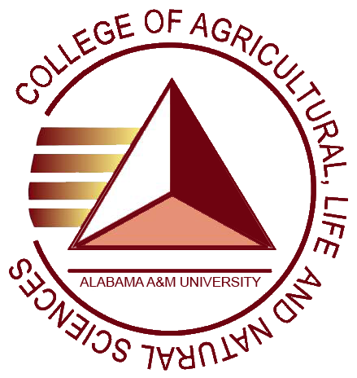
COLLEGE OF AGRICULTURAL, LIFE & NATURAL SCIENCES
Alabama A&M University
APLU: Southern AHS/CARET Joint Summer Meeting
Auburn University/Auburn, AL
Jul 27, 2018 - Jul 29, 2018
Lloyd T. Walker, PhD - Presenter

Slide 2
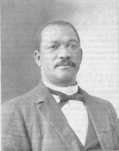
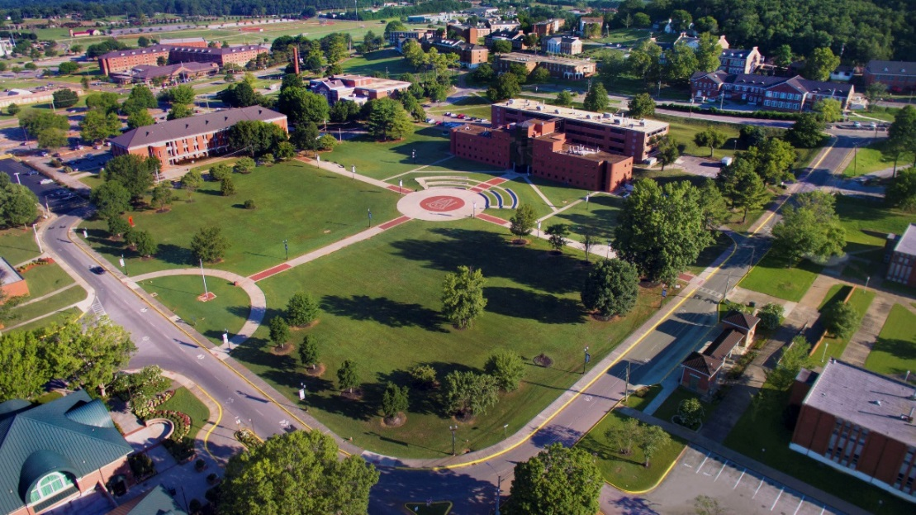
AAMU Historical Overview
Alabama Agricultural and Mechanical University
William Hooper Councill
Founder & President
1875 - 1909
Andrew Hugine, Jr.
11th President
2009 - Present

Slide 3
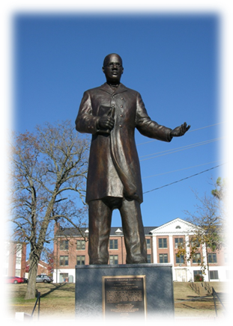
AAMU Historical Overview
First Morrill Act of 1862 provided federal funds from the sale of public land; established an endowment fund for land-grant colleges of agriculture and mechanical arts.
AAMU was founded in 1875 by a former slave, William Hooper Councill and opened as the “Huntsville Normal School” in downtown Huntsville; with its industrial curriculum, became the “State Normal and Industrial School at Huntsville.”
Second Morrill Act of 1890 required states with separate colleges for Black and White citizens (especially in the southern and border states), to designate or establish a college to train Black students in agriculture and mechanical arts; thereby, providing eligibility for those other than 1862 instructional and educational programs, to receive federal funds.
February 1891, “The State Agricultural and Mechanical College for Negroes” was deemed a land-grant institution by the federal government.

Slide 4
AAMU Historical Overview
.
In 1919, the “…College for Negroes” became “The State Agricultural and Mechanical Institute for Negroes,” a junior college.
In 1946, a “Class A” rating was received from the Southern Association of Colleges and Secondary Schools
In 1948, the name “Alabama Agricultural and Mechanical College” was granted.
In 1963, Southern Association of Colleges and Secondary Schools fully accredited the College.
In 1969, THE “Alabama Agricultural and Mechanical University” was named.
Today, the main campus of Alabama Agricultural and Mechanical University (AAMU) is situated on more than 2,300 scenic acres, a 5-minute commute from downtown Huntsville. The campus has the unique distinction of being laid out by Frederick Law Olmsted, Sr., designer of New York’s Central Park. AAMU has its own post office (Normal, Alabama); the Winfred Thomas Agricultural Research Station in Hazel Green, AL (~10 miles) and the Agribition Center located on Moores Mill Road (2.2 miles) from campus.

Slide 5
AAMU mission
Alabama Agricultural and Mechanical University is a public, comprehensive 1890 Land-Grant institution, committed to access and opportunity, and dedicated to intellectual inquiry. The application of knowledge and excellence in teaching, research and service is responsive to the needs of a diverse student population and the social and economic needs of the state and region. The University offers contemporary baccalaureate, master’s, educational specialist and doctoral level degrees to prepare students for careers in the arts, sciences, business, engineering, education, agriculture and technology. As a center of excellence, the University is dedicated to providing a student-centered educational environment for the emergence of scholars, scientists, leaders and critical thinkers, who are equipped to excel through their contributions and leadership in a 21st century national and global society.

Slide 6
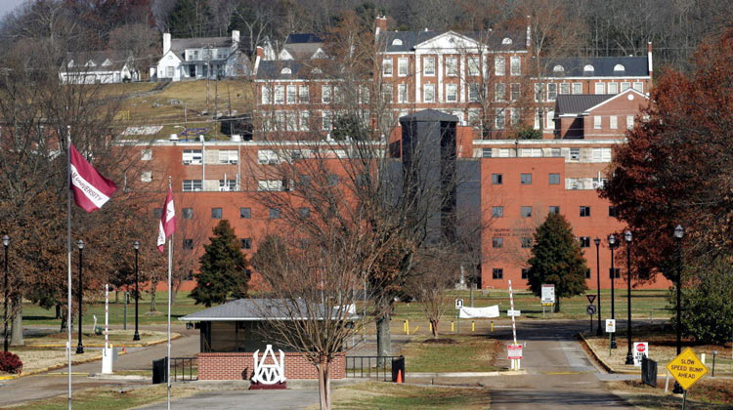
AAMU vision
The vision of Alabama Agricultural and Mechanical University is to be recognized as the premier Land-Grant institution of choice for students, faculty, staff and future employees of its students. AAMU will be recognized nationally and internationally for excellence in teaching, research, outreach, exceptional academic programs and globally competitive students.

Slide 7
AAMU Colleges
College of Agricultural, Life and Natural Sciences
College of Business and Public Affairs
College of Education, Humanities, and Behavioral Sciences
College of Engineering, Technology and Physical Sciences

Slide 8
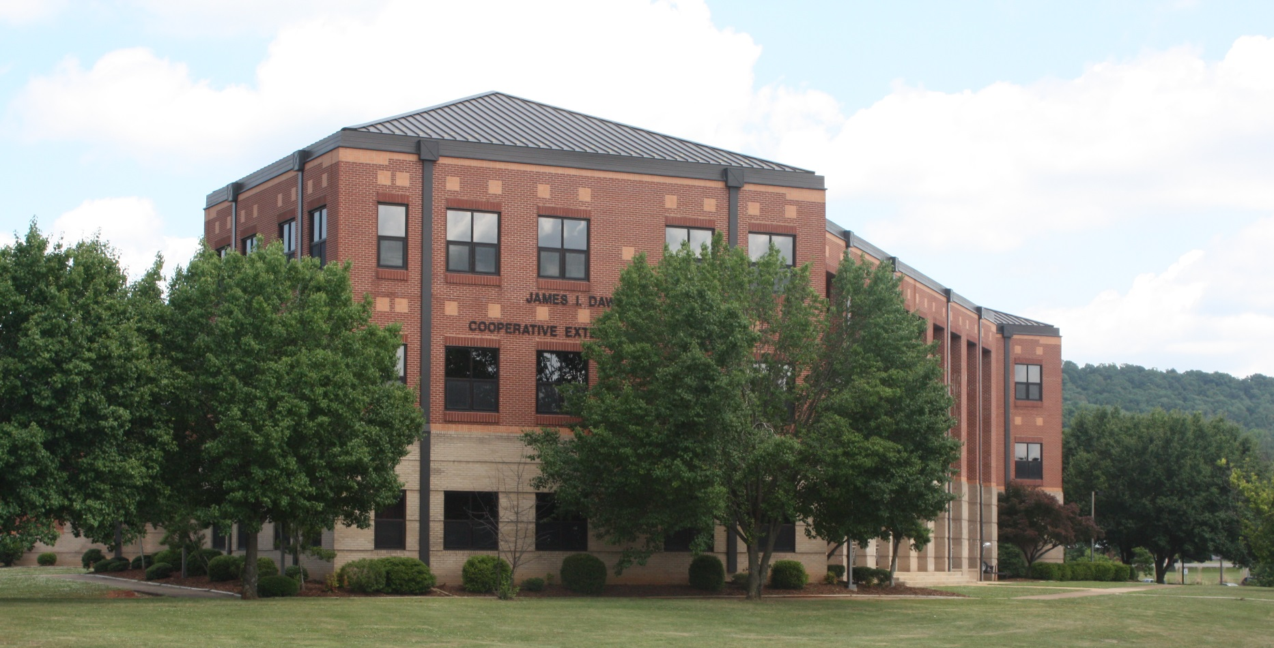
College of Agricultural, Life and Natural Sciences

Slide 9
College of agricultural, Life and natural sciences
Mission Statement
The College of Agricultural, Life and Natural Sciences (CALNS) operates in the traditional land-grant concept with instructional, research, and outreach programs. The College aims to provide a dynamic education for capable individuals, who have the determination to prepare for a career in agriculture, environmental sciences, forestry, family and consumer sciences, urban planning, and related scientific areas.
The mission is accomplished by applying scientific knowledge and basic skills of specific Instructional programs. Students prepare for rewarding careers through the following modes:
Pursuit of courses in the general education curriculum of the University that provide desirable broad educational experiences for all students;
Development of a fundamental understanding of the basic principles of the physical, biological, and social sciences, as well as the humanities as applied to agriculture, environmental sciences, family and consumer sciences, forestry, urban planning, and related areas; and,
Mastery of technical knowledge, basic skills, and their application as required for proficiency in their chosen areas of specialization.

Slide 10
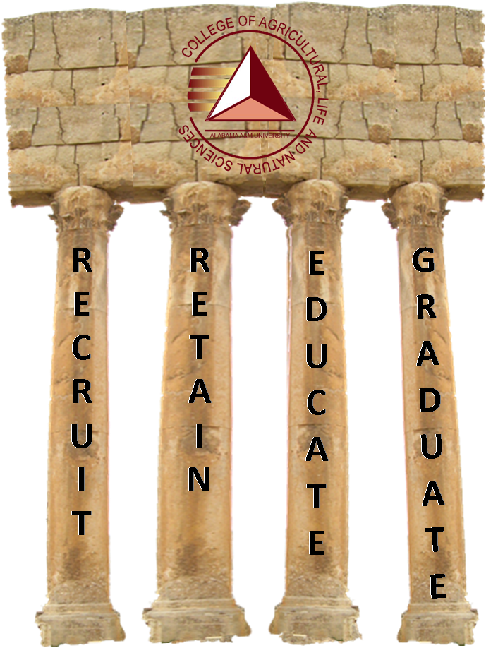
College of agricultural, Life and natural sciences
Vision Statement
The vision of the College of Agricultural, Life and Natural Sciences is to create and sustain an environment that produces accomplished professionals, to satisfy present and future workforce demands.
4 PILLARS
The 4 Pillars of the College of Agricultural, Life and Natural Sciences are the foundational tenets upon which we build our agriculture programs; resulting in the production of successful professionals.

Slide 11
Academic Programs and Majors
CALNS has four (4) academic departments and Military Science. The departments, include:
= Biological & Environmental Sciences
= Community & Regional Planning
= Family & Consumer Sciences
= Food & Animal Sciences
Other offices are:
USDA Liaison Officer
US Forest Service
USDA Soils Office

Slide 12
Academic Programs and Majors
The degrees and programs offered are:
Biological & Environmental Sciences
B.S. Biology with concentrations in Pre-Professional Health, Pre-Nursing, Environmental Health, and Secondary Education
B.S. Forestry with concentrations in Ecology, Fish and Wildlife Management, Forest Science, Forest Management, and Forestry Business
B.S. Environmental Science with concentrations in Agricultural Science, Environmental Health Science, Environmental Management, Plant Science, Soil Science, and Public & Environmental Health (minor in Remote Sensing and Geographical Information Systems)
B.S. Plant Biotechnology Science
M.S. Biology (Thesis and Non-Thesis options) with specializations in Microbiology, Physiology, Genetics & Molecular Biology, Ecology & Systemics, and Entomology
M.S. Plant and Soil Science (Thesis and Non-Thesis options) with no specializations
Ph.D. Plant and Soil Science

Slide 13
Academic Programs and Majors
Community & Regional Planning
B.S.U.P. – Bachelor of Science in Urban Planning
M.U.R.P. – Master of Urban and Regional Planning
Four (4) Areas of Specialization:
Environmental Planning
Transportation Planning
Housing and Community Development
International Planning and Development
Family & Consumer Sciences
B.S. – Family & Consumer Sciences
Three (3) Areas of Specialization:
Apparel, Merchandising & Design
Human Development & Family Studies
Nutrition & Hospitality Management
General Dietetics (accredited Program)
M.S. – Family and Consumer Sciences

Slide 14
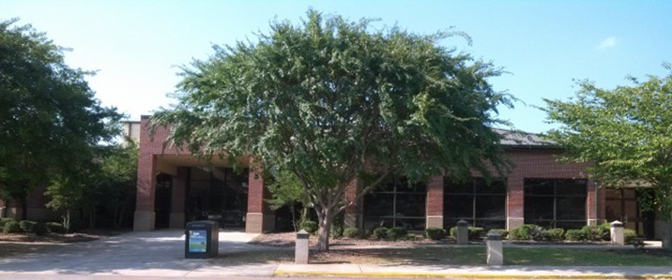
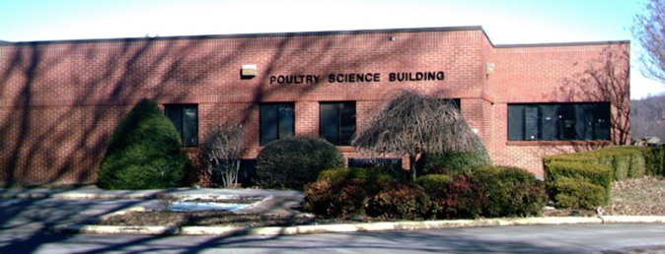
Academic Programs and Majors
Food & Animal Sciences
B.S. – Food Science & Technology
B.S. - Animal Bio-Health Science
2-yr Pre-Veterinary program through the Department of Biology
M.S. – Food Science
Ph.D. – Food Science
The Agricultural Research Center – ARC
Poultry Science Building
Thomas Wing-Carver Complex

Slide 15
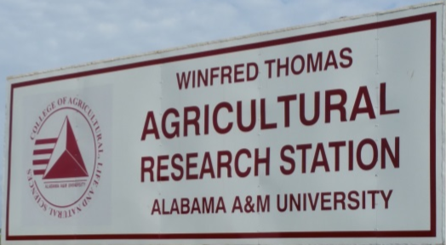
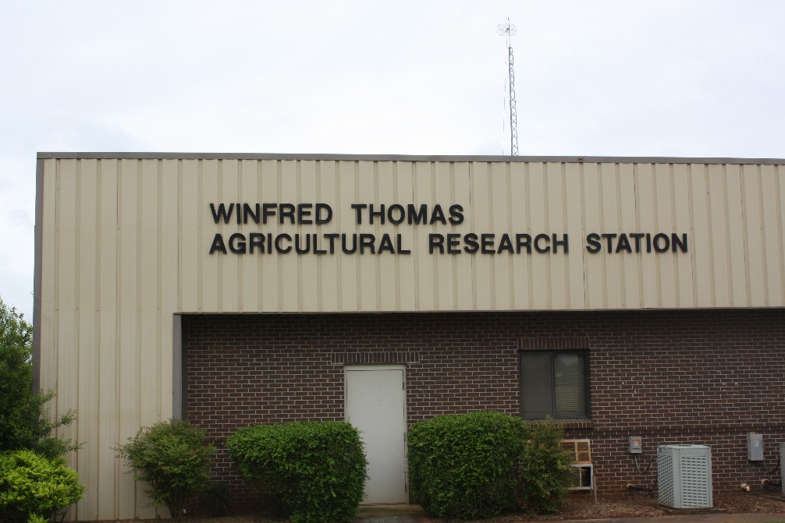
Winfred Thomas Agricultural research Station
WTARS
WTARS is overseen by the Dean/1890 Research Director of CALNS, as mandated by the 1890 land-grant mission; and is maintained through the USDA (Federal) and State funds.
WTARS provides facilities and outdoor laboratories to integrate the instructional, research, extension, and public service programs at Alabama A&M University
More than 970 acres and a 5.3-acre pond in Hazel Green, Alabama used for diverse agricultural research studies (e.g., agronomy, animal science, horticulture, forestry, soil science, silvopasture, etc.)
Outreach activities include Alabama Cooperative Extension System (ACES), the AAMU Fire Dawgs, and the Small Farms Research Center, etc.

Slide 16
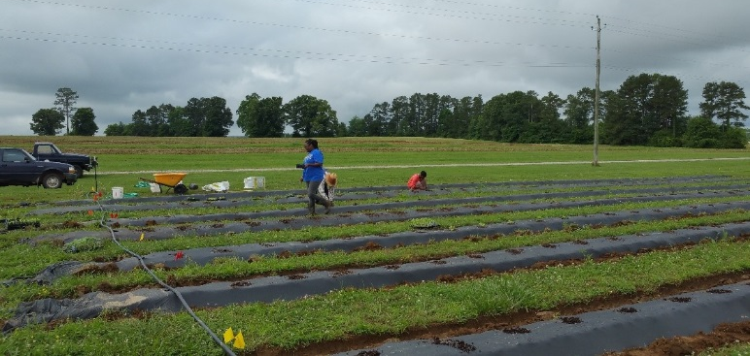
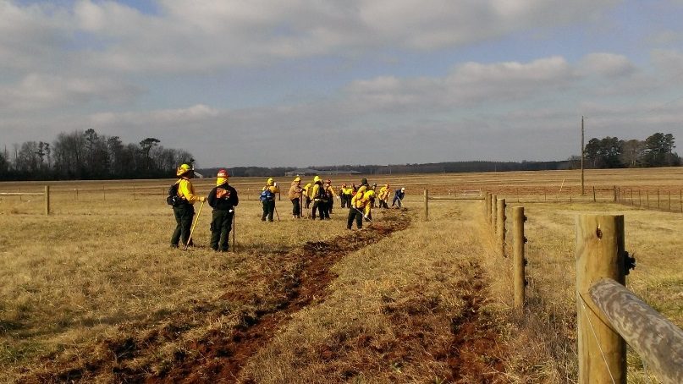
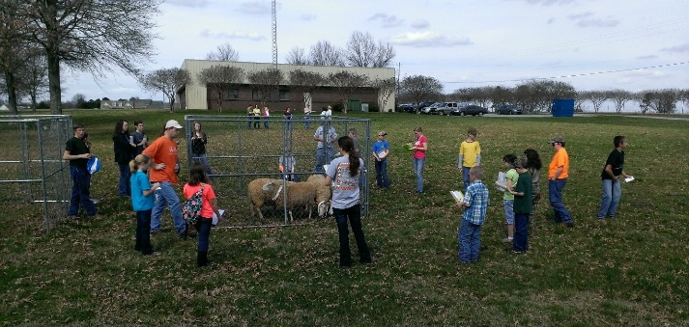
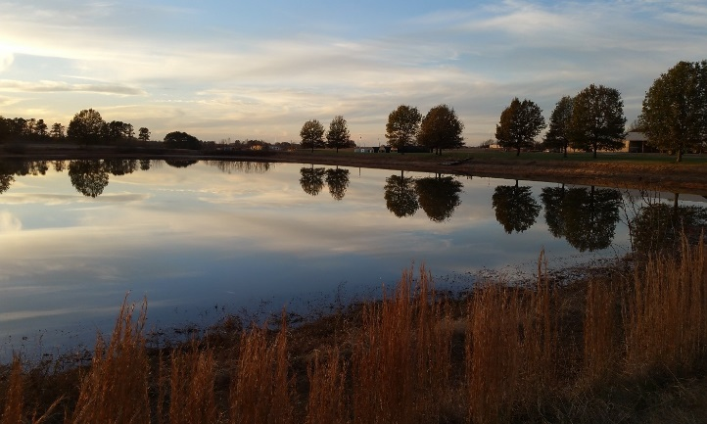
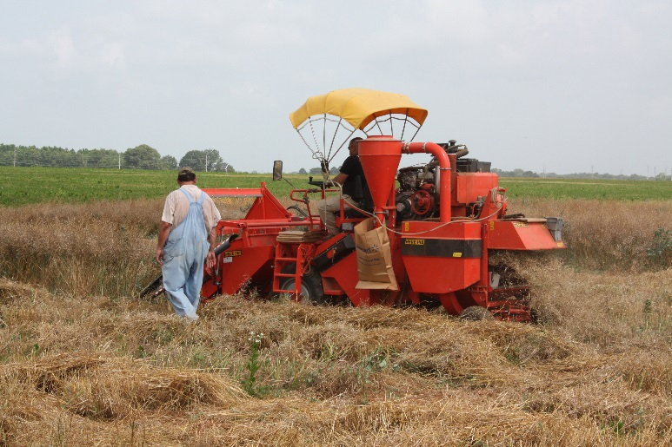
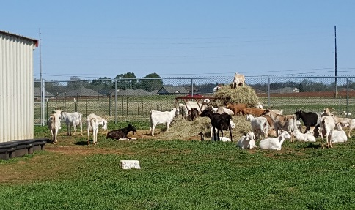
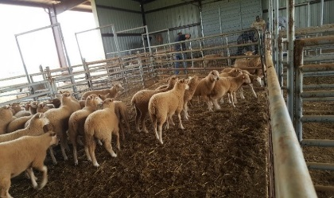
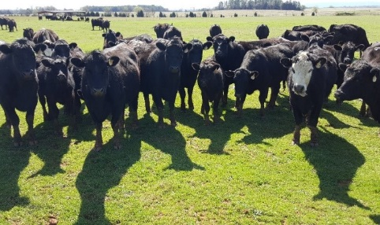
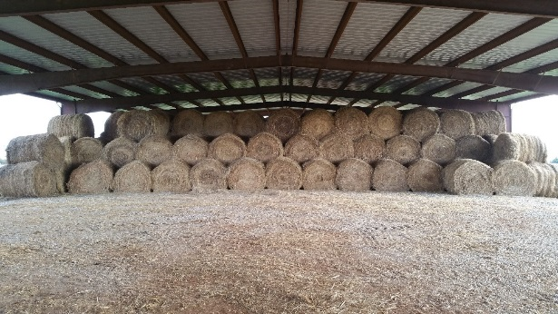
Winfred Thomas Agricultural research Station
WTARS
AAMU FireDawgs managing a prescribed burn
Planting organic vegetables
Hosted FFA teaching sheep judging
WTARS Pond
Harvesting Canola
Doctoral student entering research
data on
till/no till
corn growth
WTARS Sheep, Goats, Cows
WTARS Hay Bales

Slide 17
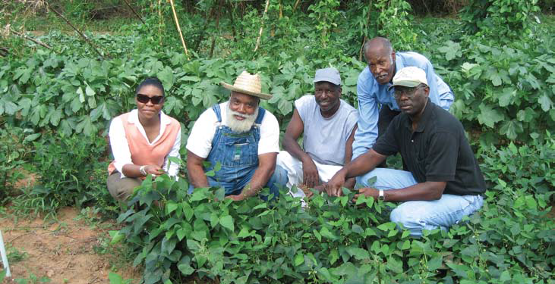
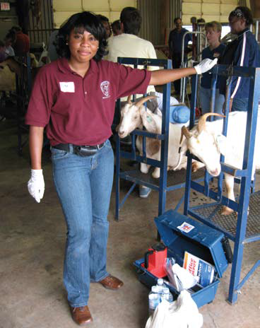
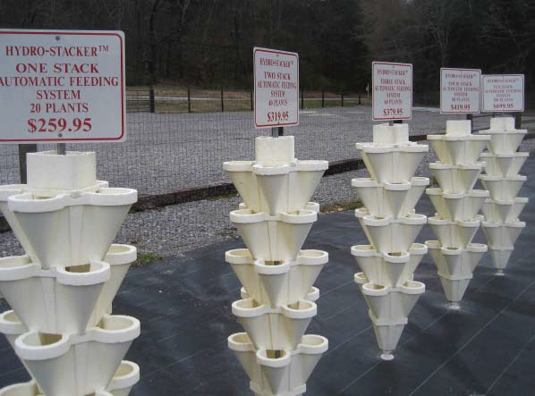
AAMU Small farms research center
Under the USDA 2501 Program (1990 Farm Bill), the Small Farms Project began in 1995 at AAMU to provide outreach and assistance to Veterans and Socially Disadvantaged Farmers and Ranchers.
The AAMU Small Farms Research Center is under the current leadership of Dr. Duncan Chembezi, Professor and Director.
He is supported by his Assistant Director, Ms. E’licia Chaverest,.
The Thomas Franklin Farm (left to right) Ms. E’licia L. Chaverest, Small Farms Research Center; Mr. Thomas Franklin; Franklin’s son-in-law; Joseph Epps,
Alabama producer in Greensboro, Alabama; and Mr. Tommie Teacher, Extension agent for Alabama Cooperative Extension System.
Ms. E’licia Chaverest participating in the Artificial Insemination
Goat Training Workshop,
in Langston, Oklahoma.
Hydro-Stackers for small strawberry farm within Huntsville, Alabama

Slide 18
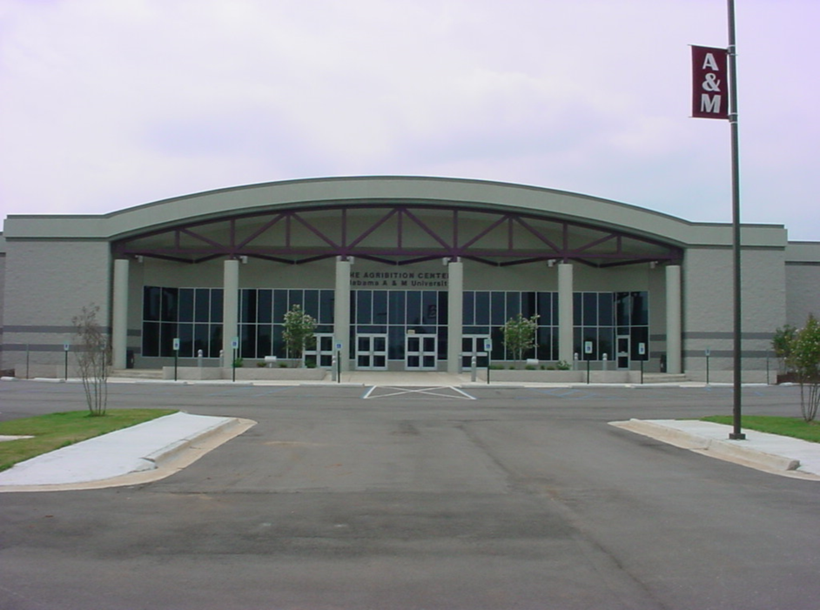
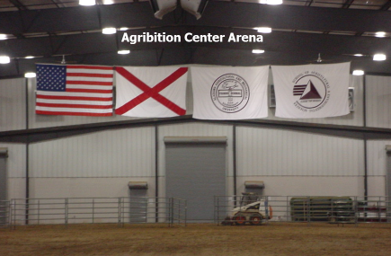
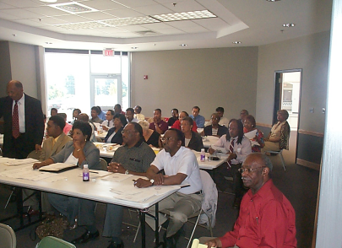
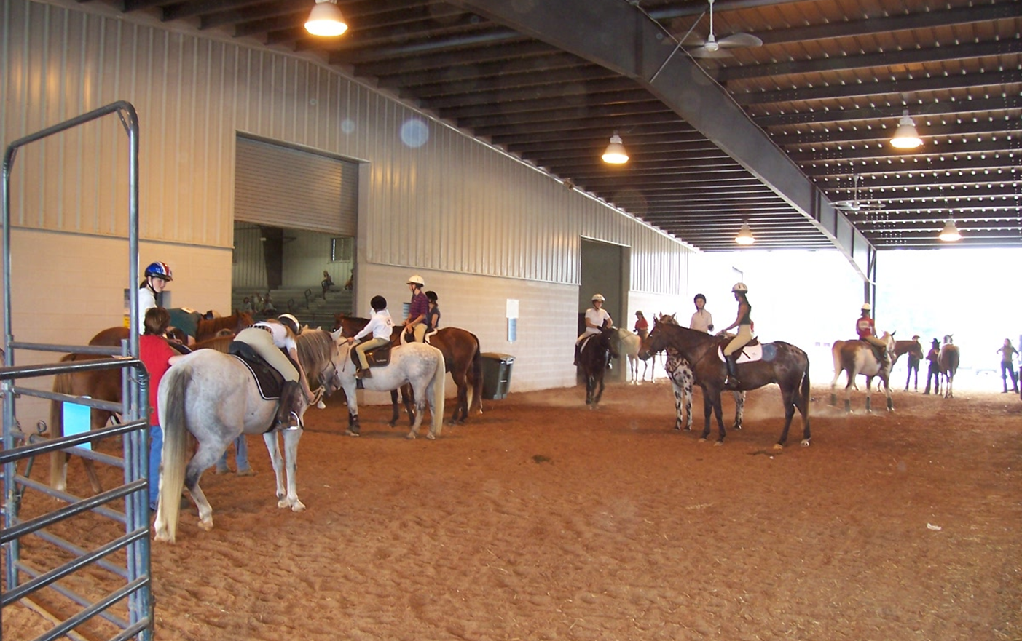
AAMU Agribition center
The AAMU Agribition Center is an integral part of the community, including but not limited to the University, North Alabama and South Central Tennessee, and the Agricultural Sector in those areas as well.
It operates as an educational, outreach, and entertainment type facility; and is available for non-traditional activities that could not be held at municipal, commercial, or private facilities.
Agribition Center Arena
Meeting Room
Back Arena
Arena

Slide 19
aalga
Alabama Agricultural Land Grant Alliance
AALGA was formulated in 2000 through an MOU among:
Alabama A&M University, Auburn University, and Tuskegee University
The MOU was signed by the Deans, Research Director and Presidents of said universities
Current Executive Director - Dr. Ron Schumack
Rotation of Chairs every 2 years – Current Chair Dr. Paul Patterson
Purpose:
A Collaboration among three (3) State Land-Grant Universities;
Carry out Joint Research Projects, and
Joint Outreach Efforts
Funding
State
Grants

Slide 20
Thank You!

