Slide 1
Addressing the Impacts of Climate Change on Agriculture and Forestry in the Southern Region
Southern Mini Land-grant Meeting
College Station, Texas
Wednesday, May 18, 2022

Slide 2
Panel Moderator
Ali Fares – Endowed Professor of Water Security and Water-Energy-Food Nexus, Prairie View A&M University

Slide 3
Status of agriculture and agriculture-related sectors
In 2015, U.S. farms contributed $136.7 billion to the economy, accounting for 0.76% of gross domestic product (GDP) and 2.6 million jobs
~1/2 of the farm revenue comes from livestock production
Other agriculture- and food-related value-added sectors
4.74% ($855 billion) of GDP and 21 million jobs (11.1% employment)
Agricultural production relies heavily on lands, water, and other natural resources
Natural resource bases are affected continually by agricultural production practices and climate change

Slide 4
Status of agriculture and agriculture-related sectors
Climate change risks depend on the rate and severity of the changes and the ability of producers to adapt to changes
Financial risks depend on food prices, local-to-global trade, and changes in production and consumption patterns
Rapid price increases for basic food commodities due to production losses are being experienced
Disrupting agricultural production in countries that are major commodity exporters affect the sector on a global scale
Food security is likely to become an even greater challenge...need to feed a projected 9.8 billion people by 2050

Slide 5
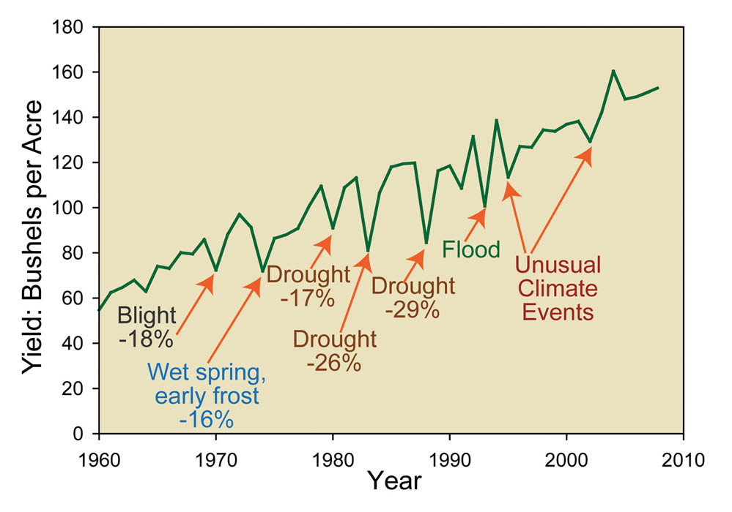
Status of agriculture and agriculture-related sectors
Any change in the climate poses a major challenge to agriculture through:
increased rates of crop failure
reduced livestock productivity
altered rates of pressure from pests, weeds, and diseases
Rural communities are particularly vulnerable to agricultural volatility related to climate

Slide 6
Status of agriculture and agriculture-related sectors
Crop and livestock production in certain regions will be adversely impacted
Direct effects - temperature increases; changes in rainfall patterns; frequent flooding; and drought
Indirect effects - increased weed, pest, and disease pressures; reduced crop and forage production and quality; and damage to infrastructure

Slide 7
Status of agriculture and agriculture-related sectors
The ability of producers to adapt to climate change through planting decisions, farming practices, and use of technology can reduce its negative impact on production
Agriculture accounted for about 9% U.S. total GHG emissions in 2015
reducing emissions in the sector could have a significant impact on total U.S. emissions
one of the few sectors with the potential for significant increases in carbon sequestration to offset GHG emissions
Direction of these effects depends on the type of agricultural practices

Slide 8
Session Description
The South will face some of the biggest challenges...challenges that will affect rural and urban communities throughout the Southern region
Diverse geographic and climatic characteristics
Varied animal and crop production systems
Vast coastal areas and working forests
Innovative strategies to discover, adopt, and communicate solutions
Panel of experts will discuss key issues to better understand the challenges we face as a region and how regional priorities affect the national agenda

Slide 9
Panel Presentations
Climate variability and change: outlook, issues, and challenges to the Southern region
Pam Knox – Senior Public Service Associate - Director UGA Weather Network and Agricultural Climatologist
Environmental equity and the impact of climate change on black-owned farms
Clarence Bunch – AgNR Program Leader, Prairie View A&M University
Strategies for crop adaptation to climate change in the Southern region
Rebecca McCulley – Chair Plant and Soil Sciences Department, University of Kentucky
Regional opportunities for addressing climate change through NIFA programs
Kevin Kephart – Deputy Director, Institute of Bioenergy, Climate, and Environment at USDA NIFA

Slide 10
Climate variability and change: outlook, issues, and challenges to the Southern region
Pam Knox – Senior Public Service Associate - Director UGA Weather Network and Agricultural Climatologist
The linkages between climate and agriculture in a world that is warming provide opportunities for innovation as well as challenges to existing production for farmers and ranchers in the southern United States.

Slide 11
Environmental equity and the impact of climate change on black-owned farms
Clarence Bunch – AgNR Program Leader, Prairie View A&M University
Effective solutions will be presented addressing how climate change disproportionately affects the technological and economic advancement of minority communities.

Slide 12
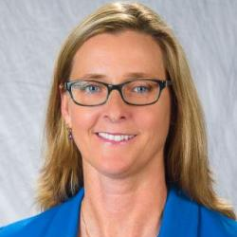
Strategies for crop adaptation to climate change in the Southern region
Rebecca McCulley – Chair Plant and Soil Sciences Department, University of Kentucky
Common strategies for climate change adaptation across commodity groups and opportunities therein will be highlighted, using an example of temperate zone pasture responses to warming and altered rainfall.

Slide 13
Regional opportunities for addressing climate change through NIFA programs
Kevin Kephart – Deputy Director, Institute of Bioenergy, Climate, and Environment at USDA NIFA
The administration’s priorities for climate have regional and national impacts that can be addressed by Southern Land-grant Universities through climate-related opportunities in AFRI and other programs.

Slide 14
Questions and Audience Engagement

Slide 15
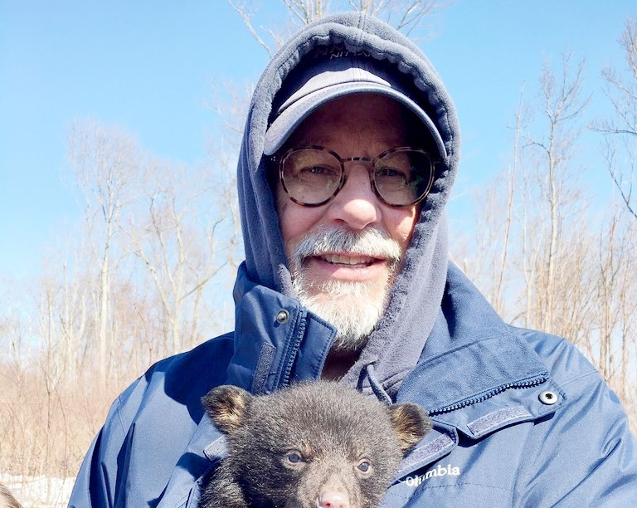
Thank you !
Gary Thompson, Executive Director of Southern Association of Agricultural Experiment Station Directors
Behind the scene effort in conceiving, planning and organizing this session

Slide 16
Thank you!

