Slide 1
MEETING NEEDS...
CHANGING LIVES
Southern Region Mini Land Grant Conference
May 18, 2022
Who is Our Audience?
Dr. Carolyn Williams
Executive Associate Director of Extension

Slide 2
Prairie View Produces Productive...
People
Our programs are intentional and designed to offer services, programs, and assistance to Texans in need. Since the pandemic, that number has increased exponentially.
Partnerships
We continue to pride ourselves on the range of partnerships we are able to forge. From rural community organizations and businesses to Fortune 500 companies and enterprises. There is room for all to assist us with serving the community.
Communities
We are invested in helping strengthen communities as a whole. A strong community gives individuals that live there hope that greater opportunities exist right where they live.
Serving the Community... the CEP Way

Slide 3
Meet the Team
Expansion Efforts
Operates in 56 Texas counties and counting (Up from 34)
Program Leaders 4
Program Specialists 15
Transition to Tech
Technology was used to deliver programs via zoom, youtube, podcasts, and even vlogs during the pandemic and going forward.
SNAP-Ed 5
County Agents 48
EFNEP 5
Building Blocks
The pandemic transitioned us to a virtual setting, but there is no substitute for experiential learning experiences.
Ext. Associates 12

Slide 4
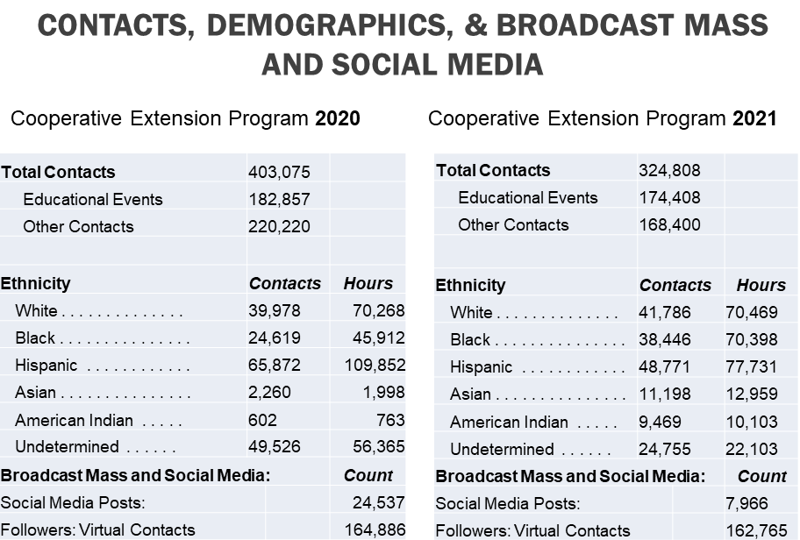
People Impacted

Slide 5
Our Audience at a Glance
2020 2021
Undetermined 14.2%
White 21.9%
Undetermined 27.1%
White 24%
American Indian 5.4%
Asian 6.4%
Asian 1.2%
Black 13.5%
Black 22%
Hispanic 28%
Hispanic 36%

Slide 6
Partnerships Forged
Rural Workforce Academy
PVAMU, Workforce Solutions, USDA
303 Trained; 145 employed or apprentice Welding, Core Construction, CNA, Electrical Technician
Sustainable Forestry and African American Land Retention (SFLR)
Partnered with 14 organizations & community groups Heir's Property Education & Legal Assistance
Assisted over 20 producers with applications for USDA Assistance Programs
Wellness in Houston
Focus on nutrition, wellness, and food deserts
30 new partnerships
Reached 17,000 youth and adults
Career Readiness Club
Cass County & Public School System
24 students assisted 8-12th grade college preparation

Slide 7
OUR PARTNERS
City of Prairie View 100 Ranchers, Inc.
Verizon
M.D. Anderson National 4-H Council Cullen Foundation Department of Labor
Texas A&M Forest Service
Houston Furniture Bank
Economic Development Administration Landowners Association of Texas Freddie Mac
Texas Small Farmers and Ranchers SOFAL
U.S.D.A.
Texas A&M AgriLife Extension Service
On-Campus Partnerships College of Business
College of Juvenile Justice and Psychology College of Nursing
College of Education College of Architecture

Slide 8
Communities Enhanced
Business in Development (BID)
78 Proposals Submitted Totaling $4,304,500
Contracts Awarded so far...
$474,950
Feral Hog Trapping Project
100 traps placed
2,100 hogs trapped
Est. Community Savings
$52 Million
Homeless Veteran Assistance Program
High School students built tiny homes for homeless veterans
LEAD- Diabetes App
500 Downloads Diabetes Education Resource

Slide 9
THANKS FROM
"THE HILL"

