Slide 1




Land-grant Universities’ Roles in
Human Health
www.suagcenter.com
Center of Excellence for Nutrition,
Health, Wellness and Quality of Life
Fatemeh Malekian, Professor, Food Science
Director: Southern University Institute for Food, Nutrition and Health
Director: Center of Excellence for Nutrition, Health, Wellness and Quality of Life (COENHWQL)
Southern University Agricultural Research and Extension Center (SUAREC), Baton Rouge LA
www.suagcenter.com

Slide 2
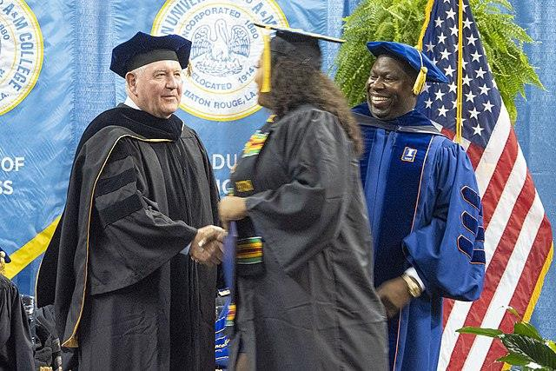
The 1890 Universities
Twenty-eight years after the passage of the Morrill Act of 1862, Congress enacted a second Morrill Act establishing Black land-grant universities.
The collective of 19 Historically Black Land-Grant 1890 universities, established between 1866 and 1912 in 18 Southern and border states, have distinguished themselves by providing exemplary programs in research and continue to be at the forefront in producing minority human capital for the food and agricultural sector.
The legislation gave states funds to establish state universities for persons of color if race was an admissions factor at the existing state university.
Commonly referred to as 1890 Universities, these institutions have a track record of “serving the
underserved” and “reaching the unreached.”
Today, these campuses are proud to remain the custodians of access to and opportunity for higher education in underserved communities.

Slide 3
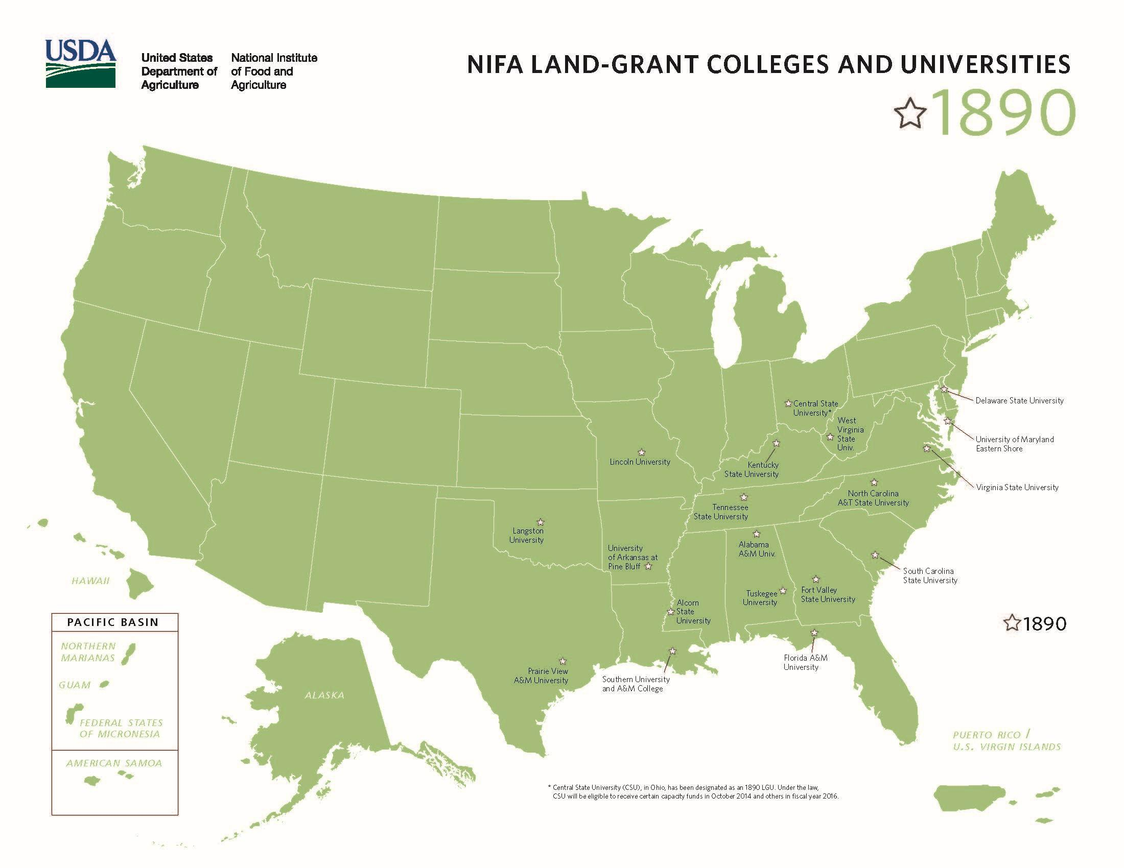

Slide 4
Health and Southern Region
Diet is etiologically linked to many health conditions, one consequence of diet- related disparities is that groups that experience these disparities also tend to have higher incidence of morbidity, and mortality rates and poorer survival for many diet-related diseases including obesity and its associated chronic diseases.
Cultural factors may also contribute to diet-related disparities in underserved minority communities.
For example, African Americans may be more comfortable with larger body sizes than other ethnicities, which may limit the extent to which healthy eating efforts are sustained.
African Americans (AAs) remain the least healthy ethnic group in the USA.

Slide 5
Cont.….
Obesity is a common, serious and costly disease (~$147 billion annually).
Obesity-related conditions include heart disease, stroke, type 2 diabetes, and certain types of
cancer that are some of the leading causes of preventable death.
Based on the most recent data from the Centers for Diseases Control and Prevention (CDC), more than 40% of U.S. adults are overweight or obese, with non-Hispanic blacks (49.6%) had the highest age-adjusted prevalence of obesity, and Louisiana, North Carolina and Alabama are among the top 10 most obese states in non-Hispanic black adults.
AA women have the highest rates of obesity or being overweight compared to other groups in the
United States, and about four out of five AA women are overweight or obese.

Slide 6
Cont.….
From 1999-2000 through 2017-2018, the prevalence of obesity increased from 30.5% to 42.4%,
and the prevalence of severe obesity (BMI above 40) increased from 4.7% to 9.2%.
Furthermore, the CDC reports that obesity and obesity-related diseases such as diabetes and heart diseases also increase the risk for more serious complications of COVID-19 among AAs and other minorities, and excess body weight significantly raises the risk of hospitalization for young COVID-19 patients.
To change these diet-related disparities, the engagement of all sectors of a community—from government, universities and policymakers, to business owners and civic groups, to parents and volunteers is required.
AA communities have trusted 1890 institutions for more than a century.
Therefore, 1890 institutions can play important roles in assisting AAs to combat diet-related disparities especially obesity and its related chronic diseases.

Slide 7


Some of the Contributing
Factors: Food Insecurity
Food Insecurity is the condition of not having access to sufficient food, or food of a satisfactory quality, to meet one's basic needs.
"a household-level economic and social condition of limited or uncertain access to sufficient food.“
Food Security: The United Nations Food and Agriculture Organization defies food security “a situation that exist when all people , at all times, have physical, social and economic access to sufficient, safe and nutritious food that meets their dietary needs and food preferences for an active and healthy life”

Slide 8
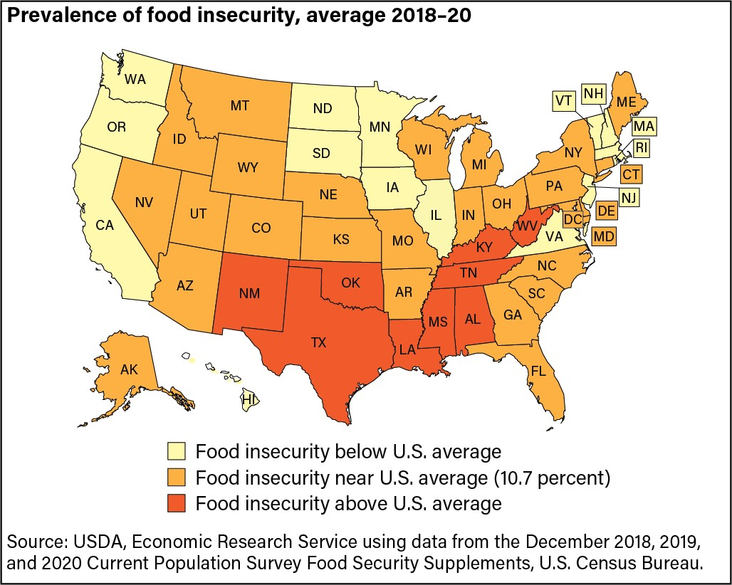
Southern Region
Six of the 10 highest state household food insecurity rates, are in the Southern Region with Mississippi at 15.9 percent, Louisiana at 15.8 percent, Arkansas at 15.1 percent, Alabama and Kentucky at 14.7 percent, and North Carolina
at 13.9 percent.
Food insecurity burden falls heavily on Black and Hispanic populations in the deep South.
Young children (under the age of
12) and elderly are hard hit

Slide 9
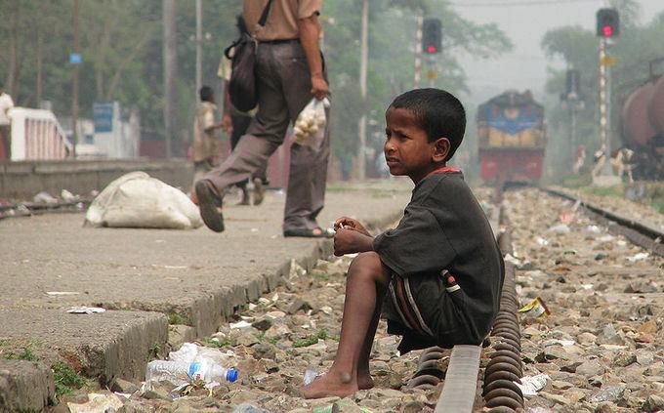
Poverty Level
The 2021 Federal Poverty Level (FPL) for a single person residing in the 48 contiguous states or Washington, D.C. is $12,880.
In Alaska, the federal poverty level for a single person is $16,090 and in Hawaii it is $14,820.

Slide 10
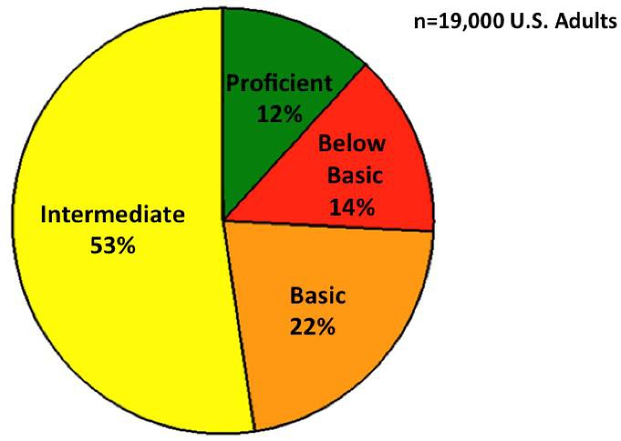
Health Literacy
“Americans often lack the capacity to obtain, process and understand basic health information and services needed to make appropriate health decisions”
Only 12% (1 out of 10) of U.S. adults are proficient in
Health Literacy
Medical racism studies have shown that black patients suffer disproportionately from neglect and early dismissal at the hand of health care providers
www.suagcenter.com
NAAL, 2003

Slide 11

Solutions
Several promising solutions to address food insecurity and health
problems have been proposed:
To strengthen and make it easier for families to connect to the existing federal food and nutrition safety net such as WIC, SNAP, etc.
To expand and to increase access to federal income support benefits such as Earned Income Tax Credit (EITC)
To increase opportunities for employment and ability for individuals to earn a living wage

Slide 12

Human Right Approach
To take a human rights approach and use its framework
  This could engage those affected and would assure that food security
monitoring would be compared to benchmarks in national action plans.
Right-to- Food approach (to respect, to protect and to fulfill)
To address persistent racial disparities in food insecurity
  Food security advocates and researchers need to also examine the potential impact of utilizing approaches that address structural racism and discrimination more broadly (see Gee and Ford, 2011 and Bailey et al., 2017).
These efforts will likely pave the way for the emergence of policy and programmatic strategies that promote equity in food access and health by addressing the legacy of racial, ethnic, and class inequality.

Slide 13
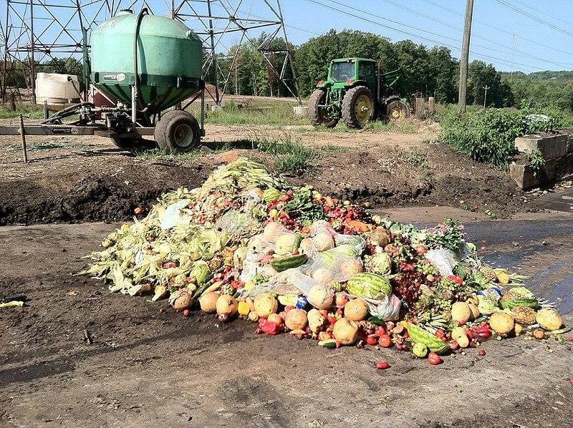
Food Waste
While farmers tap into the latest innovations in plant breeding to maximize yield, and advances in packaging help mitigate loss between pasture and plate, household waste - most notably, of produce, is at an all-time high while consumption is on the decline.
Industry experts and universities can help to put together the pieces of the produce puzzle, providing insights for a wide range of consumers to meet their nutritional needs while reducing food waste.
www.suagcenter.com

Slide 14
The Role of Land-grant Universities
4 Elements of the Grand Challenge – “How will the World Feed Itself”:
Support capacity building for communities to achieve their own food and nutrition security
University community partnerships (including the sharing of resources)
Align university resources and structures for conducting research strategy that crosses many disciplinary boundaries to create a holistic approach
Educate a new generation of students to be transdisciplinary
problem solvers
A Deeper Challenge of Change Report
www.suagcenter.com
Shorlette Ammons
Committee on Racial Equity (CORE)

Slide 15
Center of Excellence
Louisiana, North Carolina, and Alabama are among the top 10 most obese states in non-Hispanic black adults. Obesity is a common, serious and costly disease (approximately $147 billion annually)
Southern University and A&M College, North Carolina A&T State University, Tuskegee University and 1890 Universities Foundation have complementary strengths in research, teaching and Extension and are in a unique position to partner and collaborate through the establishment of a COE that will improve the health and well-being of underserved and minority populations.
The Centers of Excellence (COE), is a signature program of the 1890 Universities Foundation (total of 6).
Each COE is located at an anchor 1890 University and co-managed by a team of 1890s who participate as a COE cohort.

Slide 16
Mission
The 1890 Center of Excellence for Nutrition, Health, Wellness and Quality of Life (NHWQL) seeks to support the triple land-grant’s mission of research, teaching and extension to contribute solutions to improve the health and well-being of underserved and minority populations.

Slide 17
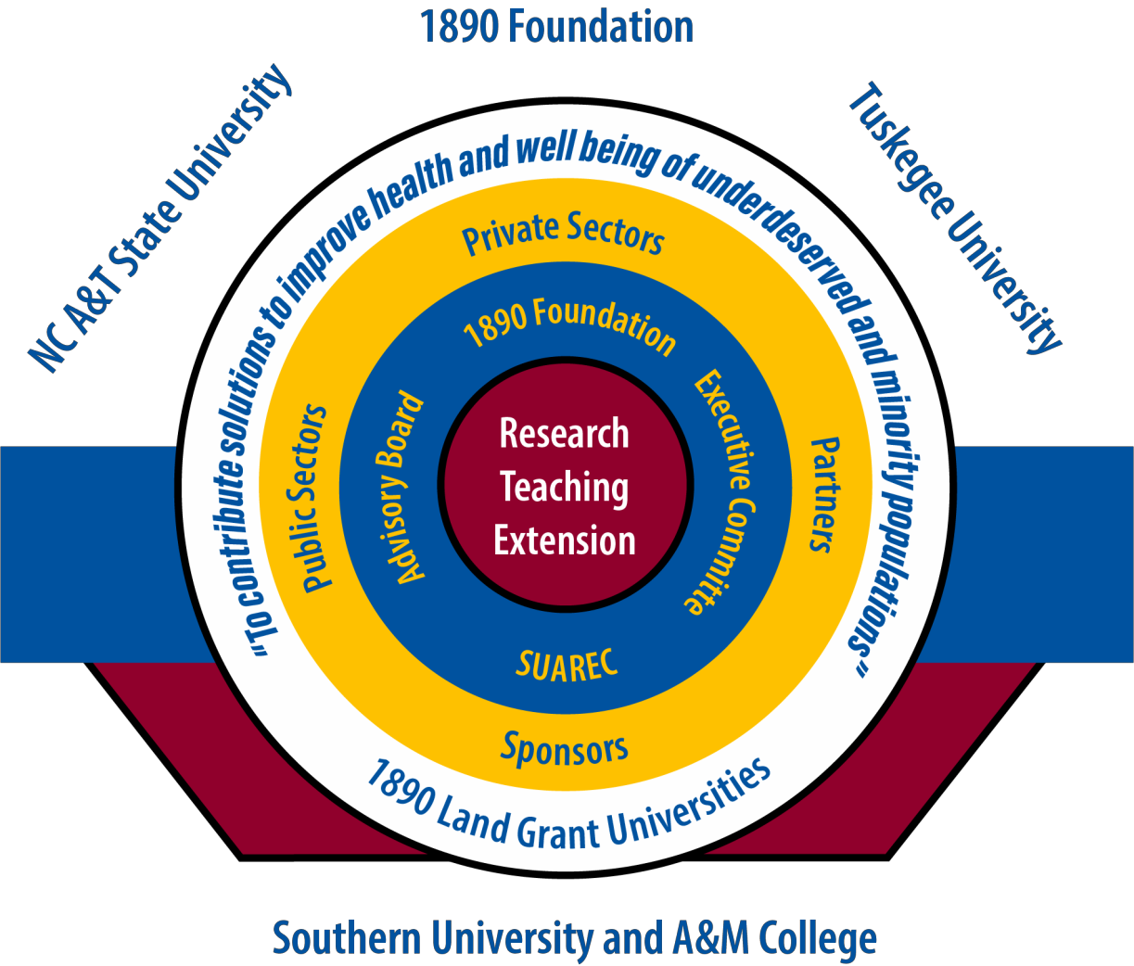
COE Team

Slide 18

COE Logo

Slide 19

Monthly Meetings
The PD, Co-PDs, and other key investigators from all three universities as well as the leaders from the 1890 universities foundation have regular monthly zoom meeting
The third Wednesday at 2:30 – 4:00 Central time
Discuss our progresses from each partners, identify potential hurdles, brainstorm solutions for identified hurdles, and describe plans for next month.

Slide 20

Center Of Excellence for NHWQL Website
By working with the Southern University’s Communication team, a center webpage (NHWQL Center ) has been developed or www.suagcenter.com
Includes background introductions of all the key investigators from each of the four partners, the EAB members, the links of each of the partners, the center logo, and all the center activities and news.
  For example, the webpage holds the flyers, survey link and contact
information for participants interested in the human gut microbiome study.
  An audio message that describes the Microbiome Study for participants.
  A mean of communications with the Sister’s Together participants.
  Videos, questionnaires, fact sheets, RFA for pilot studies and educational handouts intended for the use of participants.

Slide 21

External Advisory Board (EAB)
Very diverse background
The first EAB meeting was on October 11, 2021, via Zoom.
Meet every quarter
Consist of 7 members
Representatives are from:
  Medical societies
  Faculty /Scientist from medical and biomedical institutions
  Community members
  Private companies /food industry
  Government agencies
  Faith based organizations

Slide 22
Goals
Research: To enhance the research capacity at 1890 institutions focusing on food intake and nutritional/health outcomes.
Teaching: To strengthen and advance innovative food and nutrition educational and instructional strategies for students at 1890 institutions.
Extension: To provide training and education to underrepresented communities through multi-state food and innovative nutrition outreach programs.

Slide 23
Research
Objective: To conduct innovative research in the areas of food,
nutrition, health and wellbeing
Expected Products and Results:
  1) Establish targeted metabolomic methods to analyze the important
microbial metabolites.
  2) Develop the platform for untargeted metabolomic analysis of fecal
metabolites.
  3) Identify the microbial metabolites that can discriminate lean individuals from obese individuals.
  4) Determine the association between food intake and gut microbiota profiles in the three geographic regions.
  5) Build a metabolomics core facility at NCA&T to study diet-related health disparities and expand to other universities.

Slide 24

Flyer
As a part of research project SUAREC, NCA&T and TU have been recruiting participants.
32 AA participants from each university’s
surrounding areas
16 females 8 with BMI 20-25 and 8 with BMI 30-40 and 16 males the same as females ages 18-60
Participants have been collecting 5 days of food diaries and a stool sample at the last day (Day 5 or 6)
They bring the stool samples and diaries
to SUAREC
The samples have been shipped over night to NC A&T State University Laboratory for analysis

Slide 25
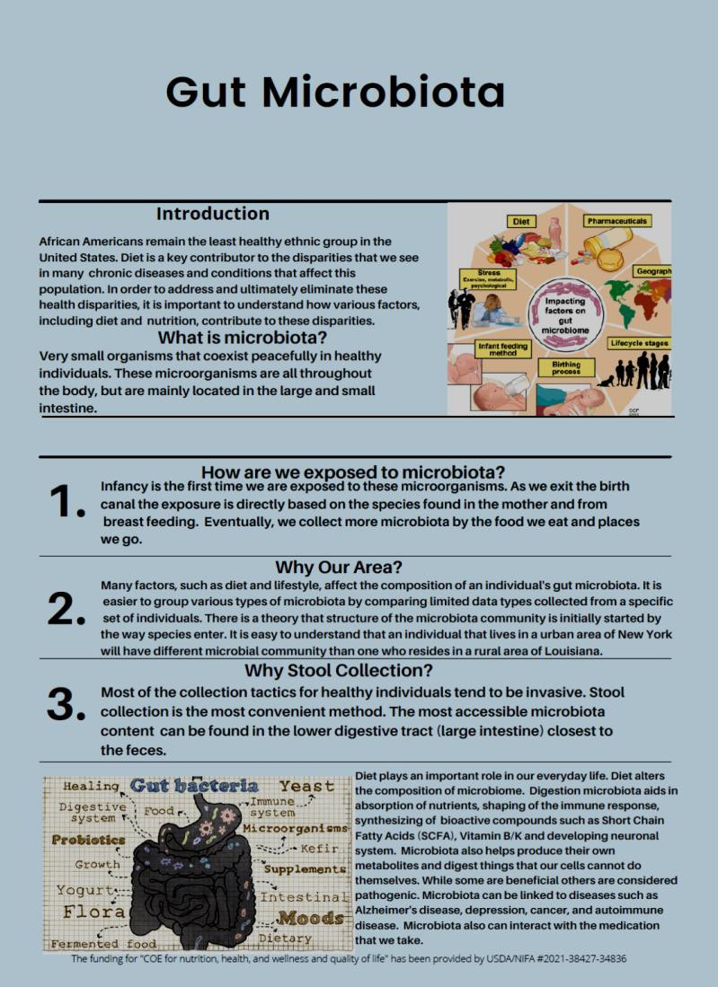
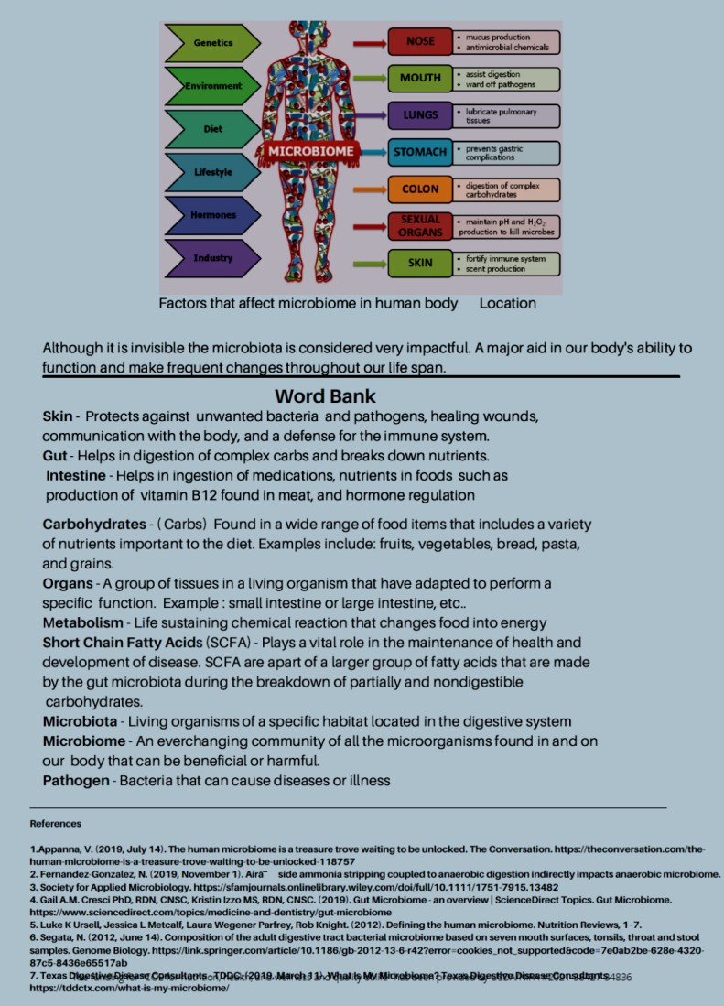
Fact Sheet

Slide 26
Teaching
Objective: To expose students to the best educational and leadership opportunities within the field of nutrition, health, wellness and quality of life.
Expected Products and Results:
  1) Recruit and train nine 1890 Scholars (three scholars/university).
    Undergraduates will collaborate and participate in innovative research and
Extension projects that have a direct impact on diet-related disparities.
  2) Provide a virtual symposium series on diet-related health disparities to the 1890 community.
    Open to students and faculty at all 1890s.
    Highlight faculty, extension specialist, students and community experts
conducting work in diet-related disparities.

Slide 27
Teaching
Seminar Series
  Five presentations by distinguished presenters in the areas of food
disparities, health disparities, obesity and related diseases in AA women
The titles and topics was finalized at the beginning of the year.
The first presentation was on October 6 at 5:30 pm via zoom with speaker Dr. Ronald Andrews.
The presentation was a great success, and several positive feedbacks were received from the participants.
The video has been placed on the COE web page.
Participants from the Advisory Board have suggested speakers for the remainder of the Series.
Student Scholars
  9 students, 3 from each university have been recruited to this program
    They have been involved with all three aspect of Land Grant Universities
    Scholar recruitment and training have been successful.
    Students have been participating in all 5 symposium, research and extension activities.
    Students have been as much as possible involved in the preparation of the symposia, introducing the speakers, asking question etc.
    They really feel that they are a very important part of the program.

Slide 28
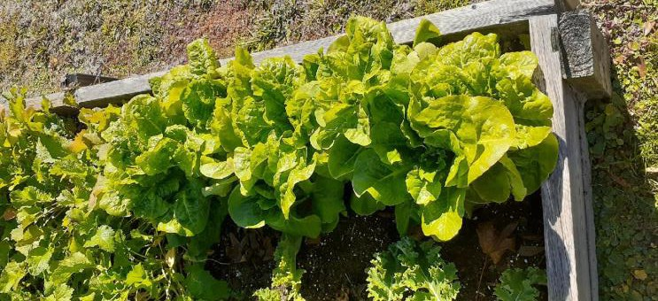

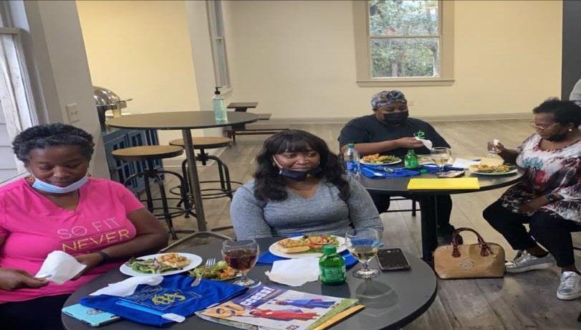
Extension
Objective: Create the platform and opportunity for Southern, NCA&T and Tuskegee to work collaboratively to further strengthen the existing nutrition education programs at each institution
Expected Products and Results:
  1) Test the feasibility of the extension program, “Sister’s Together: Move More, Eat Better” at Southern University.
  2) Test the feasibility of “Make Fruits and Vegetables Available to All” at Tuskegee University.

Slide 29
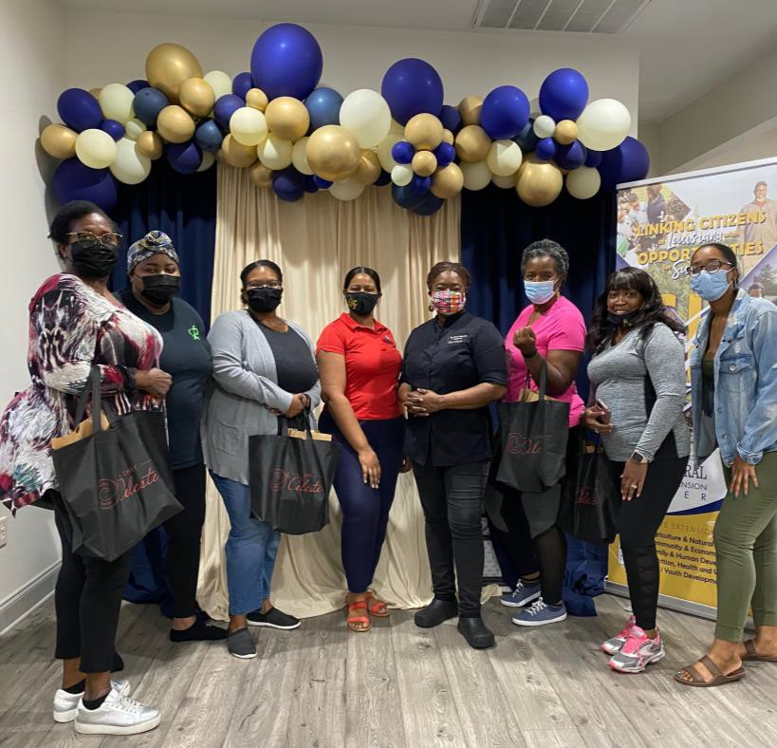
Extension
3) Share resources and experiences to develop emerging technologies for extension programs that can help the underserved minority communities combat diet-related health disparities to live a healthy life.
  Mobile Educational Technology Unit
  Speedway to Health
  Learning to Love Eating Nutritionally Always Health Solutions, Inc. [LLENA/Artificial Intelligent (AI)] App.
    App for Android and iPhone
    Identifies 24/7 access to healthy food recommendations and food recipes

Slide 30



Technology
Where AI Meets GI to For Better Health Artificial Intelligence + Glycemic Index
{
What to eat?
LLENA may solve these eating problems for
diabetes/CVD/kidney disease patients:
When to eat?
How to prepare?
Where to buy?
(Focus on Diabetes disease patients)

Slide 31

1890 Universities Foundation
The 1890 universities Foundation welcomes the participation of 1890 Universities who benefit from the Foundation’s fund development activities in publicizing financial awards to support Centers of Excellence and other program initiatives.
Pilot project program for faculty at all 1890 institutions
  4 projects has been funded
  For this RFA cycle, $250,000 was available for sub awards
  RFA released – July 26, 2021
  RFA Informational Conference Call
  Proposals due – September 7, 2021 (5:00 pm EST)
  Proposals reviewed – September 8-22, 2021
  Recipients Notified October 2021

Slide 32




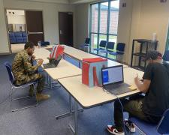
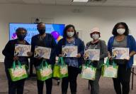
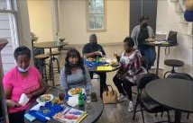









ww.suagcenter.
om
INTRODUCTION
African Americans (AAs) remain the least healthy ethnic group in the USA. Diet is a key contributor to disparities in many chronic diseases and conditions. AA communities have trusted the 1890 institutions for more than a century; therefore, they can play important roles in assisting AAs to combat diet-related disparities especially obesity and its related chronic diseases. Establishing an 1890 Center of Excellence (COE) for Nutrition, Health, Wellness and Quality of Life is very timely and will strengthen 1890s institution’s capacities in research, teaching, and extension to address diet-related health disparities in AAs. Louisiana, North Carolina, and Alabama are among the top 10 most obese states in non-Hispanic black adults. Southern University, North Carolina A&T State University, and Tuskegee University have complementary strengths in research, teaching, and extension, and are in a unique position to work as a team to establish a COE, which is on the tripartite “land-grant” mission of research, teaching, and extension to improve the health and well-being of underserved and minority population.
RESEARCH
EXTENSION
Sisters Together Program: Sister’s Together : Move More, Eat Better is a six (6) month nutrition and physical fitness program designed to assist African-American women in their journey to live their best most healthy life. The emerging technology LLENE (AI) App. also has been introduced and utilized in this program.
Volunteers watching orientation video of the guidelines for collecting samples for the research study.
Opelousas participants receives completion certificate after final class.
Baton Rouge participants enjoy healthy meal after food demonstration.
MISSION STATEMENT
The 1890 Center of Excellence for Nutrition, Health, Wellness and Quality of Life (NHWQL) seeks to support the tripartite land- grant’s mission of research, teaching and extension to contribute solutions to improve health and well-being of underserved and minority populations.
Flyer used for recruitment of participants. Bags given to participants to collect sample.
One of the objectives is to conduct innovative research that involves the community's overall nutrition, health, and well-being. This project focuses on enhancing methodologies to analyze the important microbial metabolites. Many factors, such as diet and lifestyle, affect the composition of an individual's gut microbiota. Our Center and the communities of Baton Rouge, LA, Tuskegee, AL and Greensboro, NC have successfully been able to aid as a volunteer in this research.
ACADEMICS
Symposium Series: The 1890 Center Symposium Series is an opportunity
for the health experts to be able to reach the community. The goal of the symposium series is to connect Universities faculty, students and communities to highlight discussions, forums and presentations that inform and educate. The overall focus is on nutrition, health, and well-being with topics related to the role of diet-related disparities. Our team successfully has held four seminars led by phenomenal presenters in the field of health.
Gumbo (modified recipe), red beans and string beans were prepared by Chef Celeste during food demonstration.
Scan QR code to watch Chef Celeste of Baton Rouge, LA conducting a food demonstration.
LLENA App.
Gardening: Tuskegee University Has been leading the, " Make Fruits and Vegetables Available to All" program . This project brings the concept of farm to table to communities' homes in Tuskegee, AL. With the community's efforts, they have successfully developed and harvested 28 gardens in the area. At the start of the winter break, participants were preparing to harvest their vegetables as seen in the pictures below. With much effort and work, the program is progressing to planting more gardens and incorporating raised bed gardening in the upcoming Spring Semester. Plans of expansion can be seen within the programs as Southern University and North Carolina both plan to bring Gardening to their Universities to implement as well.
1890 Center of Excellence for Nutrition, Health, Wellness and Quality of Life (COENHWQL)
PRESENTS
www.suagcenter.com
Agenda Welcome
Dr. Fatemeh Malekian
Jasmin Plowe, MPH
Public Health Specialist Shewana Hairston McSwain
^{Introduction of Speakers} Southern University Agricultural Try Healthy "SNAP-ED" Coordinator
Student Scholars
Research and Extension Center North Carolina A&T University
The Cooperative Extension Program
Pilot Projects: The 1890 Land-Grant Universities Foundation and the 19 universities designated with land-grant status under the Morrill Act of 1890 are partners in the 1890 Center of Excellence for Nutrition, Health, Wellness and Quality of Life.
The Center solicited applications from 1890s to conduct pilot projects via the RFA, which opened in late July and closed in early September. The 1890 Universities Foundation worked with the Center leadership team to design the RFA. The 1890 Foundation completed the review process. Early notification was sent to applicants during the week
Presentations Q &A Segment
Brittany Howard
Rhonda Peters ^{Catrina A. Hoffman}
Family & Consumer Science Agent Family and Consumer Science (FCS) for North Carolina Cooperative Coordinator for Tuskegee University Extension in Montgomery County ^{Cooperative Extension (TUCE)}
Closing
Dr. Renita Marshall
https://www.suagcenter.com/page/center-of-excellence
Make Fruits and Vegetables Available for All
Participants Needed!
Would like to increase your intake of fruits and vegetables?
Would you like to give your body a fighting chance against chronic diseases.
Would you like to get more physically fit?.
Would you like to save money on fruits and vegetable purchases?
If your answer is yes to any of the above questions, ALL you need is:
  Back/ front yard space
  Willingness to take care of the plants
  Harvesting your own vegetables and fruit;
The flyers of the seminars the Center has offered thus far. Please feel free to use the link below to view webpage and watch the webinars at your convh^{e}tt^{n}p^{i}s^{e}:^{n}//^{c}w^{e.}ww.suagcenter.com/page/symposium-series
Center of Excellence for Nutrition, Health, Wellness and Quality of Life
In Partnership: Southern University Ag Center, North Carolina A&T
University
For more information call: 334-727-8028 or
email: ndawkins@tuskegee.edu
of October 4th. The 1890 Foundation developed sub
Student Scholars: Southern University, North Carolina A&T State University, and Tuskegee University have complementary strengths in research, teaching, and extension, and are in a unique position to work as a team to unite our student body with the community and faculty. We have the honor of introducing our Student assistants and Scholars who have illustrated and implemented hard work and dedication to their education and career paths, to research and extension
recommended for funding. Four Research projects w award packets for those projects that were
c
ACKNOWLEDGEM
has received funding from the Center of Excellence
The Center of Excellence for Nutrition, HealthE, WNellnTess and Quality of Life is funded by the United States
for Nutrition, Health Wellness and Quality of Life.
activities under the Center. These students have been matched to work with faculty.
Departmentof Agriculture/ National Institute of Food and Agriculture USDA/NIFA # 2021-38427-34836

Slide 33
Walmart Foundation Grant
The primary goal of the Center of Excellence (COE) for Nutrition, Health, Wellness, and Quality of Life (NHWQL) is to increase the capacities of 1890 institutions to address health disparities through nutrition research, teaching, and extension.
The Walmart grant support this Center by building upon newly developing pilot projects and
other proven strategies.
The 1890 Universities Foundation have been working with the Center to provide administrative oversight of the work, including activities centered on data collection, marketing/messaging of nutrition/health resources, technical assistance to underserved communities, and website/social media communications.
Learning Objective: To expose students to the best educational and leadership opportunities within the field of nutrition, health, wellness, and quality of life, which can prepare them as the ambassadors of the underserved communities to combat health disparities.
Engagement Objective: to provide innovative nutrition education and training that leads to healthy, positive changes, increases in knowledge, skills, attitudes, and changes of behaviors necessary for choosing nutritionally sound diets and a healthy lifestyle.

Slide 34
Team Members
Dr. Malekian, Professor and Director of Southern University Institute for Food, Nutrition and Wellness, Director for Center of Excellence (SUAREC)
Dr. Marshall, Vice Chancellor for Academics (SUAREC)
Dr. York, Vice Chancellor for Extension (SUAREC)
Dr. Oscar Udoh, Director of Grants and Facilities (SUAREC)
Brittany Howard, Project Coordinator (SUAREC)
Dr. Hymon-Parker, Associate Dean for Research (NC A&T)
Dr. Sang, Professor (NC A&T)
Dr. Alexander, Assistant Professor, (NC A&T)
Dr. Dawkins, Professor, Department Chair, (TU)
Dr. McLaren, Vice President for Program Innovation and Implementation, 1890 Universities Foundation
Dr. Neufville, President & CEO of 1890 Universities Foundation

Slide 35
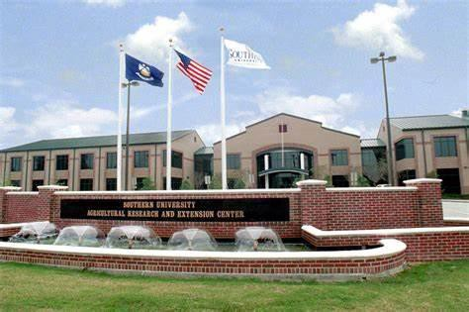
In closing we are very grateful to USDA/NIFA for providing the funds for our team to continue the work under Center of Excellence for Nutrition, Health, Wellness and Quality of Life. We are bringing other 1890 universities on board. We are anticipating to connect with Farmers, Food industries, big chain supermarkets foundations (such as Walmart), medical society, politicians and law makers and others so we can reduce and someday eradicate health disparities specially among African American and other minorities not only in the Southern Region but also in the Nation.

Slide 36



For More Information
www.suagcenter.com
Email:
Dr. Fatemeh Malekian, Project Director Fatemeh_Malekian@suagcenter.com
or
Brittany Howard, Project Coordinator Brittany_howard@suagcenter.com
The funding for “COE FOR NUTRITION, HEALTH, WELLNESS and QUALITY OF LIFE”
Has been provided by USDA/NIFA#2021-38427-34836

