Slide 1
WHO IS OUR AUDIENCE?
Exploration through Population Snapshots
John J. Green, PhD
Director and Professor, Southern Rural Development Center
Presented at the
2022 Southern Region Mini Land-Grant Meeting
College Station, TX

Slide 2
Introduction
Pursuing the Land-Grant University mission requires knowledge of the people and communities we seek to engage and serve
Communities are diverse and they change over time
Population characteristics and population change are important
To illustrate, we will explore
Population distribution
Net-migration
Aging

Slide 3
From Population “Snapshots” to “Collage”
Population data provide “snapshots” of people in places
Who the people are, what they do, and the challenges and opportunities they might face
They are used to group people and places into categories
Snapshots are useful, but any one of them on its own presents just one perspective captured through a particular “lens”
What if we look at multiple snapshots taken with different lenses and arrange them to form collages?
*Expanding from – Green, John, Tracy Greever-Rice, and Gary Glass. 2015. Sociodemographic snapshots of the Mississippi Delta. In Janelle Collins (ed.), Defining the Delta: Multidisciplinary perspectives on the Lower Mississippi River Delta. Fayetteville, AR: The University of Arkansas Press.

Slide 4
Population Change
Population change
Pop. Time 1
+ Births
– Deaths
+ Migration
----------------
Pop. Time 2
These changes occur across geographies, for today we will focus on counties

Slide 5
Data
Data sources
U.S. Decennial Censuses – 2010 and 2020
Population Estimates and Components of Population Change, Vintage 2020
American Community Survey 2020 Five-Year Estimates (20016-2020)
Focus on the Southern Region
County and county equivalents (referred to as counties throughout)

Slide 6
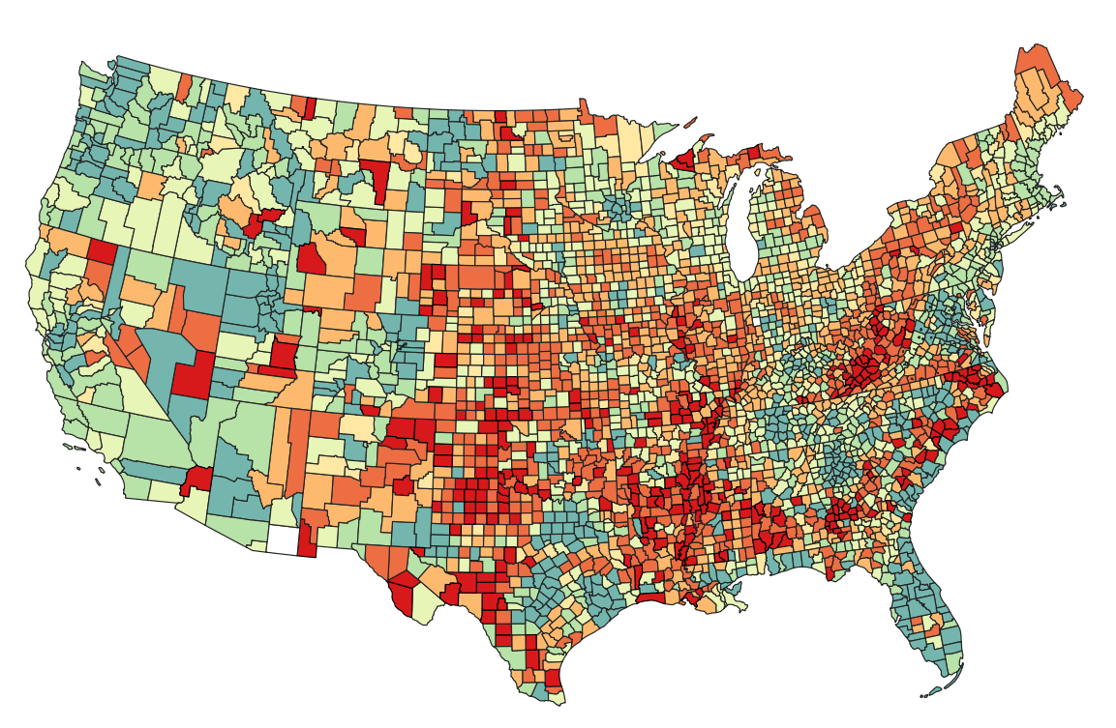
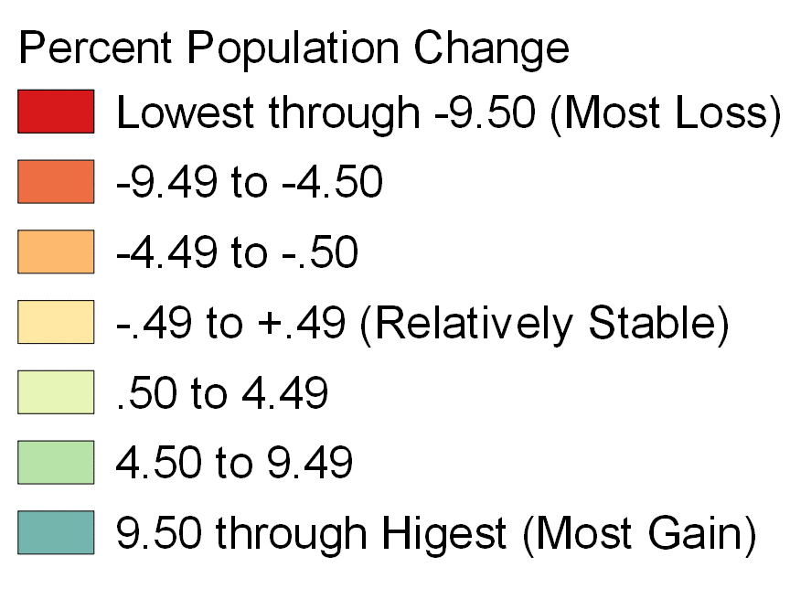
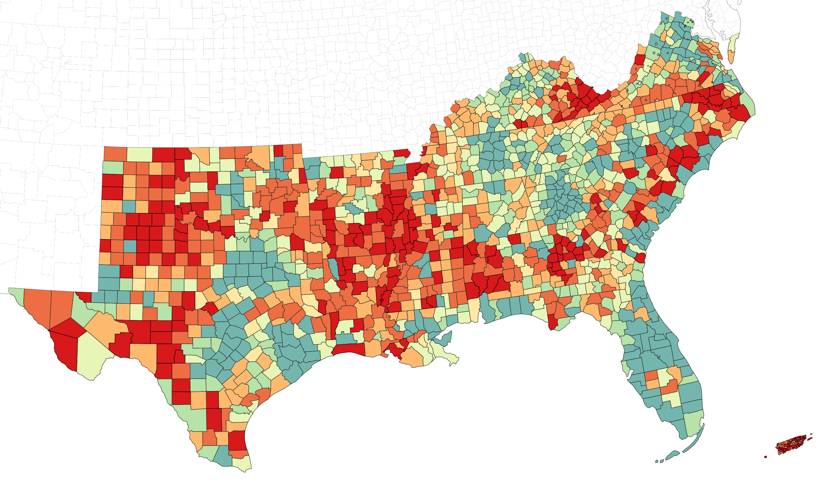
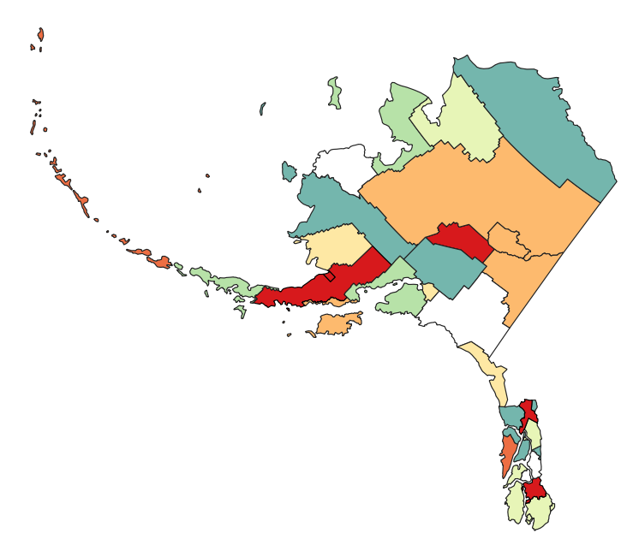
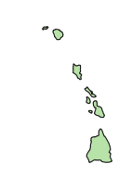
Percent Change in Population at the County Level, 2010 to 2020
Data Sources: Census 2010 and 2020. Analysis and map by J. Green.

Slide 8
Data Sources: Census 2010 and 2020; Population Estimates and Components of Change, 2020 Vintage. Includes 13 southern states. Analysis and figure by J. Green.

Slide 9
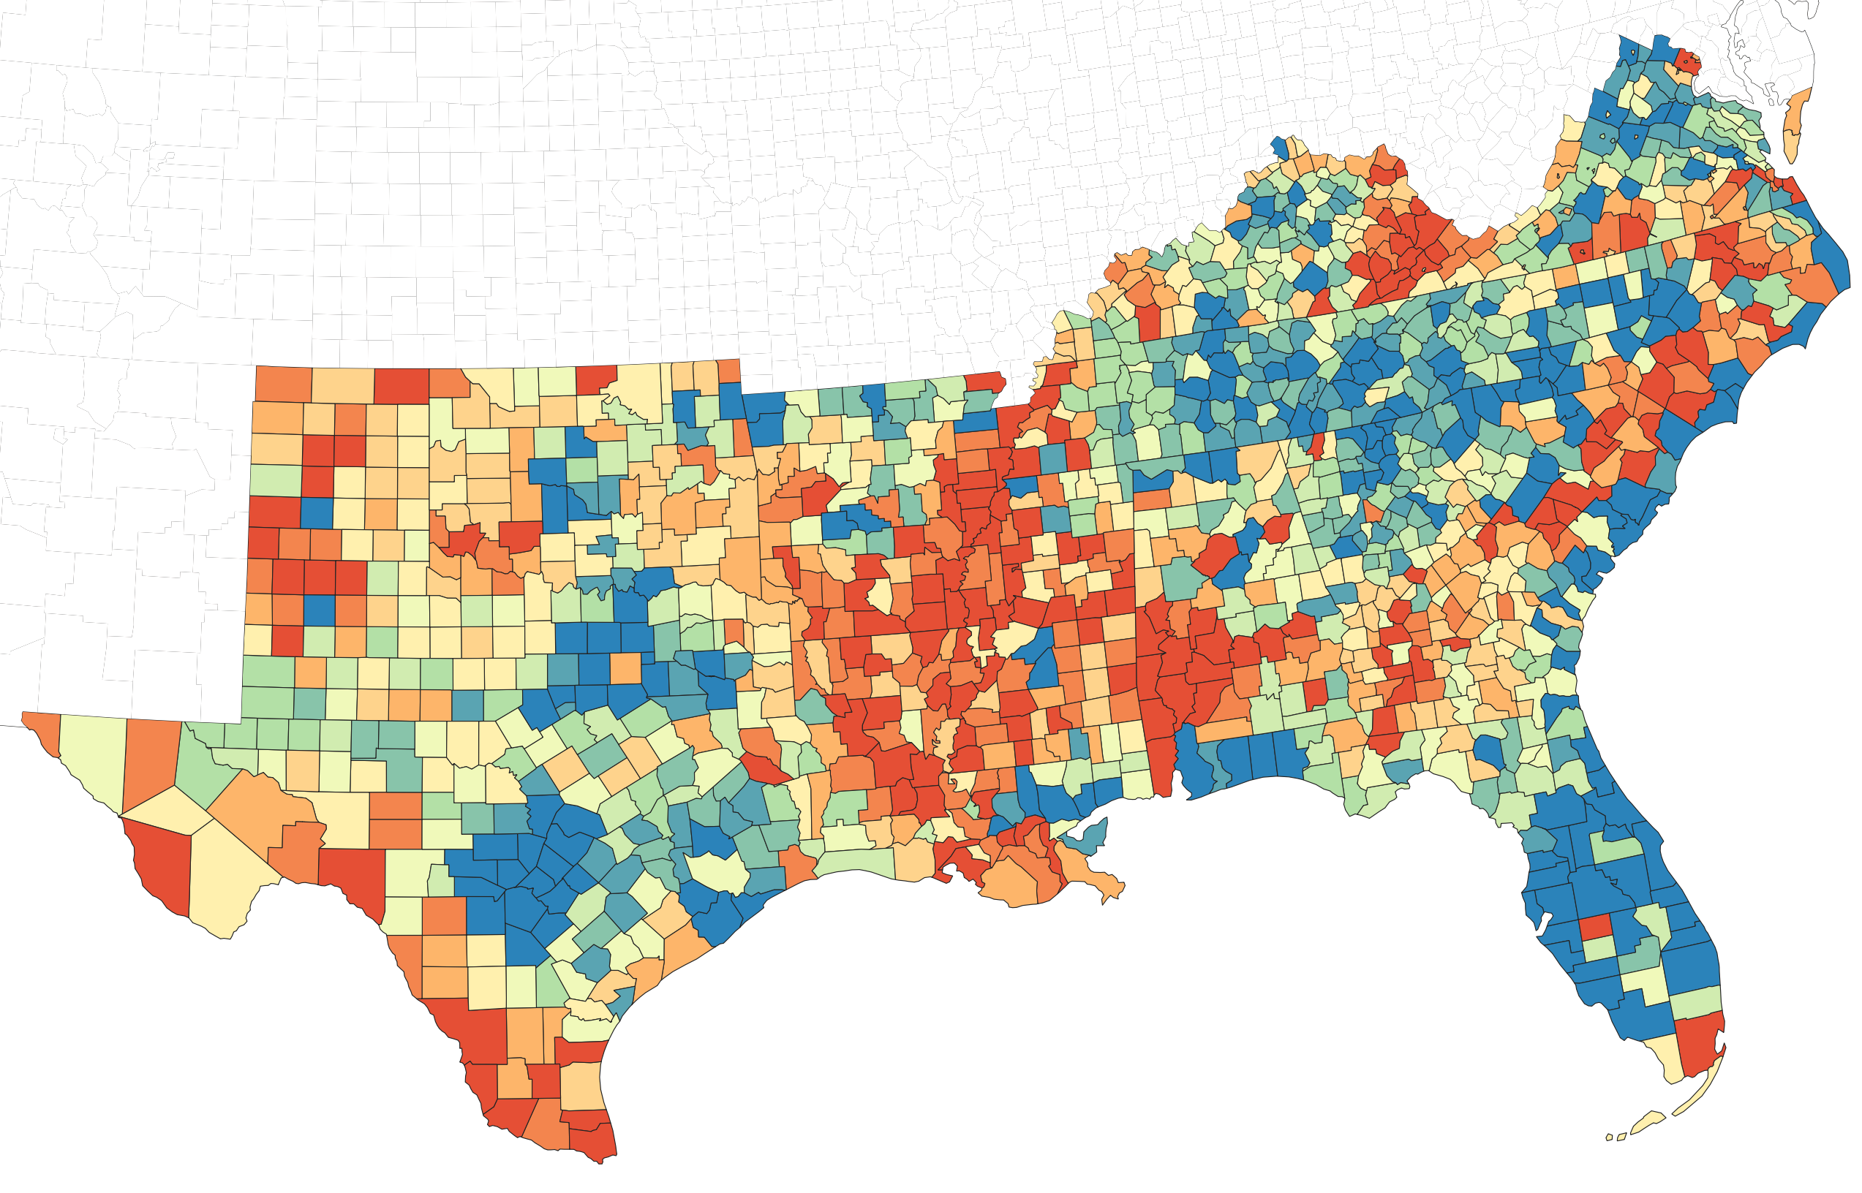
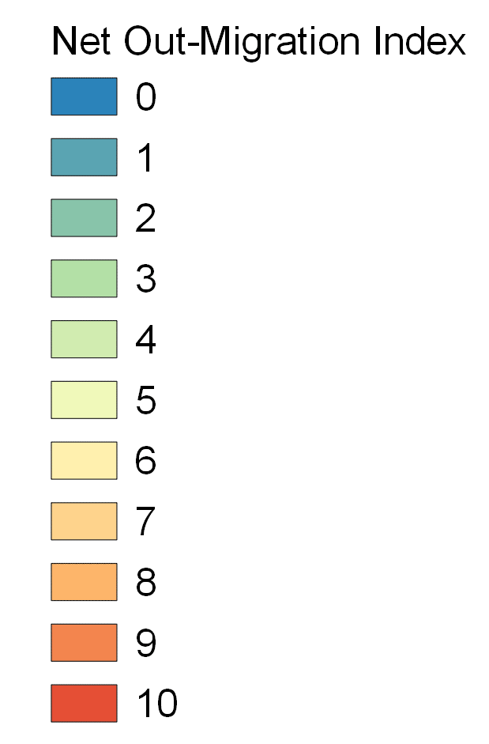
Net Out-Migration in Southern Region Counties (Number of Years 2010 to 2020)
Data Source: Population Estimates and Components of Change, 2020 Vintage. Includes 13 southern states. Analysis and map by J. Green.

Slide 10
Components of Population Change in Southern Region Counties by Metropolitan Classification, 2010 to 2020
Components of Change | In Metro Area w/ 1 Million Pop+ | In Metro Area w/ <1 Million Pop | Non-Metro w/ Urban Pop 2,500+ | Non-Metro w/ Urban Pop <2,500
Net Out-Migration (Number of Years in Past Decade)
Median | 2.0 | 4.0 | 6.0 | 6.0
Minimum | 0.0 | 0.0 | 0.0 | 0.0
Maximum | 10.0 | 10.0 | 10.0 | 10.0
Natural Decrease (Number of Years in Past Decade)
Median | 0.0 | 2.0 | 5.0 | 9.0
Minimum | 0.0 | 0.0 | 0.0 | 0.0
Maximum | 10.0 | 10.0 | 10.0 | 10.0
N (# counties) | 202 | 346 | 562 | 229
Data Sources: Population Estimates and Components of Population Change, Vintage 2020; 2013 USDA Economic Research Service Rural-Urban Continuum Codes based on Census 2010. Includes 13 southern states. Analysis and table by J. Green.

Slide 11
Population Composition in the Southern Region Counties by Metropolitan Classification, 2020 Decennial Census
Percent Population Self-Reporting Racial Identity Other than White | In Metro Area w/ 1 Million Pop+ (N=242) | In Metro Area w/ <1 Million Pop (N=375) | Non-Metro w/ Urban Pop 2,500+ (N=570) | Non-Metro w/ Urban Pop <2,500 (N=230)
Median | 41.5 | 34.3 | 35.7 | 24.4
Minimum | 5.2 | 4.9 | 3.5 | 2.6
Maximum | 99.8 | 99.8 | 99.8 | 90.2
N (# counties) | 242 | 375 | 570 | 230
Data Sources: Census 2020; 2013 USDA Economic Research Service Rural-Urban Continuum Codes based on Census 2010. Includes 13 southern states and Puerto Rico. Analysis and table by J. Green.

Slide 12
Population Composition in the Southern Region,
2020 Decennial Census
Racial and Hispanic/Latino Identity | Percent Total Population of Southern Region (w/ Puerto Rico) | Percent Total Population of Southern Region (w/o Puerto Rico)
Hispanic or Latino (any race) | 21.7 | 19.5
Not Hispanic or Latino
White | 52.6 | 54.1
Black or African American | 17.4 | 17.8
American Indian and Alaska Native | 0.6 | 0.6
Asian | 3.5 | 3.6
Native Hawaiian and Other Pacific Islander | 0.1 | 0.1
Some Other Race | 0.4 | 0.4
Two or More Race | 3.7 | 3.8
Data Source: Census 2020. Includes 13 southern states and Puerto Rico. Analysis and table by J. Green.

Slide 13
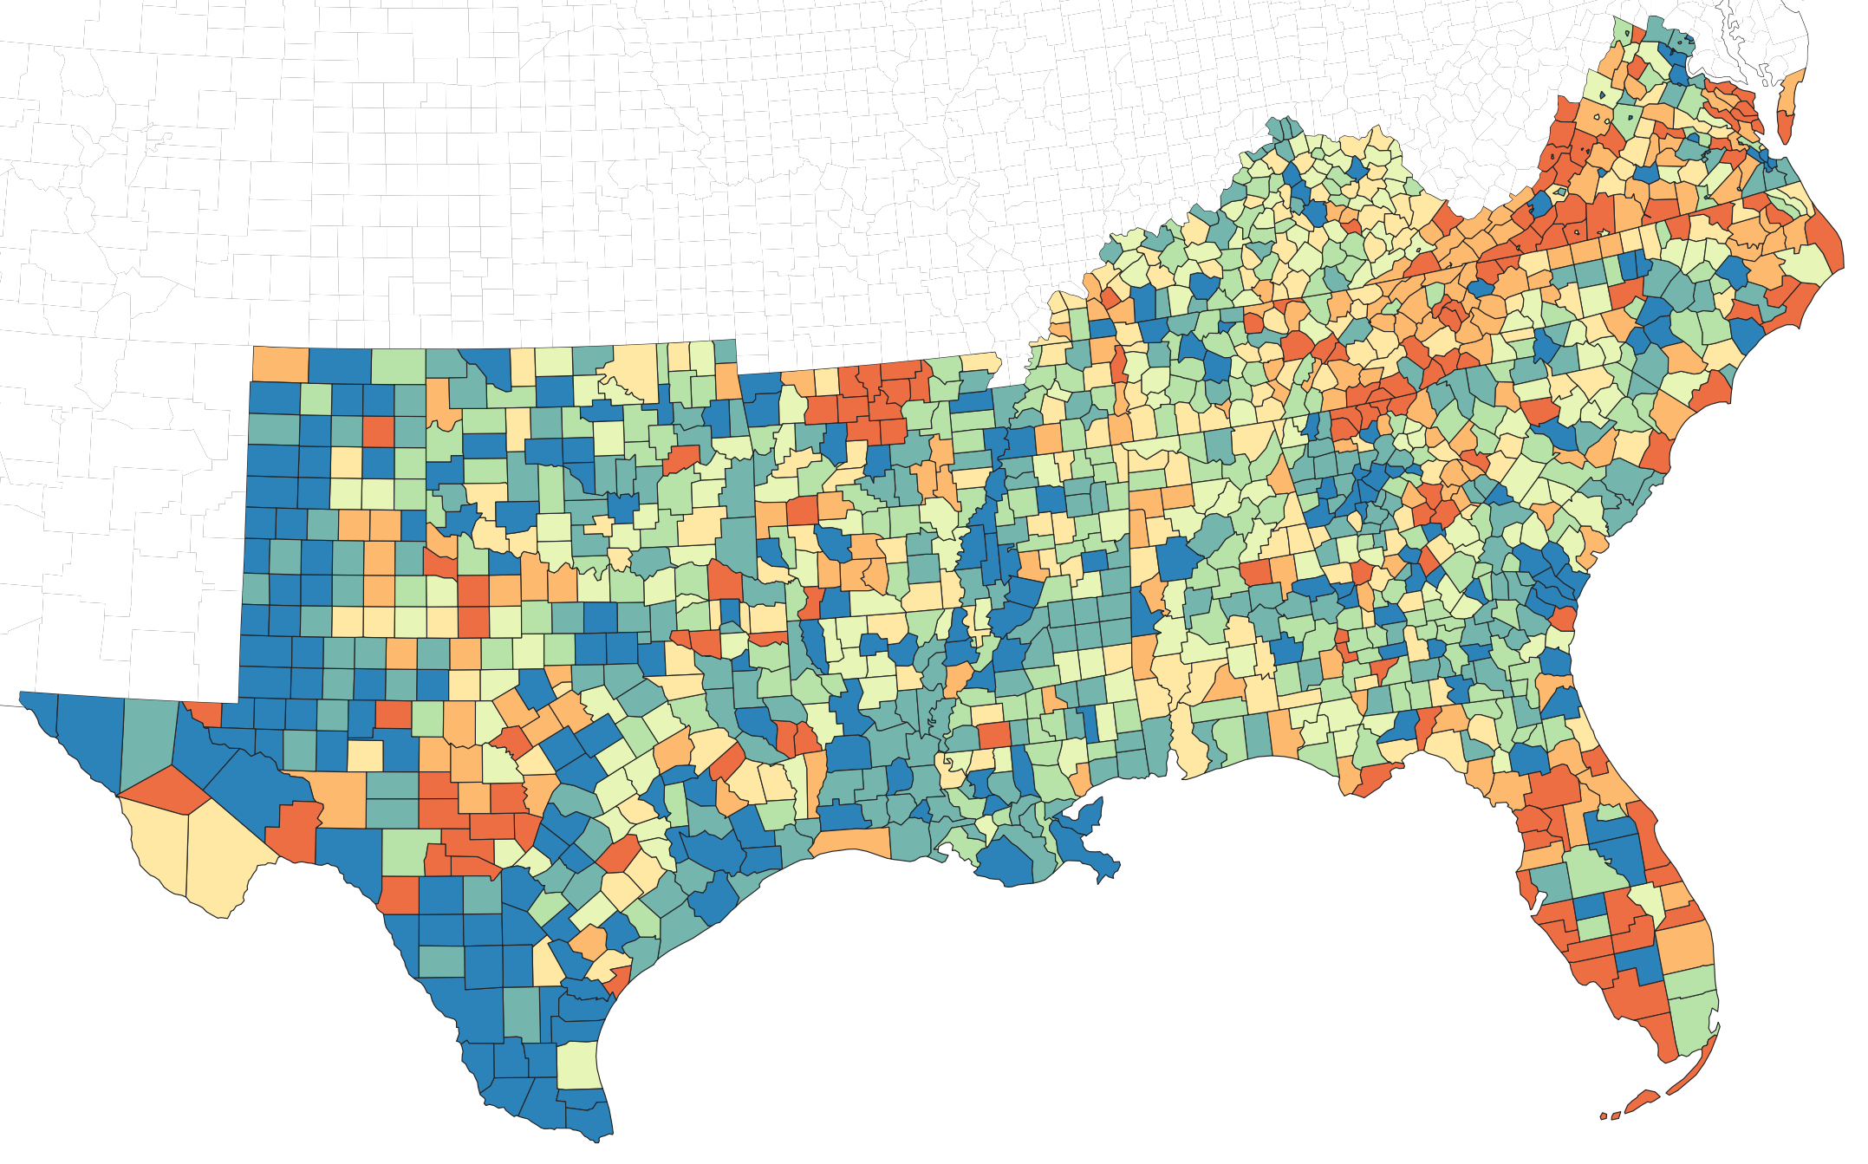
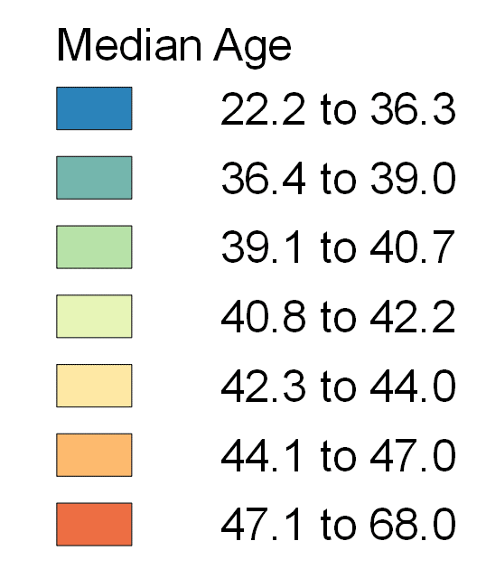
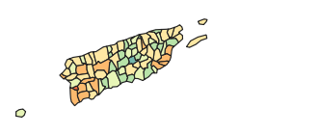
Median Age in the Southern Region
(2020 Five-Year County Estimates)
Data Source: American Community Survey 2020 Five-Year Estimates.
Includes 13 southern states and Puerto Rico. Analysis and Map by J. Green.

Slide 14
Population Age Characteristics in the Southern Region Counties by Metropolitan Classification, 2020 Five-Year Estimates
Population Age Indicators | In Metro Area w/ 1 Million Pop+ | In Metro Area w/ <1 Million Pop | Non-Metro w/ Urban Pop 2,500+ | Non-Metro w/ Urban Pop <2,500
Median Age (in Years)
Median | 39.4 | 40.8 | 40.4 | 43.8
Minimum | 25.7 | 23.7 | 22.2 | 27.8
Maximum | 53.7 | 68.0 | 57.7 | 62.2
Population 65 Years of Age and Older (Percent)
Median | 15.9 | 18.0 | 18.3 | 21.3
Minimum | 8.7 | 3.0 | 9.0 | 10.6
Maximum | 30.1 | 57.8 | 37.2 | 45.3
N (# counties) | 242 | 375 | 570 | 230
Data Sources: American Community Survey 2020 Five-Year Estimates; 2013 USDA Economic Research Service Rural-Urban Continuum Codes. Includes 13 southern states and Puerto Rico. Analysis and map by J. Green.

Slide 15
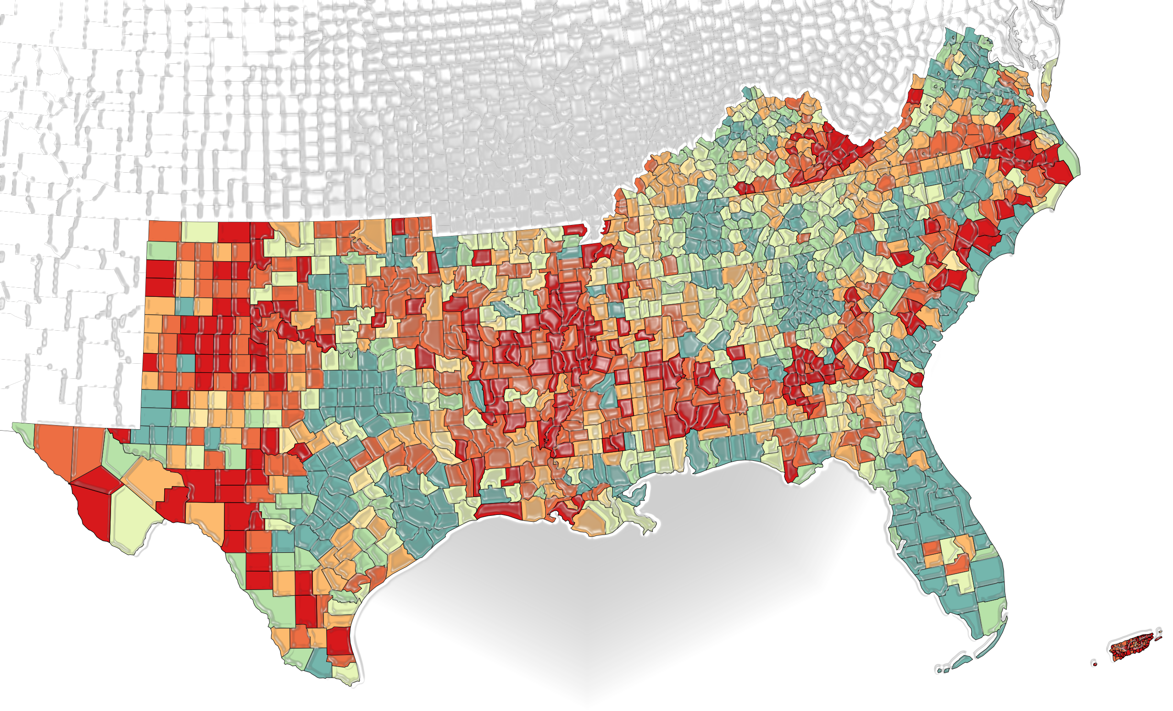
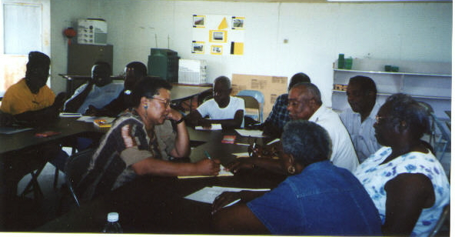
Discussion
Although incomplete, these snapshots demonstrate the variety of experiences of people and communities in the Southern Region
Engaging with the people we seek to serve, we can organize and combine these “snapshots” into “collages” to interpret patterns and make sense of them
Such information can be used to inform further research questions and to plan and improve Extension efforts

Slide 16
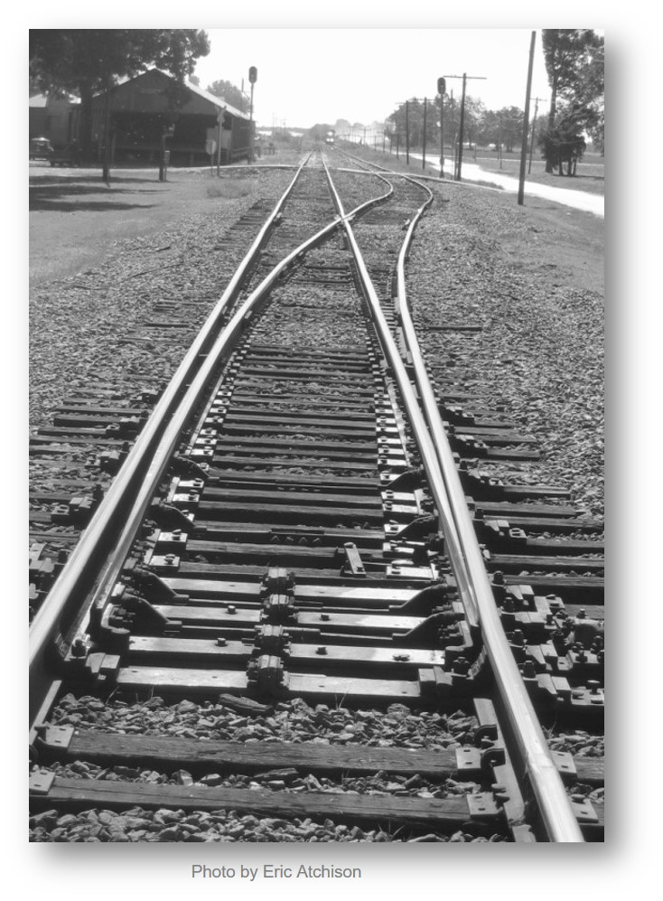
Discussion
Consider how these characteristics and trends might relate to substantive topics, such as the different needs and interests for places with:
Chronic net out-migration compared to rapid in-migration
Lower ages compared with higher ages
Populations are not static – need to regularly update the collections (e.g., impact of COVID-19 mortality)

Slide 17
Thank you!
I would like to acknowledge support from:
National Institute of Food and Agriculture, U.S. Department of Agriculture
National Institute on Aging, National Institutes of Health
The ideas expressed during this presentation are not necessarily shared by the partner organizations
I apologize for any errors or omissions

