Slide 1
NIFA Update | May 2022 Kevin Kephart, Deputy Director, IBCE Shoushan (Steve) Zeng, Division Director, Food Safety

Slide 2
NIFA Priorities
Addressing the Administration’s priorities
Addressing the needs of partners
Realizing the agency NIFA was created to be
Notes:
Addressing the Administration’s priorities
Addressing the needs of partners
Realizing the agency NIFA was created to be

Slide 3
USDA Personnel Update
USDA:
Tom Vilsack, Secretary
Jewel Bronaugh, Deputy Secretary
Research, Education, Economics (REE) Mission Area:
Chavonda Jacobs-Young, Nominee Under Secretary
Shefali Mehta, Deputy Under Secretary
NIFA:
Dionne Toombs, Acting Director
Parag Chitnis; Associate Director, Programs (leaving May 31, 2022)
Drenda William, Acting Associate Director, Operations
Brent Elrod, Acting Associate Director, Programs
Notes:
Some changes in USDA and NIFA personnel in the past year or so
Secretary and Deputy Secretary
Under secretary is still in confirmation process
Carrie has announced that she will be leaving NIFA in April and assuming the role of new Senior Vice Chancellor/Senior Vice President for the UT Institute of Agriculture (UTIA)

Slide 4
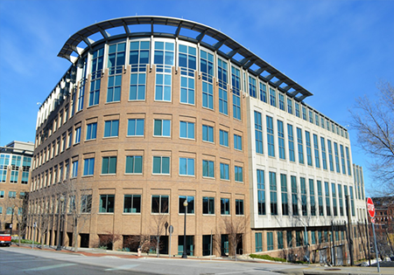
NIFA Update
October 1, 2019: Relocated from Washington, DC to Kansas City, MO
May 1, 2022: ~320 staff at NIFA (~20 staff in DC)
Goal: ~410 total FTE
NIFA staff have been working remotely since March 2020
New hires have option for remote duty stations
Senior Executives in the office 2 days a pay period
Permanent location (November 1, 2020):
805 Pennsylvania Ave
Kansas City, MO 64105
Notes:
~320 Permanent Employees on Board To Date
75 in process recruiting actions (Grants Management Specialists, National Program Leaders, etc.)
The majority of NIFA staff are remote working, with about 5 staff teleworking in KC (e.g., in the office 2 days a pay period as well).

Slide 5
Addressing needs of partners
Listening through input sessions
Adding more webinars and feedback sessions
Focusing on high-quality customer service
Building back 4-H Headquarters with strong, experienced leaders and new science advisors at LGUs
Hiring strategically to provide for better support
Notes:
We are working hard to be a true partner.
Listening through input sessions
More webinars and feedback sessions
Focus on high-quality customer service
Building back 4-H Headquarters with strong, experienced leaders and new science advisors at LGUs
Strategic Hires – brought back Josh Stull as Stakeholder Affairs Officer to work closely with leaders across the NIFA Stakeholder base. Enhancing the Communications Staff to help amplify the work of our partners and improve the flow of information from NIFA to our partners. A Communicator will be located in each region to support the regional liaison and to work with partner communicators and media in that region. Hired 64 new staff between May and October with support of experienced specialists on detail from other USDA agencies. We now have a full staff of Deputy Directors and will soon finishing hiring of Division Directors. Many familiar faces at NIFA from the LGU system are helping bring the partner perspective to our work.

Slide 6
Realizing NIFA’s Potential
Rebuilding the NIFA workforce
Improving NIFA processes
Increasing customer service
Upgrading NIFA Website
Re-engineering RFAs
NIFA Reporting System
Notes:
Now close to the staff level prior to relocation. Expect to reach full staff level this fiscal year.
Improving NIFA processes
Increasing Customer Service
New tools have been added to the NIFA website like updated list of NPLs, redesigned Programs page; New Capacity Funding flowchart; In Feb. we will move to an upgraded platform with many big improvements in content and flow of the website;
RFAs are being restructured to streamline them and make them more user-friendly;
Each quarter we are adding more enhancements to the NIFA Reporting System for streamlining and improving reporting to reduce the burden on partners.

Slide 7
Project Café - COMPLETE
Completed projects
Better training for new employees
Better training for peer review panels to provide top-quality feedback on grant proposals
Standardized application deadlines
New online calendar of RFAs and deadlines for applications
Plan for improved technology across NIFA systems
Notes:
New NPL Orientation sessions (11)

Slide 8
Webinars with NIFA Staff
NIFA staff are participating in the series of webinars with leaders from the:
Association of 1890 Extension Administrators, Inc. (AEA)
Association of 1890 Research Directors, Inc. (ARD)
Extension Committee on Organization and Policy (ECOP)
Experiment Station Committee on Organization and Policy (ESCOP)
Our first two sessions with ECOP and ESCOP had over 150+ participants.
Notes:
We are pleased to invite all NIFA staff to a series of webinars with leaders from the:
Association of 1890 Extension Administrators, Inc. (AEA)
Association of 1890 Research Directors, Inc. (ARD)
Extension Committee on Organization and Policy (ECOP)
Experiment Station Committee on Organization and Policy (ESCOP)
The purpose of these webinars is to introduce NIFA staff to these national leaders and to strengthen the partnership between Land-Grant University (LGU) national leadership and NIFA staff. The discussion sessions with AEA, ARD, ECOP, and ESCOP leaders will provide background and introductory information as we prepare to initiate the next session of the LGU2U project, which will focus on interactions between NIFA program staff and LGU leaders. The topics for each of these sessions are provided below.

Slide 9
USDA Strategic Plan: FY 2022 - 2026:
Combat climate change to support America’s working lands, natural resources, and communities
Ensure America’s agricultural system is equitable, resilient, and prosperous
Foster an equitable and competitive marketplace for all agricultural producers
Provide all Americans safe, nutritious food
Expand opportunities for economic development and improve quality of life in rural and tribal communities
Attract, inspire, and retain an engaged and motivated workforce that’s proud to represent USDA

Slide 10
NIFA Priority Leadership Teams
Provide leadership to help NIFA accomplish FY22 USDA Priorities by developing action plans, outcomes, and metrics to track progress
Climate Change
Diversity, Equity, Inclusion, Accessibility (DEIA)
Market Opportunities
Nutrition Security
Workforce Development
Core members (expanded teams have additional members):
NPL/NSL
Division Director
Deputy Director
Executive Coordinator
Notes:
NIFA has established priory teams to address the priority areas
Consist of core team with specific members with some expertise in the topic
Extended teams have a broader membership that spans divisions and institutes

Slide 11
Climate Change
Expertise in agricultural adaptation to climate change
Support research and Extension efforts in climate-smart agriculture and forestry and mitigation of agricultural greenhouse gases
Support administration goals regarding environmental justice
Support education and workforce development for anticipated jobs in clean energy and related fields
NIFA is exploring all programs for funding opportunities
Creating a new vision for leading in climate change research and Extension

Slide 12
Nutrition Security
Supporting Innovative Inter- and Trans-Disciplinary Solutions
Harnessing a Holistic Research Agenda, From Farm-to-Fork
Integrating with Climate-Smart Agriculture
Empowering Individual and Community Agency
Ongoing Webinar Series
https://nifa.usda.gov/program/nifa-nutrition-security-webinar-series Topics | National Institute of Food and Agriculture (usda.gov)
Notes:
Having consistent access, availability, and affordability of foods and beverages that promote well-being and prevent (and if needed, treat) disease, particularly among our nation’s most socially disadvantaged populations. For fiscal year 2021, our agency is estimated to invest more than $122.1 million dollars to promote nutrition security.
The NIFA Nutrition Security Team aims to help prioritize nutrition security by focusing on:
Innovative Inter- Trans-Disciplinary Solutions to Promote Healthy Eating Patterns and Behaviors to tackle the “whole picture” regarding underlying factors and most promising strategies.
Harnessing a Holistic Research Agenda, from Farm to Fork working along every link of the food chain to build a more sustainable, resilient, equitable and nourishing food system, including:
Production (e.g., agroecology, community and home food gardening, urban agriculture, farmers’ markets, regional food systems)
Preparation (e.g., ensuring sufficient, safe, and nutritious food preparation in culturally, contextually, and economically sensitive ways including disaster preparedness)
Promotion (e.g., Fostering a circular economy in rural areas by promoting local and regional food supply chains)
Consumption (e.g., enabling positive and sustained healthy eating behavior to decrease the health and financial burden of diet-related non-communicable diseases and health disparities)
Increase access to and improve the nutritional quality of our federal nutrition safety net
Disposal (e.g., limit food waste while ensuring food safety)
Integrating with Climate-Smart Agriculture on transformative discoveries, education, and engagement.
Engaging Individual, Family, and Community Agency and Capacity Building
Ongoing Webinar Series - Launched this past June, our NIFA Nutrition Security Webinar Series aims to help us share our emerging approaches to prioritizing nutrition security, while also offering us an opportunity to learn from key thought leaders in this area.
Please visit our NIFA Nutrition Security Webinar Series webpage listed here to access the materials from our first five webinars.
We hope to update this webinar series webpage soon with more of our 2022 webinar offerings.

Slide 13
Enhanced Market Opportunities
Focus on Innovation & Development of New Markets that are Fair, Competitive, Distributed and Resilient, including:
Processing & distribution capacity
Local & regional food systems
Organic & emerging opportunities
Safeguarding animal & plant health
EXCITE for vaccine education
Regional Rural Development Centers digital dashboard
Enhanced funding for Farm Stress Program
Notes:
Processing & distribution capacity
Local & regional food systems
Organic & emerging opportunities
Safeguarding animal & plant health
EXCITE for vaccine education
Regional Rural Development Centers digital dashboard - The Regional Rural Development Centers (RRDC) shared their preliminary report from the Listening Sessions Initiative to gather feedback from stakeholders engaged in developing America’s rural communities. The report is entitled Investing in Rural Recovery: Findings from a Rapid Assessment of Stakeholder Priorities for Rural Development. The report summarizes results from a survey of stakeholders, identifying their views on top priorities for rural community development, as well as their organization’s capacity and interest to engage on key issues. In total 680 survey responses are included in the analysis. Data collected in this phase of the initiative will be available publicly via a digital dashboard through the RRDC’s collaboration with the Extension Foundation under the New Technologies for Agricultural Extension funding. Through this dashboard stakeholders and policy makers will be able to interactively engage with the survey data. Phase 1 data will also be further analyzed by researchers at the RRDCs to deepen our understanding beyond the findings presented now, in the current report. Feedback shared via the survey will be utilized as a baseline for the second phase of the initiative, when the RRDCs host a series of listening sessions – facilitated discussions with key stakeholder groups to further identify strategies and investments to build resilient rural communities.
Enhanced funding for Farm Stress Program

Slide 14
Diversity, Equity, Inclusion, & Accessibility (DEIA)
Assess current practices and develop action items to advance diversity, equity, inclusion and accessibility across the agency.​
Focus for 4-H and Youth Programs
Data Analysis
Grantsmanship
Recruitment
Processes
Accessibility
Notes:
Focus for 4-H and Youth Programs
Data Analysis
Establishing baseline DEIA data​ for NIFA
Portfolio analyses​
Metrics to include in RFA & NIFA – wide​
Grantsmanship
DEIA language in RFAs
Coordination between stakeholder groups
Applicant webinars
Recruitment
Identifying liaisons for DEIA efforts within NIFA​
Webinars for NIFA Career Opportunities​
Candidate eligibility
SOP for Hiring Managers​
Identifying barriers for NIFA applicants​
Processes
Panel composition process​
Panel managers selection and outreach​
Panel process best practices and ranking of proposals​
Accessibility
508 Compliance
Access to programs and services

Slide 15
Workforce Development
Propel the development of a skilled workforce for the food & agriculture sector, including industry, academia and government
Collaborate with stakeholders & enhance their capacity
Strengthen interactions between urban and rural communities to attract future students to food and agriculture sectors
Notes:
Collaborate with stakeholders for workforce development
Extension Offices and their programs
Land Grant Universities, other minority-serving and academic institutions
Cooperative agreements
Enhance stakeholder capacity for workforce development
Improve mechanisms to efficiently implement funding programs and human resources (e.g., 1890 Scholarship Program, Pathway Internships)
Work with local/state extension partners to foster positive youth development
Determine the market/demand for well trained workforce
Collaborate within USDA and with other federal agencies to enhance internship opportunities

Slide 16
NIFA Support for Responding to Emergencies
AFRI Rapid Response to Extreme Weather Events Across Food and Agriculture Systems (A1712)
$300,000, 12 month Standard grants; $3,000,000 24 month CAP grants
Designed to rapidly deploy strategies and fill knowledge and information gaps to protect the nation’s food and agricultural supply chains, from production through consumption, during and after extreme weather and disasters
Applications must address one or more of the following emphasis areas:
Agroecosystem Resilience,
Agricultural Commodity and Nutrition Security
Health, Well-Being, and Safety
Smith-Lever Special Needs Competitive Grants Program
Smith-Lever, 1890 Extension Capacity Funds
Notes:
Rapid response – provide a method to apply for and receive funds following a natural disaster in a location; can be weather related or animal health outbreaks as examples;
Address many aspects of dealing with the aftermath such as infrastructure, support programs, outreach. “open” application period to be useful after an event; raid review and turn around time to maintain connection to event

Slide 17
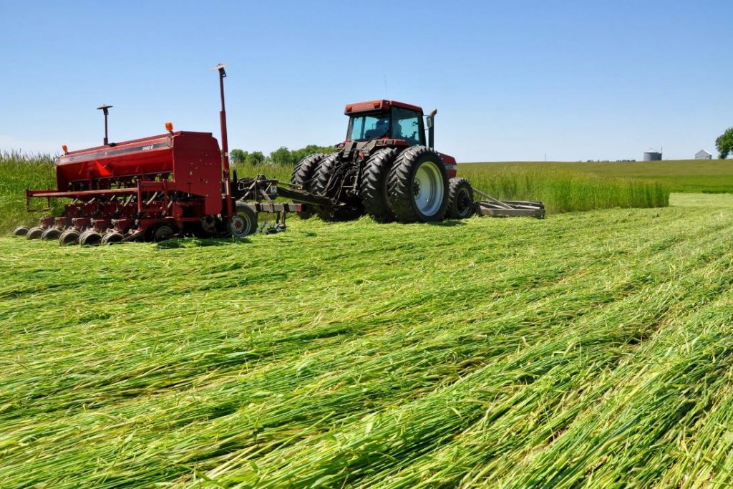
Climate-Smart Extension
Extension, Education and USDA Climate Hubs Partnerships
CAP for Climate Smart Extension
$1.5 million grants to Climate Hub Partnerships
$10 million for the Climate-Smart Extension CAP
Designed to support Extension as a national resource for CSAF adoption

Slide 18
NIFA on the Horizon
$1.01 billion in funding for USDA assistance and support for historically underserved farmers, ranchers, forest landowners and operators, and groups.
$60 million invested in AFRI Education and Workforce Development for 4-H and positive youth development. The largest single infusion of NIFA funding for 4-H in the agency’s history.
New Investigators opportunities in the AFRI Foundational RFA with technical assistance for that program.
NIFA peer review panels: the best professional development opportunity at PRS.nifa.usda.gov to sign up.
New focus on helping universities improve and develop better practices through Civil Rights Audits.

Slide 19
Justice40
Covered Priority Areas:
climate change
clean energy and energy efficiency
clean transportation
affordable and sustainable housing
training and workforce development (related to topics of other covered programs)
remediation and reduction of legacy pollution
critical clean water and waste infrastructure
Underserved Communities:
Historically marginalized and/or overburdened by pollution and underinvestment in housing, transportation, water and wastewater infrastructure, and healthcare

Slide 20
Justice40
NIFA Covered Programs
Hispanic-Serving Institutions Education Grants Program
Alaska Native-Serving and Native Hawaiian-Serving Institutions Education Competitive Grants Program
Insular Programs (DEG, RIIA, and AGEI)
Tribal College Research Grant Program
Tribal College Extension Grant Program
Tribal College Equity Grant Program
Federally Recognized Tribes Extension Program
New Beginning for Tribal Students
Scholarships at 1890 Institutions
1890 Facilities Grants Program
Centers of Excellence at 1890 Institutions
1890 Institution Teaching, Research and Extension Capacity Building Grants (CBG) Program
Agriculture Research at 1890 Land-Grant Institutions (Evans-Allen)
Agricultural Extension Programs at 1890 Institutions

Slide 21
Justice40
Actions Underway
Assessment of statutory language for the covered programs
Added language to RFAs
Outreach with stakeholders and partners to identify and prioritize current topics and priority concerns of tribal, national or multistate significance.
Promoting awareness of Justice40 activities and implementation among NIFA’s stakeholders and partners.
Highlight impacts for environmental justice from throughout NIFA
Determination of OMB reporting requirements
Collaborations with other USDA and USG agencies to identify data and methods for tracking investments and benefits.
Notes:
An image is included showing a young man overlooking coastal islands.

Slide 22
Climate Summit
A response to NIFA stakeholders
A Summit is a Dialog. A discussion among partners
Establish community knowledge and identify strengths
Develop a long-term Roadmap
Autumn 2022
Notes:
An image is included showing a random word cloud with the words ExperimentStations, 1994TribalColleges, ARS, REE, 1890Institutions, APLU, HispanicServingInstitutions, 1862AcademicPrograms, ExtensionService, NonLandGrant, and NIFA

Slide 23
Non-Discrimination Statement
https://www.usda.gov/non-discrimination-statement
In accordance with federal civil rights law and U.S. Department of Agriculture (USDA) civil rights regulations and policies, the USDA, its Agencies, offices, and employees, and institutions participating in or administering USDA programs, are prohibited from discriminating based on race, color, national origin, religion, sex, gender identity (including gender expression), sexual orientation, disability, age, marital status, family/parental status, income derived from a public assistance program, political beliefs, or reprisal or retaliation for prior civil rights activity, in any program or activity conducted or funded by USDA (not all bases apply to all programs). Remedies and complaint filing deadlines vary by program or incident.
Persons with disabilities who require alternative means of communication for program information (e.g., Braille, large print, audiotape, American Sign Language, etc.) should contact the responsible agency or USDA’s TARGET Center at (202) 720-2600 (voice and TTY) or contact USDA through the Federal Relay Service at (800) 877-8339. Additionally, program information may be made available in languages other than English.
To file a program discrimination complaint, complete the USDA Program Discrimination Complaint Form, AD-3027, found online at How to File a Program Discrimination Complaint and at any USDA office or write a letter addressed to USDA and provide in the letter all of the information requested in the form. To request a copy of the complaint form, call (866) 632-9992. Submit your completed form or letter to USDA by: (1) mail: U.S. Department of Agriculture, Office of the Assistant Secretary for Civil Rights, 1400 Independence Avenue, SW, Washington, D.C. 20250-9410; (2) fax (202) 690-7442; or (3) email: program.intake@usda.gov.
USDA is an equal opportunity provider, employer and lender.
Notes:
REQUIRED SLIDE. DO NOT REMOVE FROM YOUR PRESENTATION.
It is acceptable to summarize this statement verbally while displaying it, by reading the first bullet point in its entirety, and stating that the slide contains contact information for individuals with disabilities to request reasonable accommodations, that language access services will be provided to limited English proficient individuals upon request, and that anyone wishing to file a complaint can utilize the phone number, fax number, or postal mailing address listed on the slide.

Slide 24
Questions?
Notes:
Questions?

Slide 25
We Look Forward
To The Work Ahead
Contact:
Kevin Kephart
Deputy Director, IBCE
Kevin.Kephart@USDA.GOV
Notes:
An image is included showing a farmer standing in a field of ripe small grains. Could be wheat or barley.

