Slide 1
Opportunities For Addressing Climate Change Through NIFA Programs Kevin Kephart Deputy Director, Institute of Bioenergy, Climate, and Environment May 18, 2022

Slide 2
Non-Discrimination Statement
https://www.usda.gov/non-discrimination-statement
In accordance with federal civil rights law and U.S. Department of Agriculture (USDA) civil rights regulations and policies, the USDA, its Agencies, offices, and employees, and institutions participating in or administering USDA programs, are prohibited from discriminating based on race, color, national origin, religion, sex, gender identity (including gender expression), sexual orientation, disability, age, marital status, family/parental status, income derived from a public assistance program, political beliefs, or reprisal or retaliation for prior civil rights activity, in any program or activity conducted or funded by USDA (not all bases apply to all programs). Remedies and complaint filing deadlines vary by program or incident.
Persons with disabilities who require alternative means of communication for program information (e.g., Braille, large print, audiotape, American Sign Language, etc.) should contact the responsible agency or USDA’s TARGET Center at (202) 720-2600 (voice and TTY) or contact USDA through the Federal Relay Service at (800) 877-8339. Additionally, program information may be made available in languages other than English.
To file a program discrimination complaint, complete the USDA Program Discrimination Complaint Form, AD-3027, found online at How to File a Program Discrimination Complaint and at any USDA office or write a letter addressed to USDA and provide in the letter all of the information requested in the form. To request a copy of the complaint form, call (866) 632-9992. Submit your completed form or letter to USDA by: (1) mail: U.S. Department of Agriculture, Office of the Assistant Secretary for Civil Rights, 1400 Independence Avenue, SW, Washington, D.C. 20250-9410; (2) fax (202) 690-7442; or (3) email: program.intake@usda.gov.
USDA is an equal opportunity provider, employer and lender.
Notes:
REQUIRED SLIDE. DO NOT REMOVE FROM YOUR PRESENTATION.
It is acceptable to summarize this statement verbally while displaying it, by reading the first bullet point in its entirety, and stating that the slide contains contact information for individuals with disabilities to request reasonable accommodations, that language access services will be provided to limited English proficient individuals upon request, and that anyone wishing to file a complaint can utilize the phone number, fax number, or postal mailing address listed on the slide.

Slide 3
EO 14008: Biden/Harris Administration Climate Crisis Priorities
A government-wide approach
Engagement with America’s farmers, ranchers, and forest landowners in combating the climate crisis and reducing greenhouse gas emissions (e.g. carbon sequestration, enteric methane)
Voluntary adoption of climate-smart agricultural and forestry practices.
Workforce training to advance conservation, agriculture, and reforestation
Civilian Climate Corps Initiative
Help mobilize the next generation of conservation and resilience workers and maximize creation of accessible training opportunities and good jobs.
This initiative will aim to conserve and restore public lands and water, bolster community resilience, and address climate change.

Slide 4
EO 14008: Biden/Harris Administration Climate Crisis Priorities
Net-zero greenhouse gas emissions economy-wide by 2050
Reducing greenhouse gas emissions economy-wide by 50-52% of 2005 levels by 2030.
Quantification of carbon sequestration and greenhouse gases so that we can demonstrate the benefits of our investments.
Equity will be a vital consideration in all we do on climate change at USDA.
We must ensure that the programs we support and the investments we make are available to everyone and that we take special steps to ensure that farmers of color and small and medium-sized farmers are able to participate and prosper as a result of our work.

Slide 5
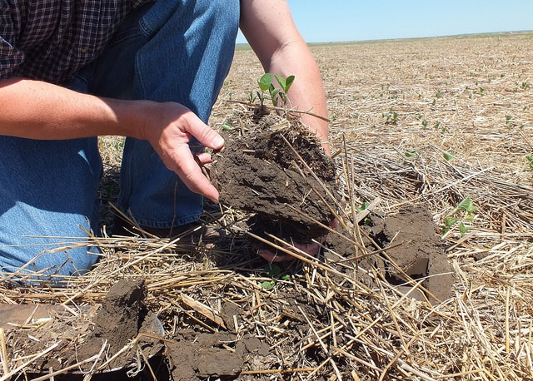
EO 14008: Biden/Harris Administration Climate Crisis Priorities
USDA is to develop recommendations for a climate-smart agriculture and forestry (CSAF) strategy.
Decrease wildfire risk fueled by climate change
Source sustainable bioproducts and fuels
Conservation actions that
Provide measurable carbon reduction
Sequester carbon
Notes:
An image showing a soil sample being collected.

Slide 6
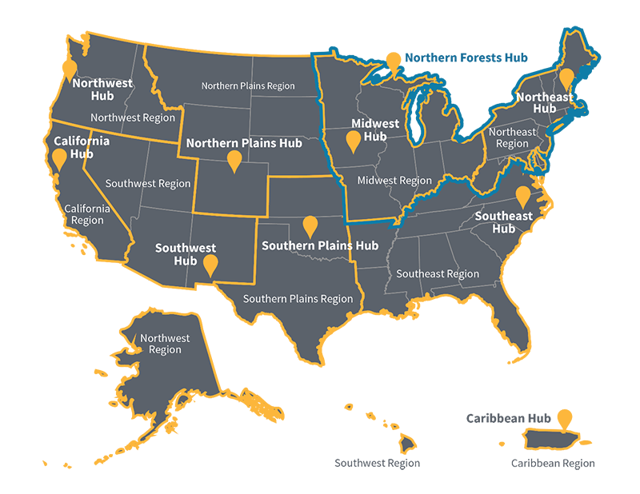
EO 14008: Biden/Harris Administration Climate Crisis Priorities
The USDA Climate Hubs play a central role:
Strengthen education, training, and technical assistance for CSAF practices.
Lower barriers and increase the rate of adoption of CSAF practices
Facilitate collaborations to develop necessary innovation or curate tools and technologies to moderate stressors.
Bring “lessons-learned” back to USDA to complete a cycle of learning, enhancing resilience, and improving productivity.
Notes:
Images include logos for USDA ARS and the Forest Service. A map showing locations for the 10 USDA climate hubs is included.

Slide 7
USDA Strategic Plan: FY 2022 - 2026:
Strategic Goals:
Combat climate change to support America’s working lands, natural resources, and communities
1.1 Use Climate-Smart Management and Sound Science to Enhance the Health and Productivity of Agricultural Lands
1.2 Lead Efforts to Adapt to the Consequences of Climate Change in Agriculture and Forestry
1.3 Restore, Protect, and Conserve Watersheds to Ensure Clean, Abundant, and Continuous Provision of Water Resources
1.4 Increase Carbon Sequestration, Reduce Greenhouse Gas Emissions and Create Economic Opportunities (and Develop Low-Carbon Energy Solutions)

Slide 8
NIFA Funding Opportunities:
AFRI Foundational and Applied Science Program
Executive Summary, page 4
. . .climate change, nutrition security, markets, indigenous traditional ecological knowledge, equity for underserved producers. . .
Background, page 13
. . .adaptation and mitigation . . .
https://www.nifa.usda.gov/afri-request-applications

Slide 9
NIFA AFRI Funding Opportunities:
AFRI Foundational and Applied Science Program:
Plant Health and Production and Plant Products $66 million
Animal Health and Production and Animal Products $55 million
Food Safety, Nutrition, and Health $39 million
Bioenergy, Natural Resources, and Environment $33 million
Agriculture Systems and Technology $29 million
Agriculture Economics and Rural Communities $34 million

Slide 10
NIFA AFRI Funding Opportunities:
Plant Health and Production and Plant Products ~ $66 million
A1102 – Foundational Knowledge of Agricultural Production Systems
A1112 – Pests and Beneficial Species in Agric Production Systems
A1152 – Physiology of Agricultural Plants
A1141 – Plant Breeding for Agricultural Production
A1113 – Pollinator Health: Research and Applications
A1143 – Conventional Plant Breeding for Cultivar Development

Slide 11
NIFA AFRI Funding Opportunities:
Animal Health and Production and Animal Products ~ $55 million
A1211 – Animal Reproduction
A1231 – Animal Nutrition, Growth, and Lactation (methane)
A1221 – Diseases of Agricultural Animals
A1201 – Animal Breeding, Genetics, and Genomics (enteric methane)

Slide 12
NIFA AFRI Funding Opportunities:
Food Safety, Nutrition, and Health ~ $39 million
A1344 – Diet, Nutrition, and the Prevention of Chronic Diseases

Slide 13
NIFA AFRI Funding Opportunities:
Bioenergy, Natural Resources, and Environment ~ $33 million
A1401 – Soil Health (includes Signals in the Soil)
A1411 – Water Quantity and Quality
A1414 – Sustainable Bioeconomy through Biobased Products
A1451 – Sustainable Agroecosystems: Health, Functions, Processes and Management

Slide 14
NIFA AFRI Funding Opportunities:
Agriculture Systems and Technology ~ $29 million
A1521 – Engineering for Agricultural Production and Processing
A1531 – Biorefining and Biomanufacturing
A1551 – Engineering for Precision Crop and Water Management
A7303 – AI Institutes (collaboration with NSF)

Slide 15
NIFA AFRI Funding Opportunities:
Agriculture Economics and Rural Communities ~ $34 million
A1601 – Small and Medium-Sized Farms
A1642 – Social Implications of Food and Agricultural Technologies
A1651 – Environmental and Natural Resource Economics

Slide 16
NIFA AFRI Funding Opportunities:
Crosscutting Programs ~ $42 million
A1402 – Agric. Microbiomes in Plant Systems and Natural Resources
A1701 – Critical Agricultural Research and Extension (CARE)
A1541 – Data Science for Food and Agricultural Systems (DSFAS)
A1261 – Inter-Disciplinary Engagement in Animal Systems (IDEAS)
A1181 – Agricultural Biosecurity
A1721 – Extension, Education and USDA Climate Hubs Partnerships
CAP for Climate Smart Extension
A1811 – AFRI Commodity Board Co-funding Topics
A1712 – Rapid Response to Extreme Weather Events Across Food and Agric. Systems
A1556 – Regional Innovation and Demonstration of Climate-Smart Agric. for Future Farms

Slide 17
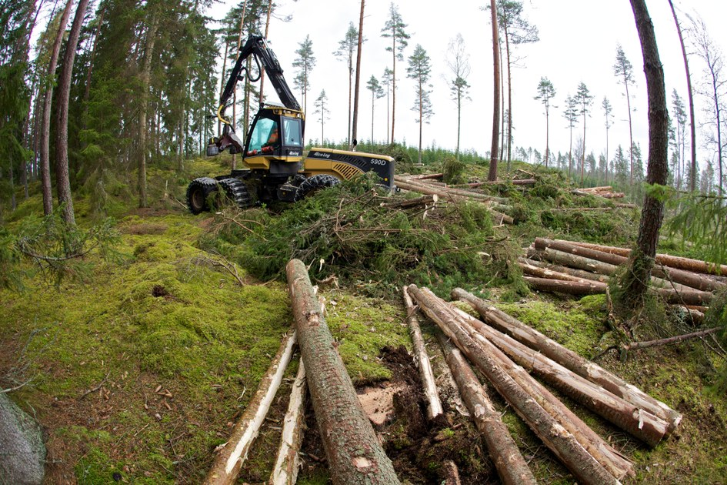
NIFA AFRI Funding Opportunities:
A9201 AFRI Sustainable Agriculture Systems - $70 million
1. Climate-Smart Agriculture and Forestry
GHG Mitigation
Markets and Socio-economies
Regionally Appropriate Climate Adaptation and Resilience
Notes:
An image is included of a forest management operation.

Slide 18
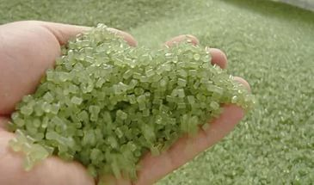
NIFA AFRI Funding Opportunities:
A9201 AFRI Sustainable Agriculture Systems Program
2. Strengthening the Bioeconomy
Sustainable bioenergy and biobased products
Resilience and robustness of food and agricultural systems
Potential sustainability impacts (modeling, AI, etc.)
Notes:
An image is included showing a handful of bioplastic resin.

Slide 19
NIFA AFRI Funding Opportunities:
A9201 AFRI Sustainable Agriculture Systems Program
3. Food and Nutrition Security
Local and regional food systems
Nutrition-sensitive climate-smart agriculture
Nutrition security and diet-related health disparities
Notes:
An image is included showing a variety of healthy foods, such as salmon filets, avocado, nuts, berries, broccoli, and fruit.

Slide 20
NIFA AFRI Funding Opportunities:
AFRI Education and Workforce Development - $68 million
A7101 Predoctoral Fellowships
A7201 Postdoctoral Fellowships
A7703 Special Topics: Youth Innovators Empowering Agriculture Across America (YEA)
Notes:
An image is included showing two students working at a computer.

Slide 21
Examples of Other Support for Climate Change
Sustainable Agriculture Research and Education (SARE)
Beginning Farmer & Rancher Development Program (BFRDP)
Sun Grant Program
Crop Protection and Pest Management (CPPM)
Bioproduct Pilot Program (BPP)
Capacity Funds
Hatch and Hatch multi-state
Evans-Allen
Agricultural Extension Programs at 1890 Institutions
McIntire-Stennis
Smith-Lever
RREA
Notes:
An image is included showing two students working at a computer.

Slide 22
Additional Climate Priorities
Sustainable Aviation Fuels (SAF) Grand Challenge
Feedstock development
Optimization of SAF production from oilseed crops
Expanding the near-term availability of fats, oils, and greases (FOG) including oilseed crops
Sustainable crop and forest management at scale (climate smart agriculture & forestry)
Post-harvest supply chain logistics (transportation, storage, preprocessing)
Regional supply chain integration, optimization, and decarbonization
Sustainability analysis (environmental, economic, social)
SAF co-product development
Extension/outreach/tech transfer
Workforce development
Notes:
An image is included showing researchers in a field of mustard.

Slide 23
Additional Climate Priorities
Environmental Justice
Executive Order 14008: Tackling the Climate Crisis at Home and Abroad
Defines Justice40: 40 percent of benefits from covered programs should be directed to disadvantaged communities

Slide 24
Justice40
Covered Priority Areas:
climate change
clean energy and energy efficiency
clean transportation
affordable and sustainable housing
training and workforce development (related to topics of other covered programs)
remediation and reduction of legacy pollution
critical clean water and waste infrastructure
Underserved Communities:
Historically marginalized and/or overburdened by pollution and underinvestment in housing, transportation, water and wastewater infrastructure, and healthcare

Slide 25
Justice40
NIFA Covered Programs
Hispanic-Serving Institutions Education Grants Program
Alaska Native-Serving and Native Hawaiian-Serving Institutions Education Competitive Grants Program
Insular Programs (DEG, RIIA, and AGEI)
Tribal College Research Grant Program
Tribal College Extension Grant Program
Tribal College Equity Grant Program
Federally Recognized Tribes Extension Program
New Beginning for Tribal Students
Scholarships at 1890 Institutions
1890 Facilities Grants Program
Centers of Excellence at 1890 Institutions
1890 Institution Teaching, Research and Extension Capacity Building Grants (CBG) Program
Agriculture Research at 1890 Land-Grant Institutions (Evans-Allen)
Agricultural Extension Programs at 1890 Institutions

Slide 26
Justice40
Actions Underway
Assessment of statutory language for the covered programs
Added language to RFAs
Outreach with stakeholders and partners to identify and prioritize current topics and priority concerns of tribal, national or multistate significance.
Promoting awareness of Justice40 activities and implementation among NIFA’s stakeholders and partners.
Highlight impacts for environmental justice from throughout NIFA
Determination of OMB reporting requirements
Collaborations with other USDA and USG agencies to identify data and methods for tracking investments and benefits.
Notes:
An image is included showing a young man overlooking coastal islands.

Slide 27
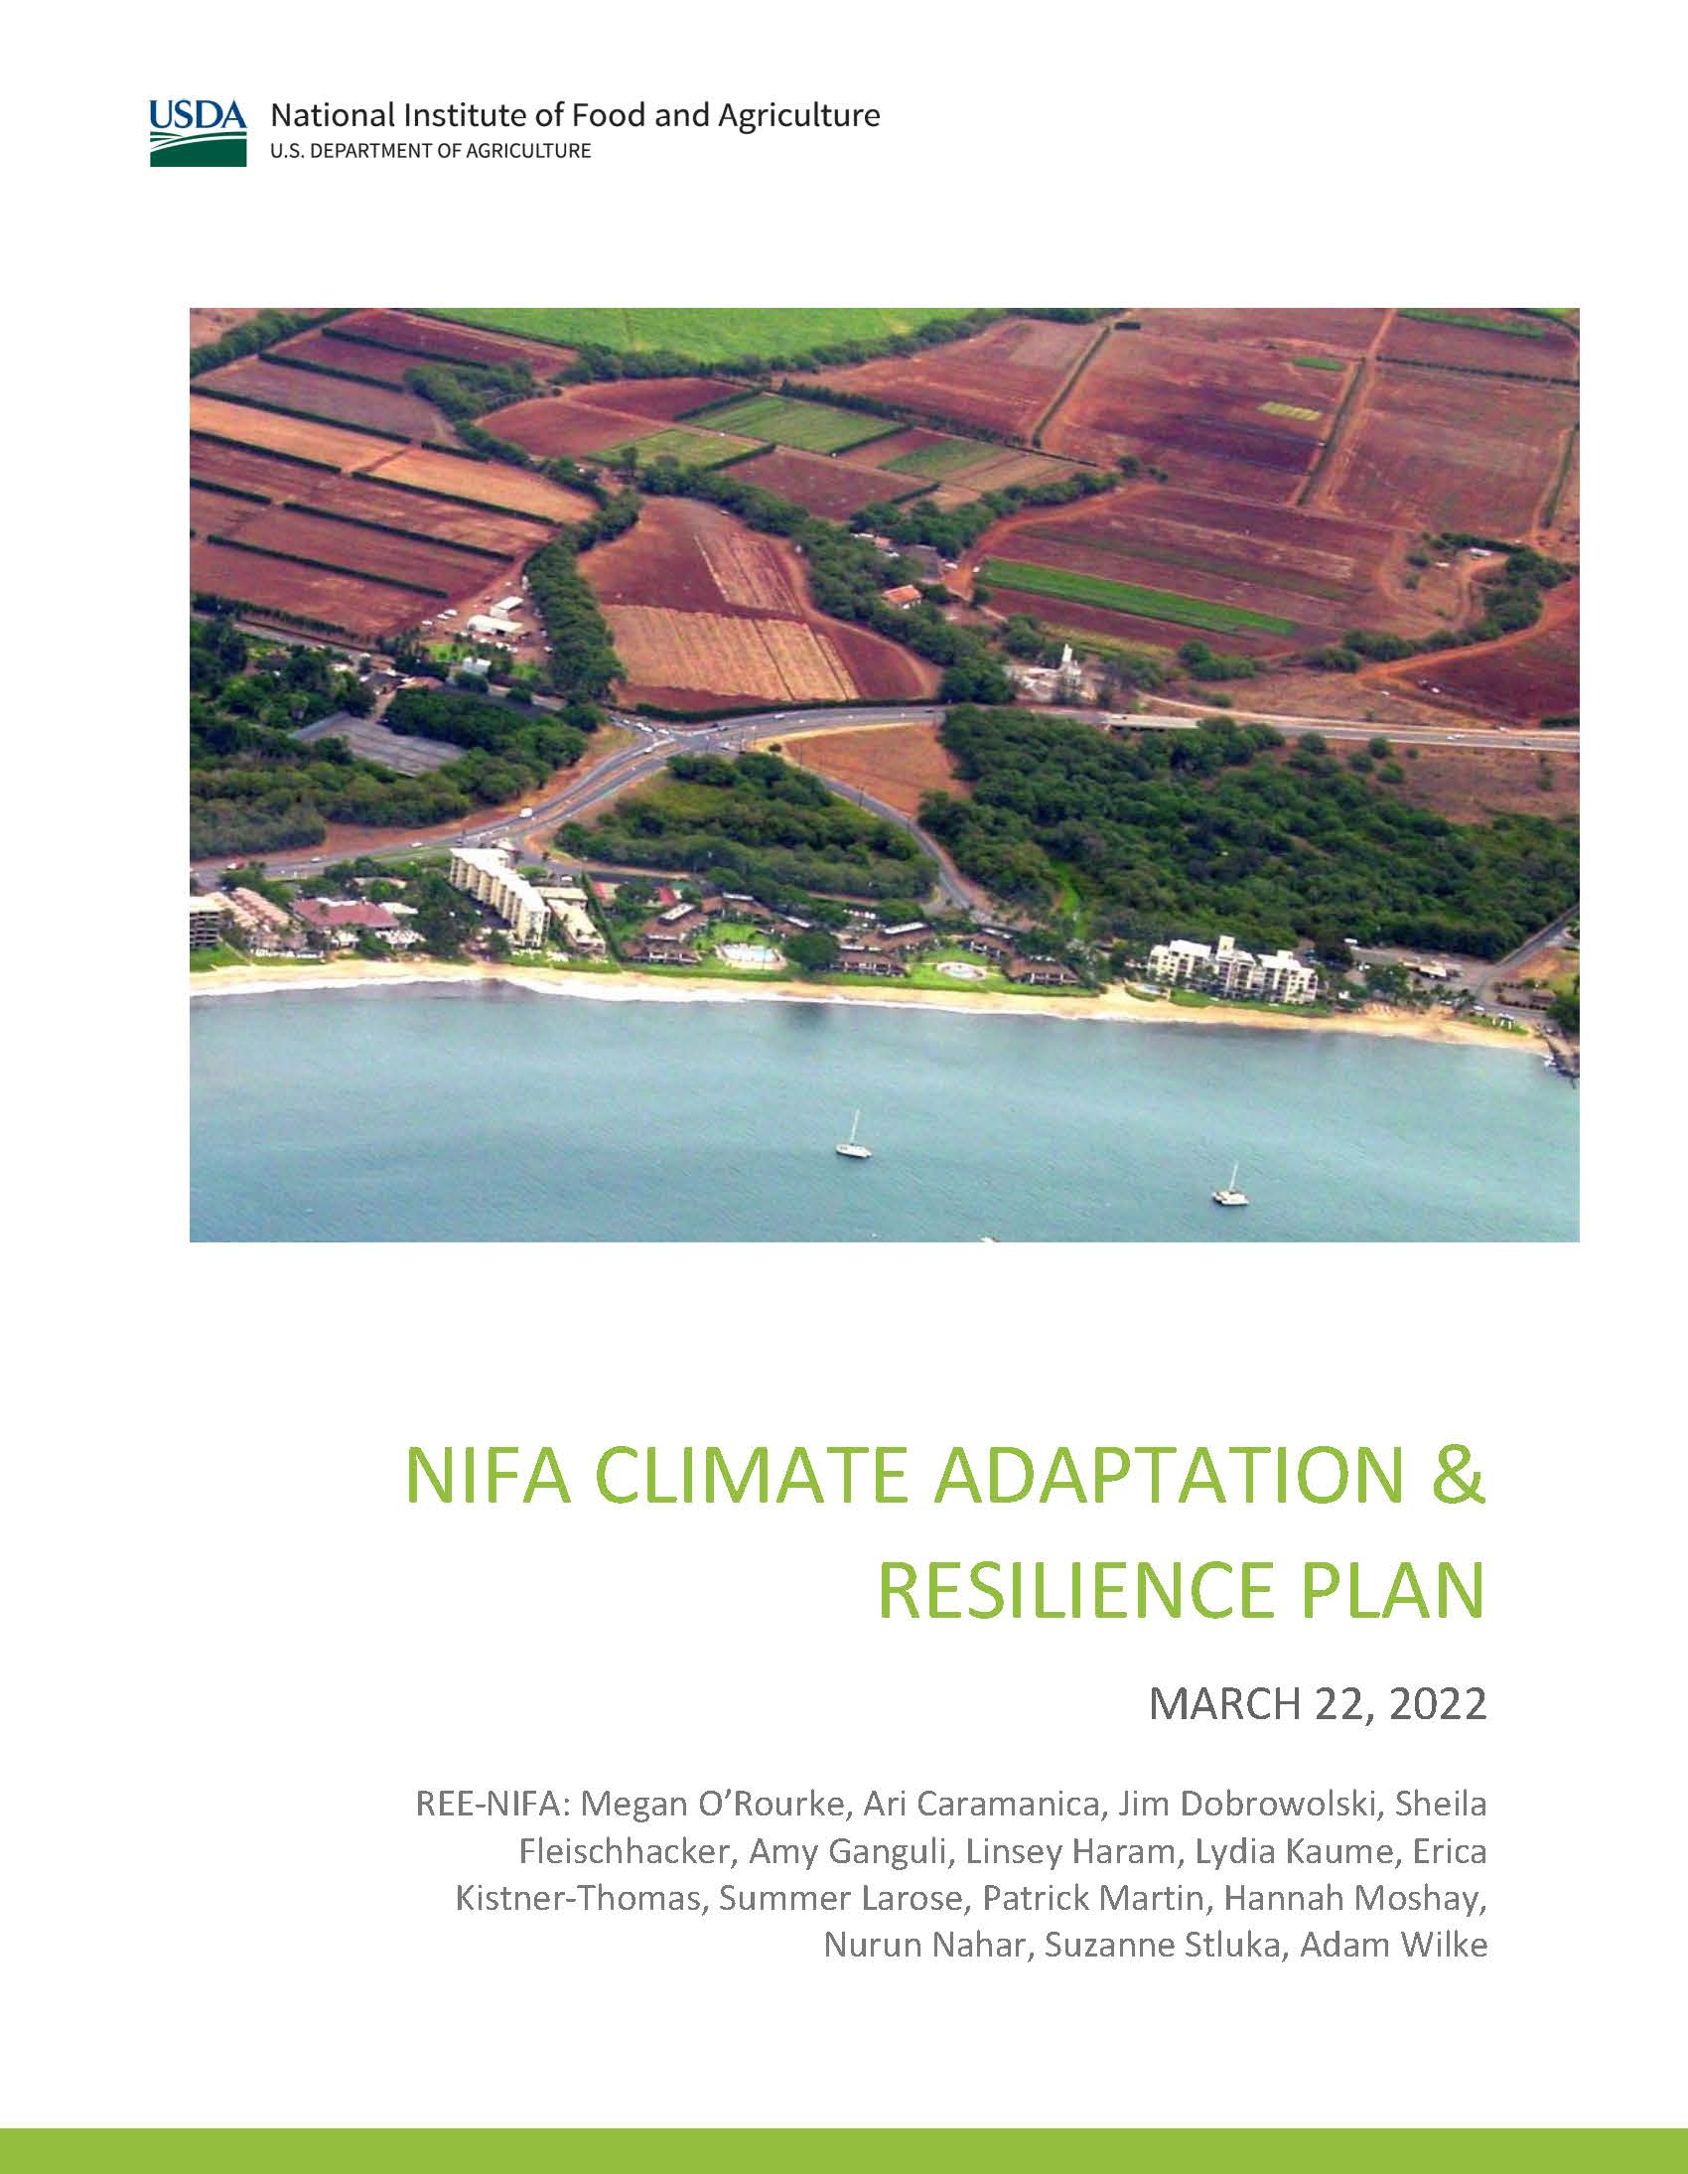
NIFA Climate Adaptation Plan
KEY CLIMATE CHANGE VULNERABILITIES
Water Quality and Quantity
Agroecosystem Productivity and Sustainability
Food and Nutrition Security
Resilience To Extreme and Variable Weather Events
Education Pipeline
Continuity of Operations

Slide 28
Agriculture Innovation Mission for Climate Website: www.AIMforClimate.org Twitter: @AIMforClimate To increase and accelerate agriculture and food systems innovation in support of climate action. Innovation = research, development, demonstration, deployment
Notes:
A background image showing wheat spikes.

Slide 29
OBJECTIVES
Increase investment
Demonstrate collective commitment to significantly increase investment in agriculture innovation for climate-smart agriculture and food systems by its participants over 5 years (2021-2025).
Enable Coordination and Collaboration
Support frameworks and structures to enable technical discussions and the promotion of expertise, knowledge, and priorities across international and national levels of innovation to amplify the impact of participants’ investments.
Increase Cooperation
Establish appropriate structures for exchanges between Ministers and chief scientists, and other appropriate stakeholders, as key focal points and champions for cooperation on climate-related agricultural innovation, to engender greater co-creation and cooperation on shared research priorities between countries.

Slide 30
Climate Summit
A response to NIFA stakeholders
A Summit is a Dialog. A discussion among partners
Establish community knowledge and identify strengths
Develop a long-term Roadmap
Autumn 2022
Notes:
An image is included showing a random word cloud with the words ExperimentStations, 1994TribalColleges, ARS, REE, 1890Institutions, APLU, HispanicServingInstitutions, 1862AcademicPrograms, ExtensionService, NonLandGrant, and NIFA

Slide 31
Climate Summit - Issues
Calculating measurement – how do we measure carbon sequestration and GHG reductions?
What are the climate-smart value propositions for farmers?
What are the barriers to sharing data derived from federal-sponsored research?
Connecting NIFA partners with ARS, ERS, NASS, Forest Service R&D, NRCS, OCE and other agencies.
How do we foster collaborations with the private sector?

Slide 32
We Look Forward
To The Work Ahead
Contact:
Kevin Kephart
Deputy Director, IBCE
Kevin.Kephart@USDA.GOV
Notes:
An image is included showing a farmer standing in a field of ripe small grains. Could be wheat or barley.

