Slide 1
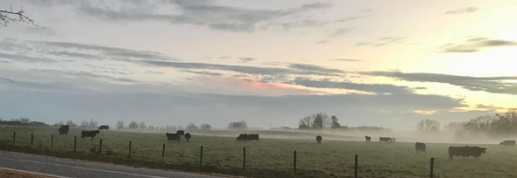

Climate variability and change:
Outlook, issues, and challenges to the Southern region
Pam Knox
University of Georgia Agricultural Climatologist

Slide 2
Overview
What is climate and how is it changing?
What climate do we expect in the future?
How does climate affect agriculture?
How does agriculture affect climate?
What actions do we need to take to address the changing climate?

Slide 3
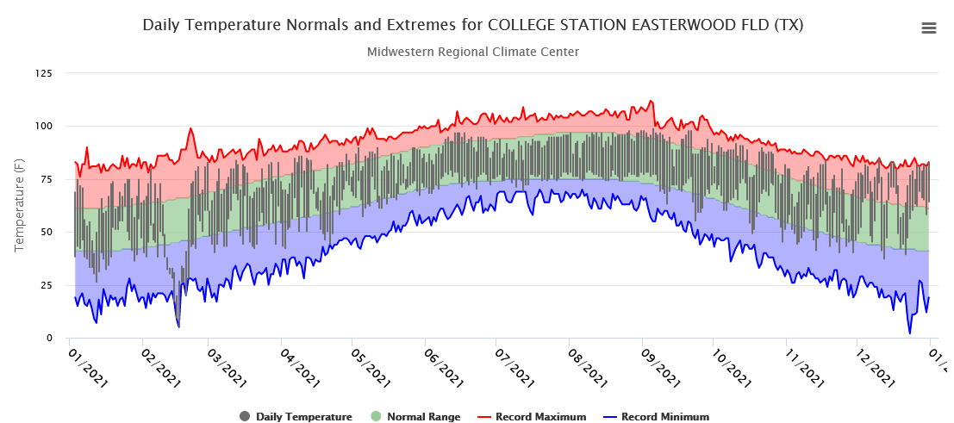
What is Climate?
Averages
Ranges
Extremes
Cycles
https://mrcc.purdue.edu/CLIMATE/

Slide 4
Texas Temperature Trend
https://www.ncdc.noaa.gov/cag/

Slide 5
Texas Temperature Trend
Variability from ENSO, volcanic activity, sudden stratospheric warming, internal ocean/atmosphere interactions
https://www.ncdc.noaa.gov/cag/

Slide 6
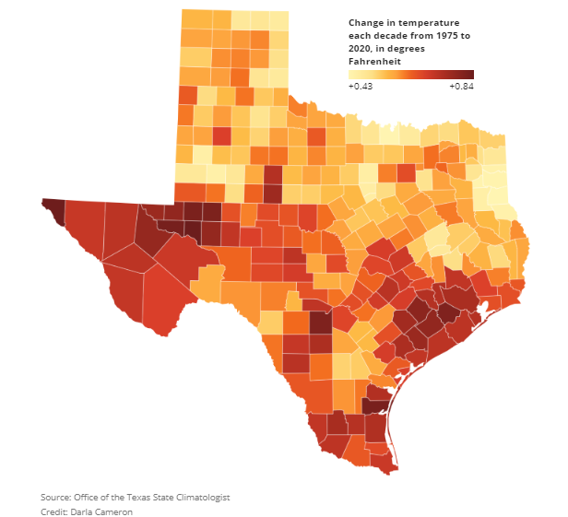
Texas Temperature Trend
All counties in Texas are getting warmer, not just the urban ones
Every couple of degrees of warming doubles the number of 100+ days

Slide 7
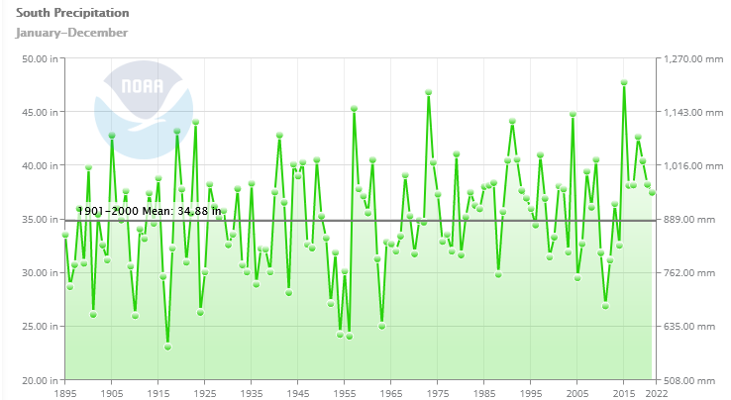
South Regional Precipitation Trend

Slide 8
What to expect in the future
Warmer temperatures, especially at night, will add to stress on livestock, outdoor workers, and some crops
More variable rainfall patterns—heavier rain with longer dry spells between events will lead to more floods and more droughts
Longer growing season (about one extra week for every 1 F of increase)

Slide 9
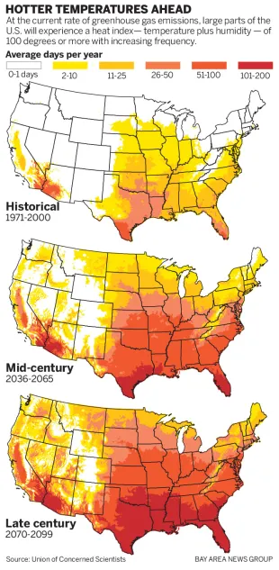
How does a changing climate affect agriculture?
Increased temperature lengthens growing season for plants and pests
Higher temperatures increase heat stress on livestock and outdoor workers
Higher temperatures increase evaporation, resulting in increased water stress and more active water cycle

Slide 10
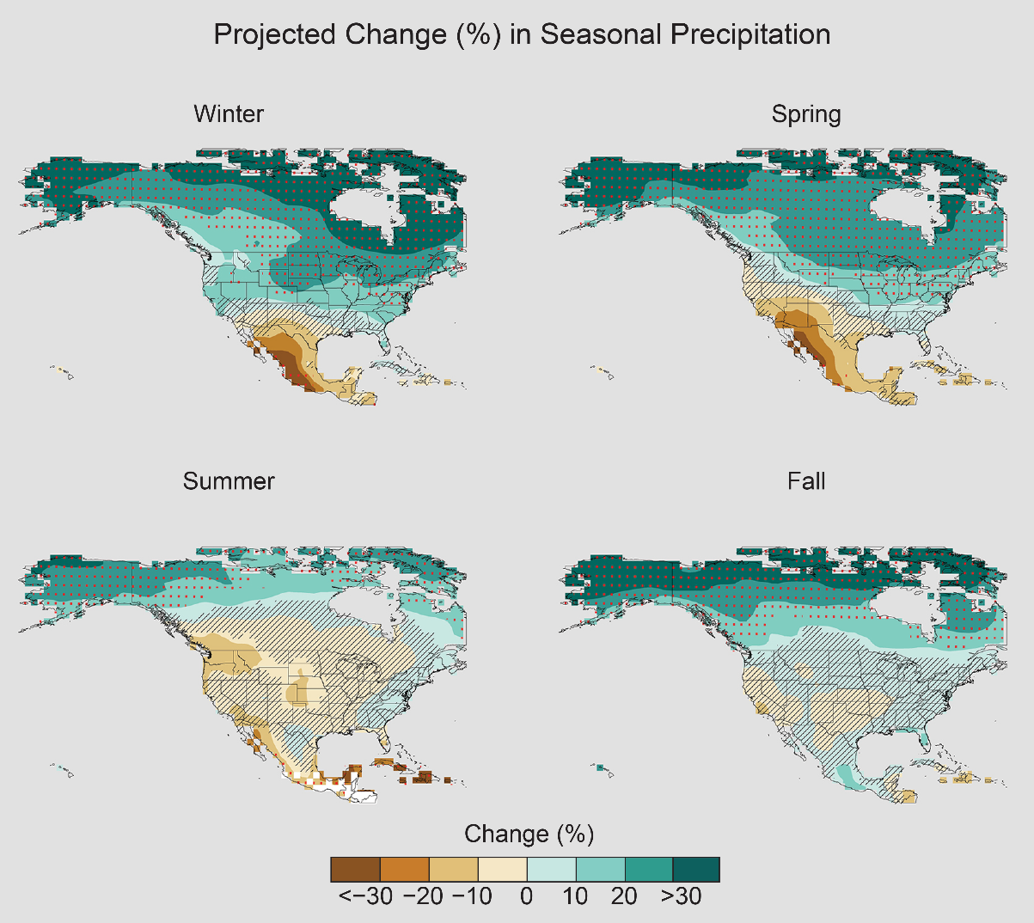
How does a changing climate affect agriculture?
More droughts and more floods
Higher CO2 slightly increases plant growth IF there are enough nutrients and water available
Production areas will change since climate change is global and other areas may see worse impacts than we do

Slide 11
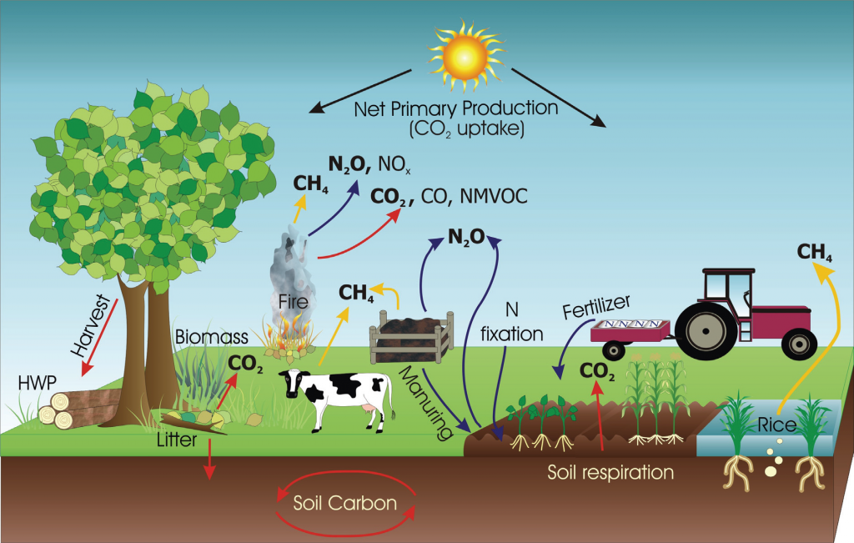
How does agriculture affect climate?
Emission of gases
Changes in land use
Runoff and erosion
Overproduction
Soil health
Agriculture produces about 11 percent of all greenhouse emissions (up to 24 % if include forestry and land use impacts)

Slide 12
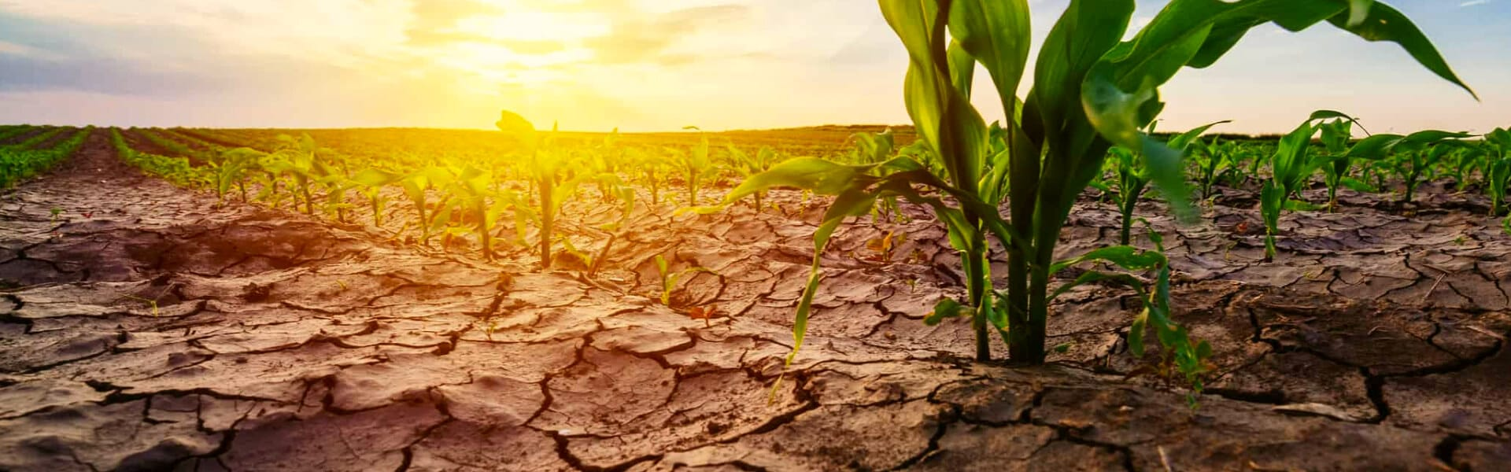
How does agriculture affect climate?
Clearing of land and draining of wetlands releases carbon dioxide and methane
Intensive crop production increases local humidity, increases demands for irrigation, increases erosion, increases use of fuel

Slide 13
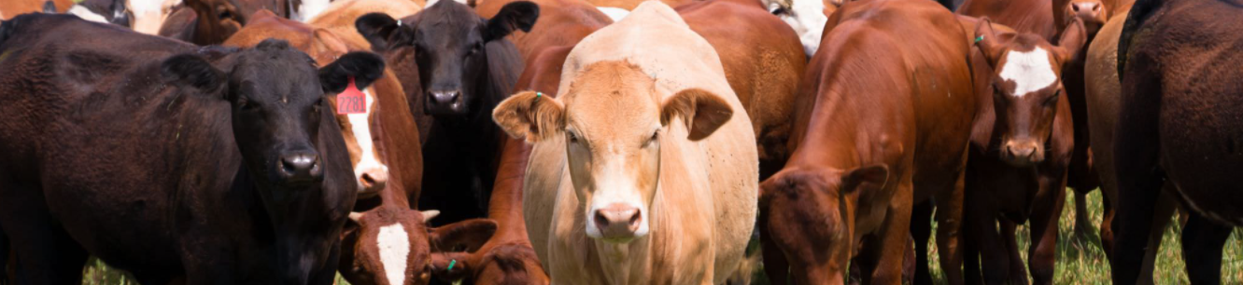
How does agriculture affect climate?
Increased use of fertilizers releases NO2 to air and water
Livestock production releases methane
Intensive production can dry out soils, increasing pollution and decreasing water-holding capacity

Slide 14
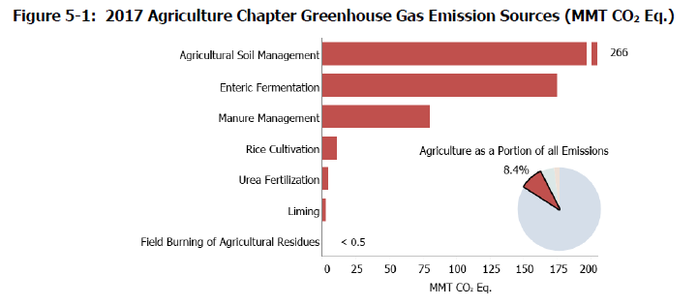
How does agriculture affect climate?
Emission of greenhouse gases like carbon dioxide, methane, nitrous oxide
Change in land use affects albedo, soil moisture, local climate
Runoff of fertilizers affects stream health and contributes to Gulf of Mexico dead zones
Overproduction leads to increased food waste, which increases methane emission

Slide 15
What actions do we need to do to address climate change?
Crop production—reduce use of water and chemicals by use of cover crops, smart irrigation, and precision agriculture
Reduce use of fuel for production and transportation of agricultural products
Carbon sequestration can capture some carbon in forests, land

Slide 16
What actions do we need to do to address climate change?
Switch to new hybrids or new crops to take advantage of the changes in climate where you are
Reduce production of methane by less clearing of land, changing animal diets, waste digesters
Reduce food waste at all stages of production and use

Slide 17
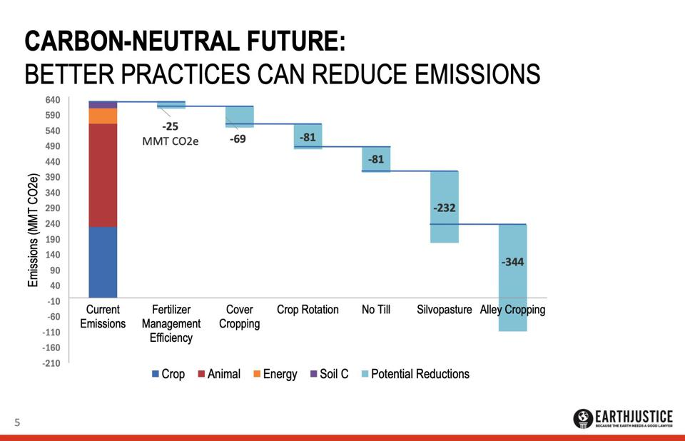
What actions do we need to do to address climate change?

Slide 18
Summary
Farmers will always be concerned about this year and next year’s crops, but long-term production modifications that reduce greenhouse gas emissions can also provide economic benefit to producers now as well as in the future as they deal with the impacts of a warmer and more variable climate in the future.
Extension can and must play a critical role in dealing with both current conditions and preparing for the future climate and its challenges.

Slide 19
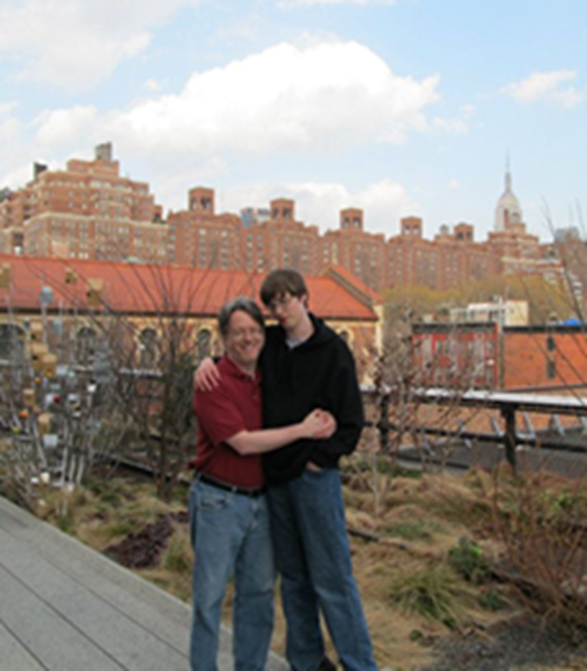



Thank You!
Pam Knox
pknox@uga.edu
706-542-7186 office
706-621-1970 cell
https://site.extension.uga.edu/climate
SEAgClimate
@SE_AgClimate

