Slide 1
Strategies for Crop Adaptation to Climate Change in the Southern Region
Dr. Rebecca L. McCulley,
Dept. of Plant & Soil Sciences

Slide 2
Overview:
Identify general approaches to Cropping System Adaptation within the context of the future expectations for our region
Examine a specific example from Central Kentucky Pastures

Slide 3
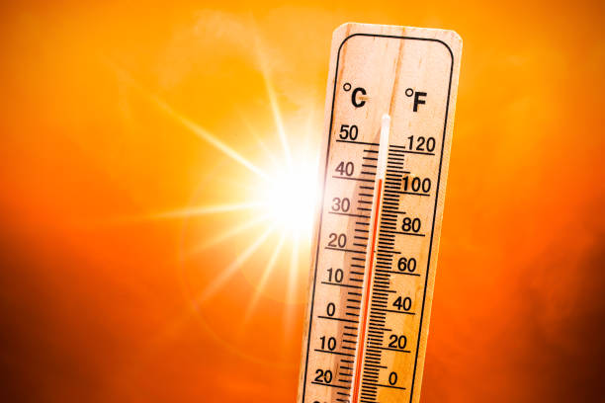
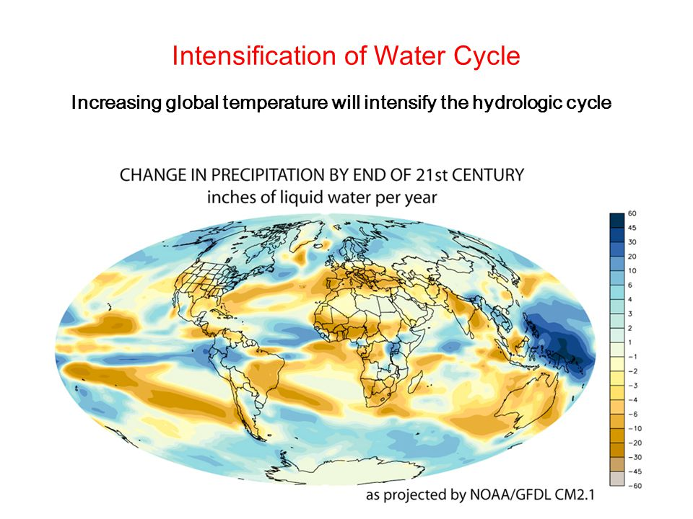
Future Climate Expectations:
Warmer temperatures, especially at night
Intensification of hydrologic cycles – more drought, more floods

Slide 4
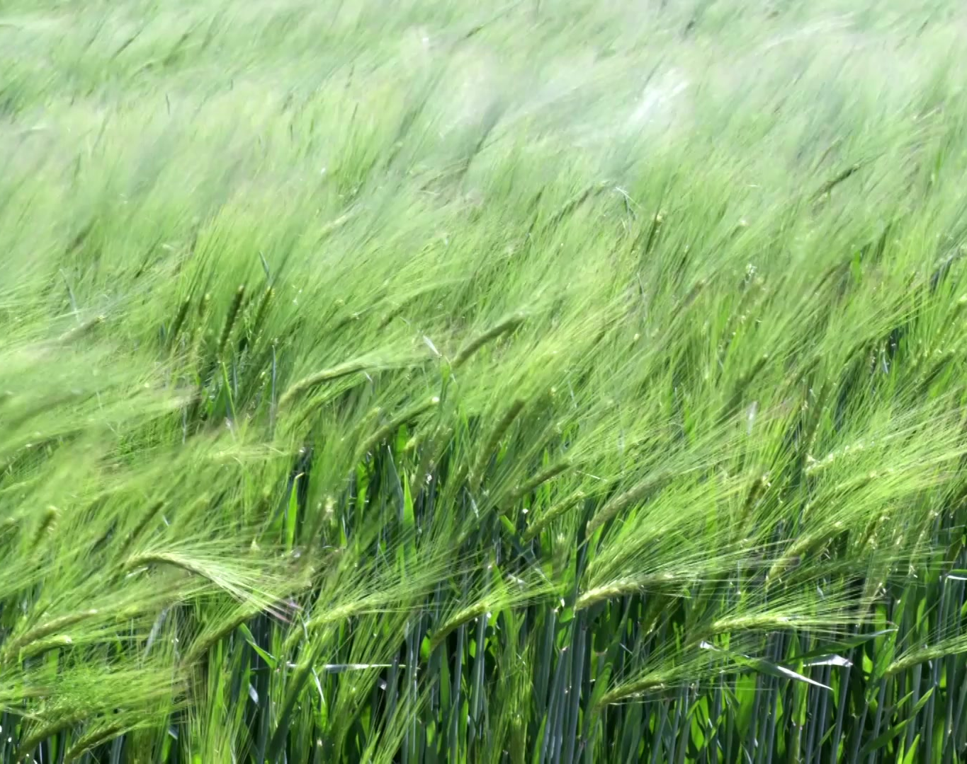
Implications for Cropping Systems:
Extension of growing season
Increased water stress
Increased pest stress
Problems with seed set
Increased rates of plant development – could increase susceptibility to freezes, etc.

Slide 5
Cropping System Adaptations:
Adopt new crops or additional rotations
Adjust planting dates to take advantage of new conditions and/or avoid adverse conditions
Increase water availability & irrigation, where possible
Increase soil organic matter
Create new cultivars with enhanced pest and abiotic resistance
Employ biophysical and rotational approaches to pest issues
Explore alternative uses for traditional crops

Slide 6
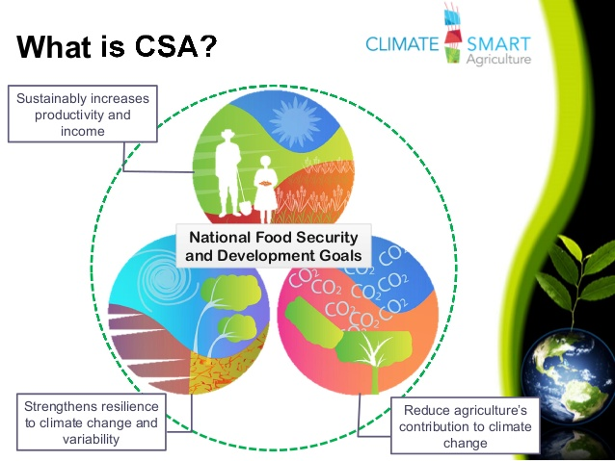
Importance of Climate-Smart Agriculture:
An approach developed to tackle food security and climate change challenges in a synergistic fashion.

Slide 7
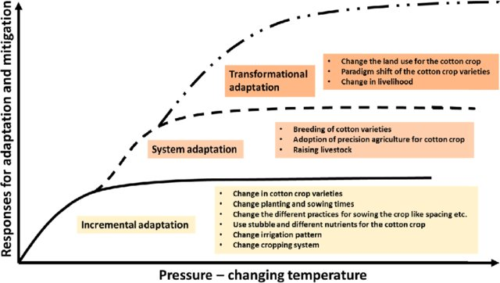
Cropping System Adaptations:
Sharma et al. 2021. Ecological Indicators.

Slide 8
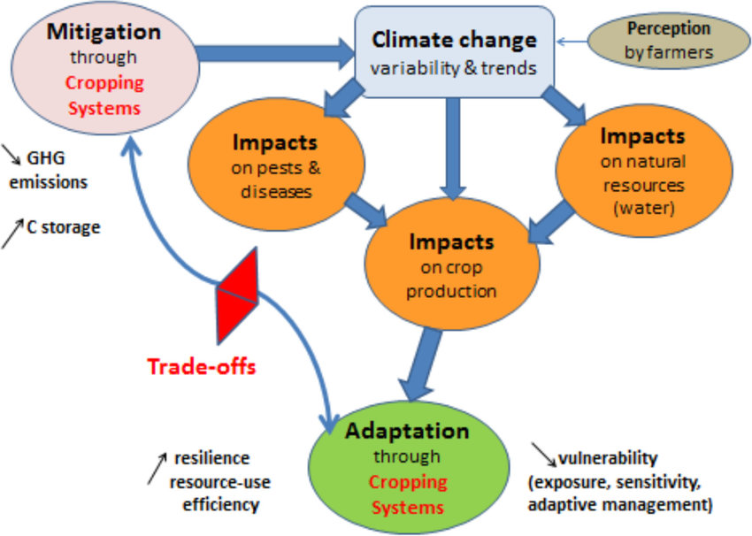
Achieving Adaptation & Mitigation:
Debaeke et al. 2017. Cahiers Agricultures.

Slide 9
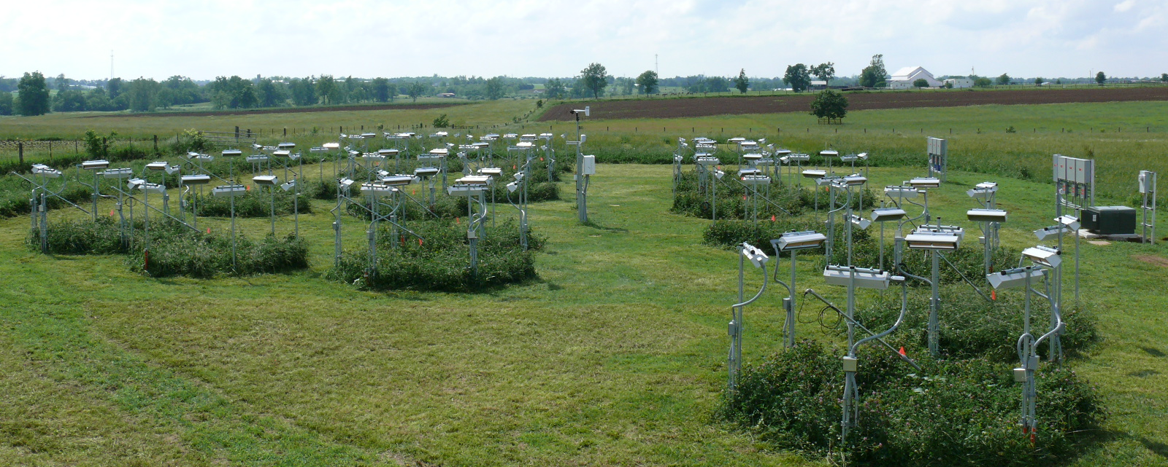
Climatic Resiliency of Central Kentucky Pastures

Slide 10
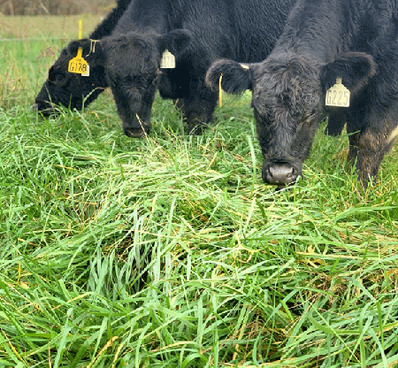
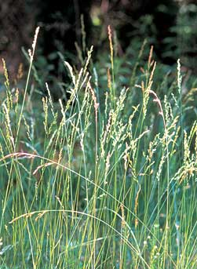
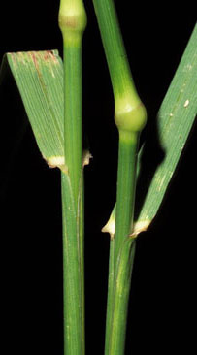
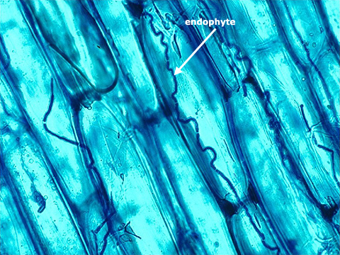
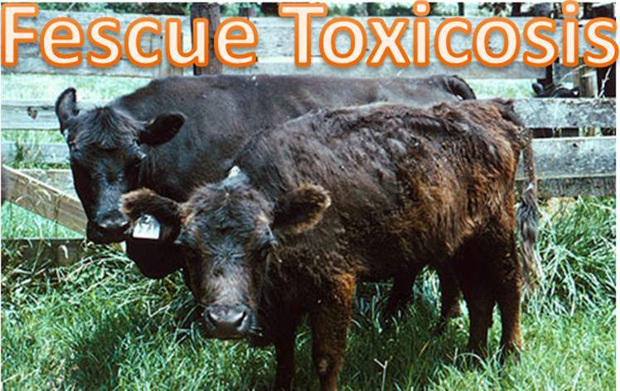
Current KY Pastures:
Dominated by cool season grasses
How will climate change impact KY pastures?

Slide 11
Hypothesized future warming in Central KY will:
Decrease forage production
Increase negative effects of fescue toxicosis on grazing animals
But region is also supposed to get wetter. Will more rainfall offset warming effects?

Slide 12
UK Forage Climate Change Study
N
+ 3 ^{O}C Day and Night
+ 30% Long-term Normal Precipitation
P
S
P
S
S
P
P
S
P
S
P
S
H4
P3
C3
HP2
C2
P4
S
P
S
P
P
S
S
P
S
P
P
S
C4
HP4
HP3
H3
H2
P2
Weather
Station
S
P
P
S
P
S
P
S
S
P
HP1
C5
H1
HP5
P1
S
P
S
P
S
P
P5
H5
C1
4 Treatments:
C- Ambient Control
H - Elevated Temperature (+3ºC)
P - Increased Precipitation (+30% long-term growing season ppt)
HP - Elevated Temp & Increased Ppt.
Data Logger Control
Trailer

Slide 13
Does warming decrease forage production?

Slide 14
How is forage production adaptation achieved?
Species composition changed.
More dominance of warm-season grasses, crabgrass and bermuda.

Slide 15
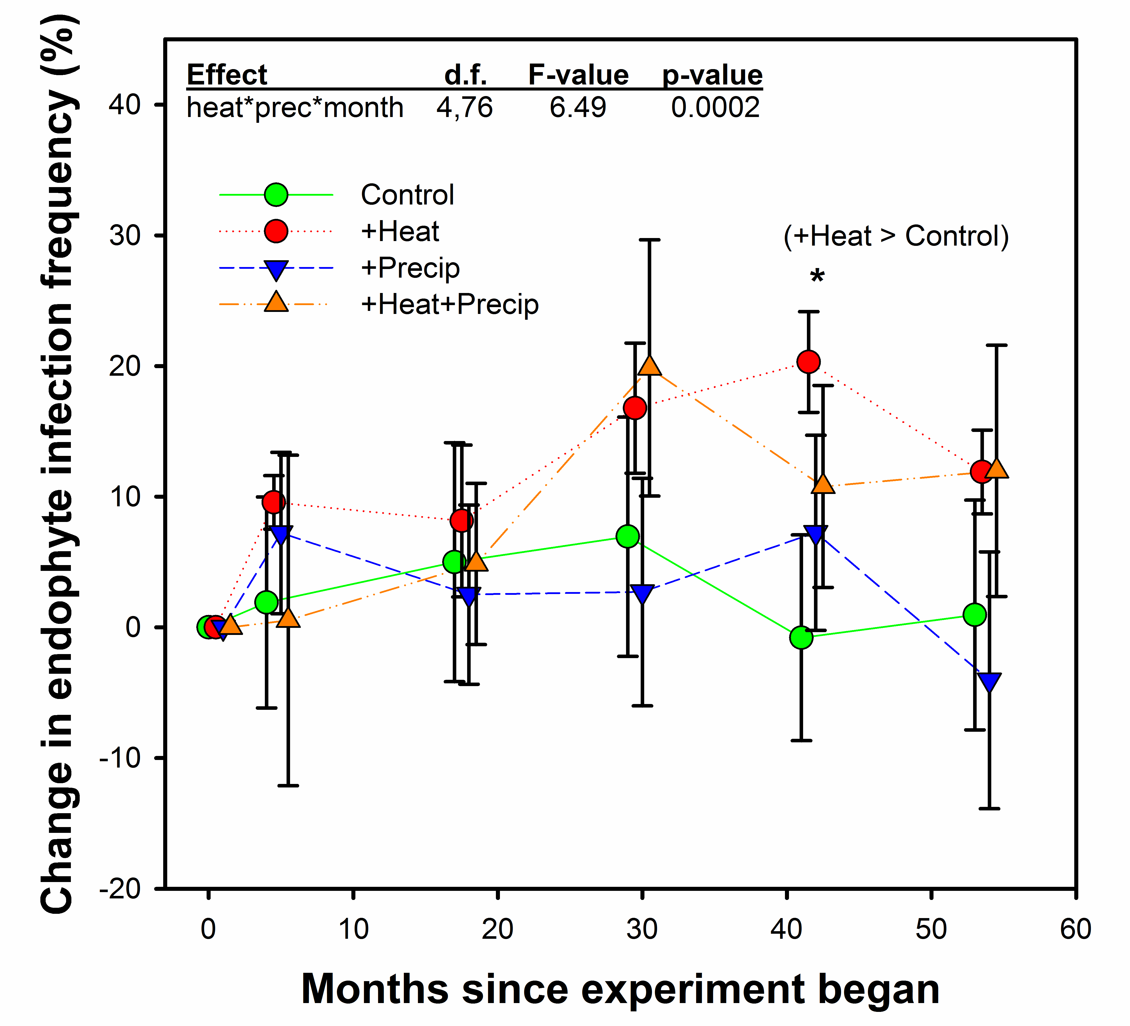
Does warming increase fescue toxicosis?
Warming stressed tall fescue and selected for endophyte infected plants.

Slide 16
Does warming increase fescue toxicosis?
Warming increased concentrations of the toxic alkaloids responsible for fescue toxicosis

Slide 17
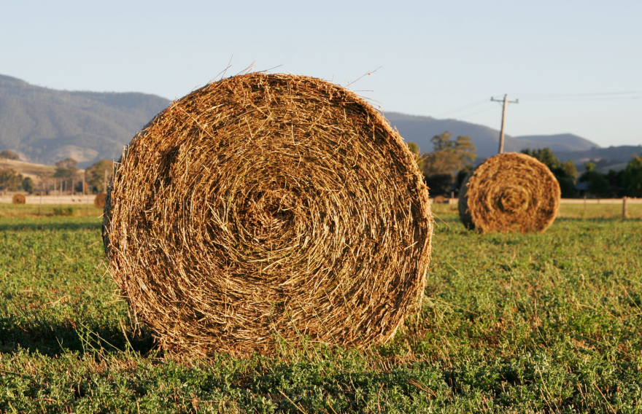

Conclusions:
Pastures in a warmer Kentucky will be more dominated by warm season grass species but will produce similar or greater quantities of forage to that of today.
However, increases in endophyte-associated toxic compounds suggests fescue toxicosis will intensify for animals grazing endophyte-infected tall fescue stands.

Slide 18

Cropping System Adaptations:
Adopt new crops or additional rotations
Adjust planting dates to take advantage of new conditions and/or avoid adverse conditions
Increase water availability & irrigation, where possible
Increase soil organic matter
Create new cultivars with enhanced pest and abiotic resistance
Employ biophysical and rotational approaches to pest issues
Explore alternative uses for traditional crops

Slide 19
Conclusions:
By adapting our management strategies, our cropping systems, and our genetics, we can achieve climate-smart agriculture.

Slide 20

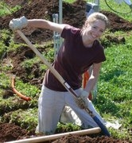
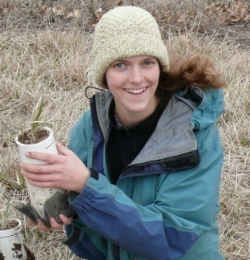
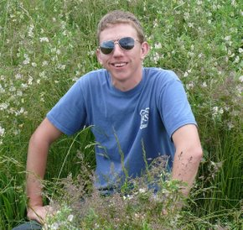

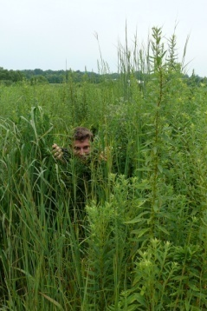
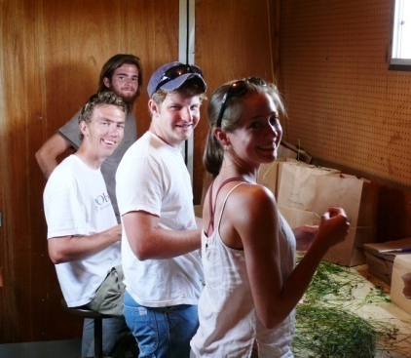

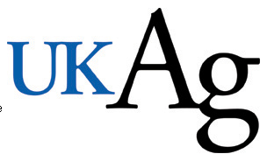



Acknowledgements:
Jim Nelson, Elizabeth Carlisle
Glade Brosi, Jacob Siegrist, Sarah Hall, Cody Burton, Lindsay Slaughter, Ben Leffew, Javed Iqbal, Marie Bourguignon, & Dan Weber
Rachel, Jarred, Brian, Payton, Alison, Amael, Alex, Sara, Luke, & Dan
Collaborators
Funding Sources

