Slide 1
A UTIA P&T Committee Perspective
Jun Lin, animal Science
Forbes Walker, BIOSYSTEMS Engineering & Soil science

Slide 2
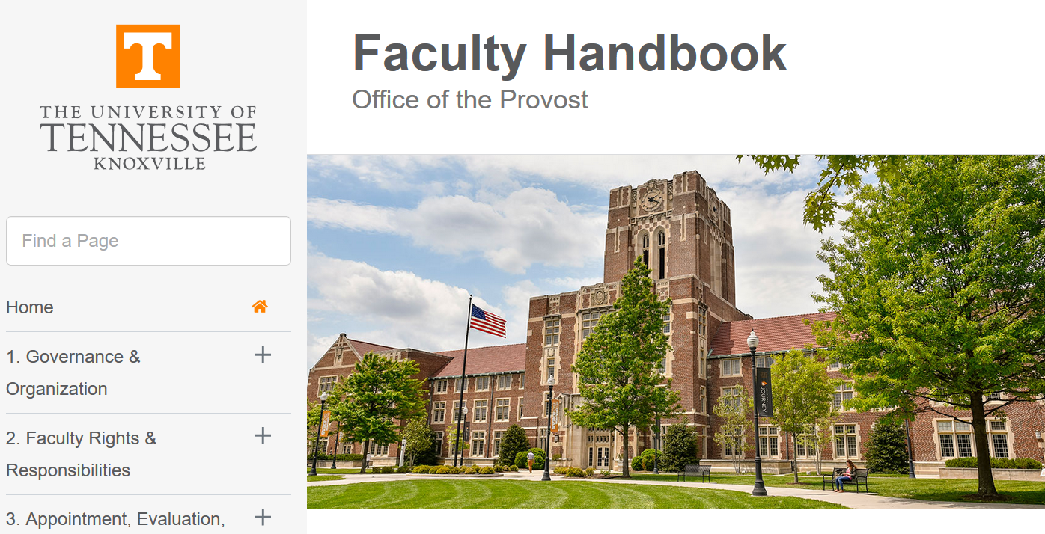
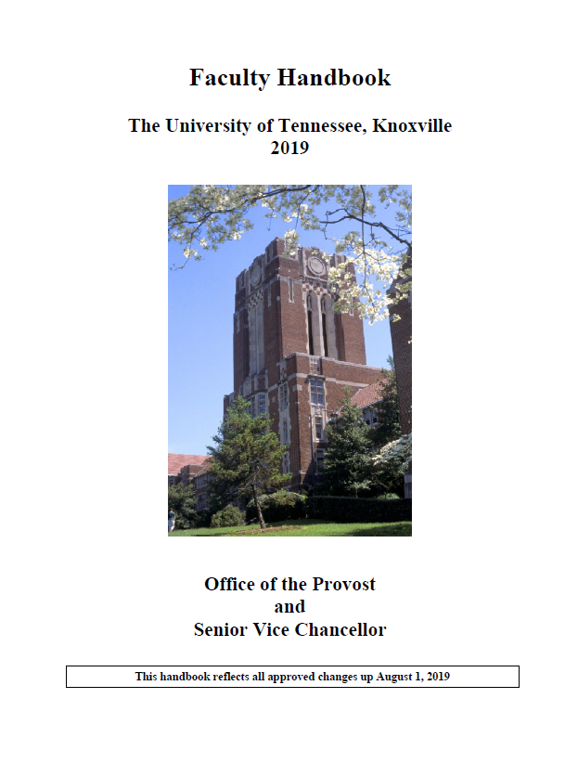
Tenure & Promotion…
Academic Milestone
Letter of appointment
Preparation is key!
Know-follow the “rules” and expectations
Faculty Handbook
Revised 2019
Office of Provost
P&T Workshop

Slide 3
Getting Better Informed of Expectations
Tenure & Promotion
Mentors-Advisors (Seek input)
Department Head-Annual Evaluation
Departmental Faculty Review Team
Mid-Cycle Review
Take feedback constructively

Slide 4
Dossier is Not an Autobiography…
Your “Pitch”
Highlights R/T/E accomplishments during evaluation period
Conveys potential for continued success & “fit” UTIA-Department

Slide 5
“Best” Guides for Composing a Successful Dossier
Dossiers of individuals recently promoted
UTIA Chancellor’s Library
Not for content…
Effective ways to convey YOUR unique accomplishments and contributions

Slide 6
Like Grant Writing… Compose Dossier for Your Reviewers
Real people… who want you to succeed!
Departmental Faculty
Department Heads
Deans
Chancellor

Slide 7
UTIA Promotion & Tenure Committee
We are real people too and want you to succeed!
9 Professors
Tenured
3 year term
Appointment | Department
95% Research/5%Teaching | Plant Sciences
100% Extension | EPP
88% Teaching/12% Extension | 4-H ALEC
85% Research/15% Teaching | Food Science
58% Research/42%Teaching | FWF
100% Extension | BESS
100% Extension | FCS
90% Research/10% Teaching | Animal Sciences
88% Research/12% Teaching | Ag & Res Econ
2019-2020

Slide 8
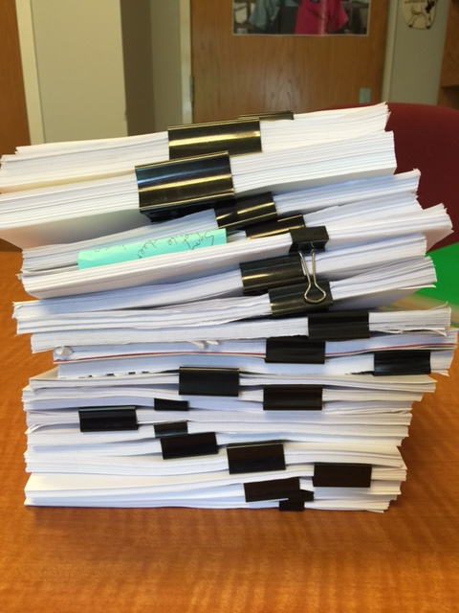
Compose Dossier for Your Reviewers
Be mindful of their challenges
Very little “extra” time
“Volunteered” to review several dossiers
Dossiers not available until mid-December
Christmas break up through beginning of spring semester☹
Early morning/late nights
UTIA P&T Committee Members
Many 200+ pages

Slide 9
UTIA P & T Committee
Member Review ‘Opportunities’
Dossier
Curriculum vitae
Supporting materials
Letters from external evaluators
Annual Retention Review Forms/Annual Review Forms/Mid-Cycle review?
Any/all other statements, reports, summaries and recommendations from peer committees and reviewers
Notes:
According to the Faculty Evaluation Handbook, the materials submitted must include: the dossier, the curriculum vitae, and
any supporting materials such as sample publications, videos, recordings, or other appropriate forms of documentation.
The dossier contains information similar to what is in your curriculum vitae. It also contains the evaluative information such as peer evaluations of teaching and summaries of teaching evaluations.
The curriculum vitae is used to provide background for the department head’s request for external assessments.

Slide 10
UTIA P & T Committee Procedures
All reviews & plans to participate in the discussion of each candidate
Except for Departmental Member (RECUSED)
Primary reviewer
Secondary reviewer
Committee discussion using draft letter
Vote Promotion & Tenure
P/S reviewers and Chair revise draft letter
Chair sends revised letter to Committee (All except for recused)
Edits incorporated
Final letters are sent to Deans and copied to Department Heads, candidates & all P&T members
Notes:
Everyone on the committee takes their role seriously and reads every dossier. However, each member of the P&T committee is assigned as primary reviewer for at least one candidate. We try to make those assignments based on percentage of appointment in teaching, research, and extension because the committee member will be most familiar with the expectations of the appointment. It is the job of the primary reviewer to draft a letter of recommendation from the committee. The primary reviewer then shares contents of the letter and written materials submitted with the entire committee. A secondary reviewer also is assigned to each candidate. Like the primary reviewer, the secondary reviewer provides considerable attention to the candidate.
After discussions and comments from the committee (typically 30 to 45 minutes), each member of the committee votes using a written ballot to indicate yes, the candidate should be recommended for tenure and/or promotion. We vote on tenure and promotion separately. Votes are tallied and a record of votes is included in the letter of recommendation from the committee. The committee chair edits the letters written by primary and secondary reviewers with input from the entire committee. They are then distributed to the entire committee for comment. When the letters are finalized, they are sent to appropriate deans with copies to department chairs and the candidates.

Slide 11
Candidates Reviewed For 2019-2020
Assistant to Associate Professor
N=8 (plus 1 non-tenure track)
Associate to Professor
N=5
Professor
N=1 (vote for tenure)
Deadline of Feb 1st
Mid-Cycle Reviews
N=8
Deadline of April 12th

Slide 12
From Assistant to Associate
Associate professors are expected to:
Hold doctorate or other terminal degree, or equivalent training and experience
Be good teachers
Have achieved and maintained recognized record of disciplinary research/scholarship/creative active activity/engaged scholarships
Have achieved and maintain a record of institutional, disciplinary, and/or professional service or outreach engagement
Have normally served as an assistant professor for at least five years
Have demonstrated that they work well with colleagues and students
UTK Faculty
Handbook 2019
Notes:
We strictly adhere to the criteria for appointment to faculty rank as stated in the UTK Faculty Handbook.
The general scope of performance in a particular rank is consistent across the university. However, the requirements for you as an individual are defined by the department in which your appointment resides and is a function of your particular discipline. This is why you will not find specific information on how much peer-reviewed journal articles or grant dollars you must have to be promoted and tenured.
Associate professors are expected to…

Slide 13
From Associate to Professor
Professors are expected to:
Hold doctorate, etc.
Be accomplished teachers
Have achieved and maintain a nationally recognized record of disciplinary research/scholarship/creative activity/engaged scholarship
Have achieved and maintain a record of significant institutional, disciplinary and/or professional service
Serve as mentors to junior colleagues
Have normally served as associate professor for at least five years
Have shown beyond a doubt that they work well with colleagues and students in performing university responsibilities
UTK Faculty
Handbook 2019

Slide 14
Expectations for Tenure
Regular, full time, tenure-track faculty appointments at the academic rank of assistant, associate or full professor, are eligible-no less than 1 and no more than 7 academic years
Granted on the basis of a demonstrated record of achievement and the promise of continued excellence
Faculty at UTK are expected to become good, solid teachers who work enthusiastically with students, try new approaches to pedagogy, and contribute to the development of departmental programs. Faculty must also establish an independent record of accomplishment in scholarly work, normed to the standards of the discipline, which can be documented and validated by peers.
from UTK Faculty
Handbook 2019

Slide 15
Concept of Tenure & Reasons for its existence
The Development of Academic Freedom in the United States. 1952. Richard Hofstadter and Walter P. Metzger
Tenure system: to safeguard academic freedom, which is a requisite condition for all who teach and conduct research in higher education
Important for faculty to properly fulfill their core responsibilities
However, TENURE is not a guarantee of lifetime employment
However, no single person can exercise the authority to remove a tenured scholar
Notes:
Considerable confusion remains among the general public and many of our colleagues as to its meaning and the evaluation of performance for its achievement.
‘Adequate cause’, e,g, misconduct or incompetence

Slide 16
UTIA P&T Committee Teaching Tips
Work with your mentor(s) to craft teaching philosophy
Provide a detailed list of courses taught (number, title and course description and credit hours), frequency, participation level, class size, estimate of time spent
Engage in peer review
Show that you adopt suggestions
Incentivize students to participate in SAIS reviews
SAIS response rate is generally low
Present student evaluation summaries in an organized way
Notes:
The P&T committee must review your materials based on the Faculty Evaluation Handbook. However, we have a few tips to help you through the process.
Make sure to participate in regular peer teaching reviews and show that you adopt suggestions from the peer review
Work closely with your mentor in crafting a statement of teaching philosophy and implementation. This helps the reviewers know you and understand the lists of courses, workshops or in-service training you do and the impacts.

Slide 17
Teaching
Promotion & tenure progresses along a continuum
“Marathon versus Sprint”
Show promise
Be good
Be accomplished
Associate
Professor
Adapted from J. Burney
Notes:
Promotion and tenure progresses along a continuum. Think of it as a marathon rather than a sprint. We look for progress each year.

Slide 18
Teaching IS an Integral Component of Research
Research IS an Integral Component of Teaching
List of Graduate Students Mentored
Provide start-completion dates & thesis titles
Identify awards & research outcomes of each student
Publications, abstracts, etc.
List of Undergraduates Mentored
Identify awards & research outcomes of each student
Publications, abstracts, etc.
List of Research Publications
Identify graduate student & post doc authors

Slide 19
UTIA P&T Committee Research Tips
Show promise
Gaining external recognition
Achieved and maintain recognized record
Engaged scholarship
Achieved and maintain nationally recognized record
Engaged scholarship
Associate
Professor
Notes:
As an assistant professor, you need to show promise and gain external recognition. As an associate professor you have achieved and you maintain a recognized record of disciplinary research, scholarship, creative active activity and engaged scholarship. As a professor, recognition should be national.
Outreach research, scholarship and creative activity extends faculty endeavors to serve the public. According the faculty handbook, the best examples of outreach research and creative outreach activities are those that engage faculty in advancing knowledge through the pursuit of their scholarly interests while simultaneously addressing specified community problems and issues, thereby benefiting the scholar, the discipline, the university and society.”

Slide 20
Publication Tips to Strengthen Dossier
List and number publications, preferably newest to oldest
Clearly indicate your contribution (e.g., corresponding author, collaborator/coauthor, etc.) & your graduate students and postdocs
Include only articles that are published or in press (with documentation of final acceptance) under Articles published in Refereed Journals section.
Manuscripts in preparation or submitted or in preparation should be listed elsewhere
Don’t intermix publication types

Slide 21
Helpful Grant Tips to Strengthen Dossier
Include a summary table at the beginning of this section conveying total amount of funding, total amount of funding as Lead PI, and total funding awarded to your program
Per each grant listed, include title, PI and co-PIs, agency, start and end dates, total amount awarded, and how much funding went to your program.
Indicate
Your role and if you were the Lead PI or Co-PI
Grant specific cost-share
In-kind funding
Notes:
Indicating how much funding is coming to you or your department is not required. However, it strengthens your dossier.

Slide 22
Extension Based Tips
Occurs in many different venues
On and mostly off campus
Organize materials so it is easy to understand
What is your Extension program(s)
Who your audience is
How many you are reaching
What impacts you are making
Reviews and assessments from peers and participants
In-service training
Volunteer training
Different types of presentations
Different types of publications

Slide 23
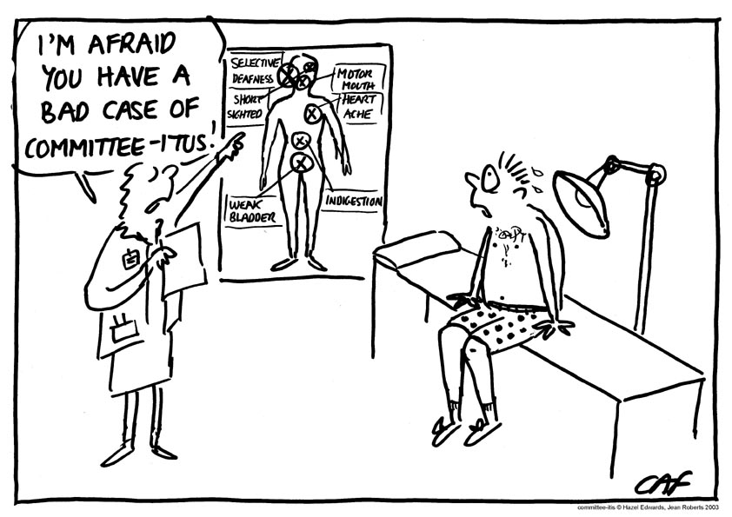
Institutional, Disciplinary, and/or Professional Service
Look for balance
Not too much as to affect T/R/E responsibilities
Service/Responsibility
Mentoring Junior Faculty-Promotion to Professor

Slide 24
Additional Tips to Strengthen Dossier
Dossier is the only material most will have for getting to know you
Make it EASY to read
Clearly designate or include only your scholarship record from your last promotion, and/or your start date
Include these dates
Make sure they are correct & consistently presented
Statement of Responsibilities
Should be consistent with appointment letter

Slide 25
Dossier
Dossiers should be checked by the submitting department before submission
Section A-1 and statement of responsibilities
First impressions matter
No typos, careless errors
Your departmental rep is NOT present when your dossier is reviewed by UTIA P & T committee
Demonstrate transparency in dossier
Don’t embellish or hide problems

Slide 26
Time Line for Review Should
be Clearly Documented
If previous employment is to be included, formal acknowledgement by academic deans along with the time period of review to be conducted by the UTIA P&T committee and others is important (e.g., different institution versus UTIA).
Approval by academic deans to include service before tenure track appointment is also important (e.g., Research assistant professor to tenure track)
Other atypical instances should be documented to ensure straightforward review

Slide 27
“Spoon Feed” Your Reviewers!
Expect to summarize your “raw” data in each section to best reflect your RESULTS during period evaluated
Overall summary table at beginning of dossier is helpful
Tables, graphs or charts at beginning of other sections are all effective ways to document accomplishments
Make sure that tables, graphs, or charts are legible, don’t assume reviewers will print documents in color
Make sure all your numbers add up
Show consistency and accuracy across all sections
Dossier & CV need to be well aligned

Slide 28
External Letters of Assessment Tip
Important and valued by UTIA P&T Committee & others
Department Head’s choice
Effort to ‘assist’ with obtaining evaluative letters where majority if not all of individuals have no obvious or direct working relationship with candidate is important for obtaining an unbiased review of accomplishments and output

Slide 29
Format Considerations
Include a table of contents.
Arrange each section as listed in Appendix B, page 44-50 of the Manual for Faculty Evaluation.
Each section should be paginated with the section and page number (i.e., A-1, A-2; B-1, B-2, etc.).
Number each item in different listings
Be sure all required documents are included (A1 summary sheet etc)

Slide 30
Uploading Dossier
Dossiers are now uploaded on the UTIA P&T Sharepoint site (single PDF or 3 PDFs?)
Avoids formatting & printing issues occurring with multiple Word documents
Avoids challenges/issues that may result from a reviewer attempting to hunt for and then assemble dossier components before review
Adobe allows for combining pdf files into a single document.
Candidate provide Department pdf of dossier
Department adds relevant sections, saves document as a PDF file, then uploads single document on UTIA P&T site
Notes:
File 1: main T/R/E Service
File 2: A section, table of contents, dept expectation, statement of responsibilities
File 3: External letters, dept retention reviews (every year), teaching evaluation, dept committee report, DH letter

Slide 31
On behalf of the 2018-2019 & 2019-2020
UTIA P&T Committees
All the Best!
Thank you!
This presentation is a slightly modified version based on 2018 P&T Committee Perspective slide (kindly provided by Dr. Feng Chen, past Chair)

